Slide 1
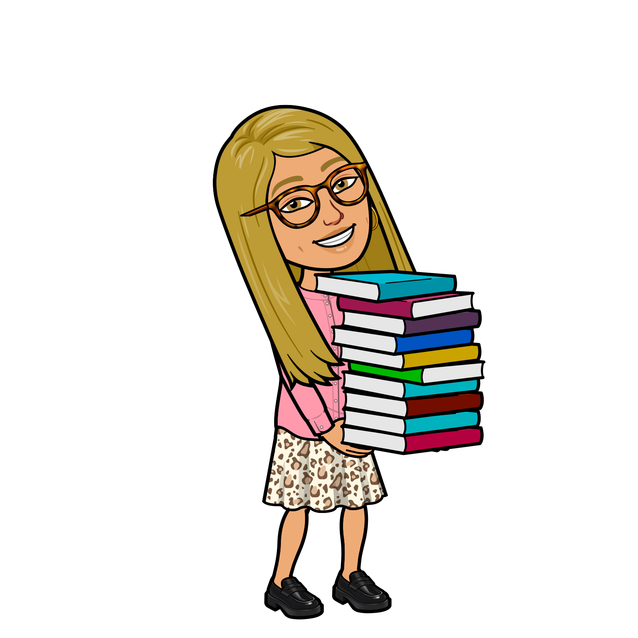
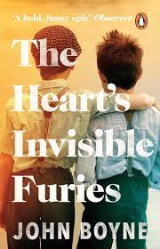
Ms Keaveney
Head of English
University: English BA Hons (University of Nottingham)
MA – Educational Leadership (UCL)
Favourite Book: The Heart’s Invisible Furies, John Boyne
Why?: Set in a small west Cork village of Goleen, in 1945, 16 year old Catherine Coggin discovers she is pregnant. Catherine’s journey to Dublin and the adoption of her son, Cyril, is a heart-wrenching, hilarious and all-consuming story. Cyril, a boy who knows he is gay in a society that hates his sexuality, will take decades to unlearn a history of crippling guilt and shame, while at the same time truly weighing his own weaknesses. The book blazes with anger as it commemorates lives wrecked by social contempt and self‑loathing. I found myself looking forward to reading it when I came home from work – a book I think everyone should read!

Slide 2
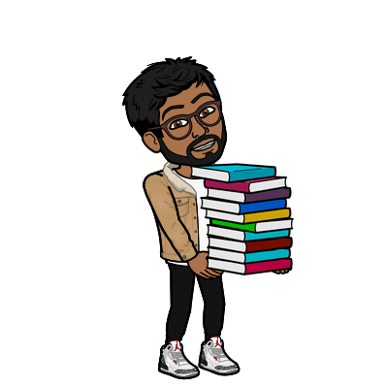
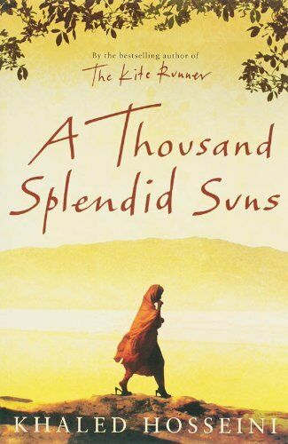
Mr Ahmed English Teacher
University: BA HONS English Language and Linguistics - Queen Mary, University of London.
PGCE English - UCL.
Favourite Book: A Thousand Splendid Suns, Khaled Hosseini
Why?: I think personally the book brings a lot of nostalgia for me as this was one of the first books I read after Sixth form. I loved Hosseini's emotional and intricate ways in which he conveyed real life issues. I found that although giving the perspective of two women through the lens of a male author can be somewhat limited, Hosseini still binds the story of Mariam and Laila with his ability to portray a full range of Human emotion.

Slide 3
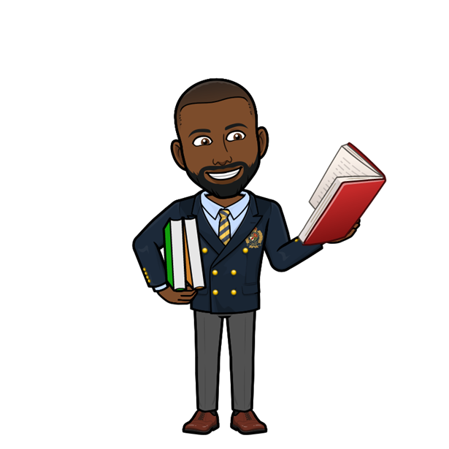
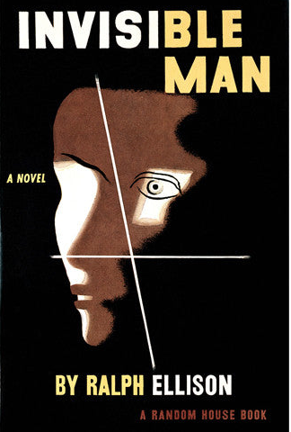
Mr Joseph Assistant Headteacher
University: BA(Hons) English & American Literature, University of Kent
MA, English Education, Institute of Education, University of London
Favourite Book: Invisible Man, Ralph Ellison
Why?: Imagine a world where people refuse to see you, not because you are invisible, but because you lack value in their eyes and eventually your own.
An extract from the book - “I am a man of substance, of flesh and bone, fibre and liquids- and I might even be said to possess a mind. I am invisible because people refuse to see me…When they approach me they see only my surroundings, themselves, or figments of their imagination- indeed, everything and anything except me.”

Slide 4
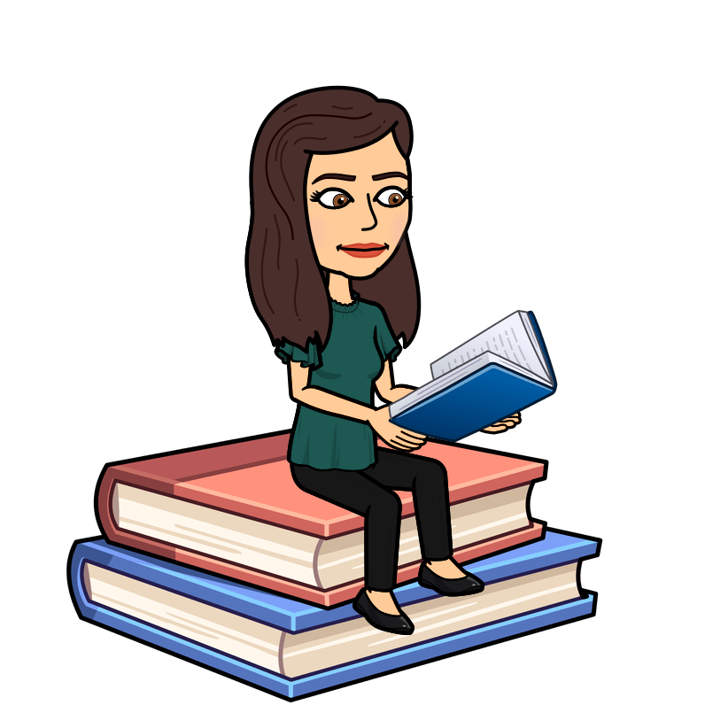
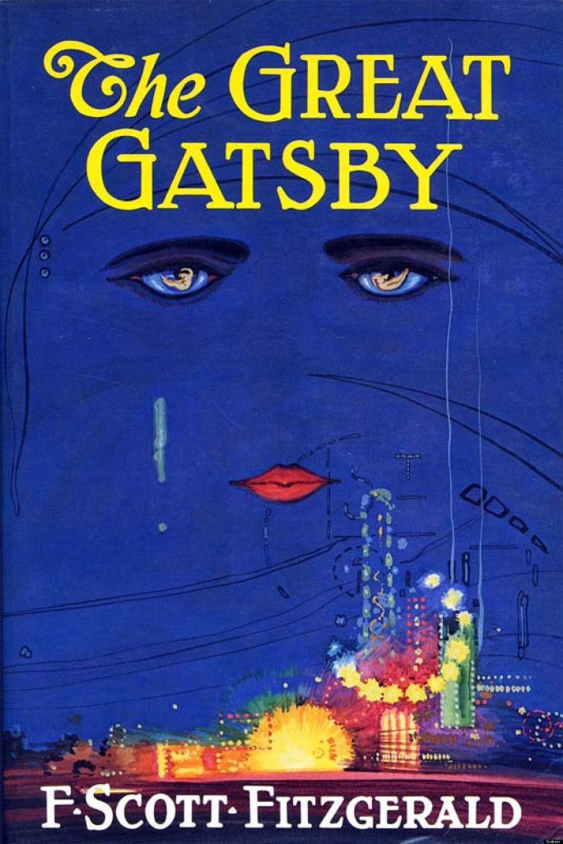
Dr Brown
English Teacher
University: BA, English, Cornell University
PhD, English, University of Connecticut Favourite Book: The Great Gatsby, F. Scott Fitzgerald.
Why?: I love the rich, beautiful descriptions of 1920s New York City and the vivid cast of characters who are all simultaneously terrible and understandable in their own ways. It introduces many of the ideas and questions that define American literature in the century that follows: the American dream, whether or not we can change who we are, how we define what is true or moral. Though I've read and taught the novel enough times to have much of it memorised, I still find something new to interest me every time I reread.

Slide 5
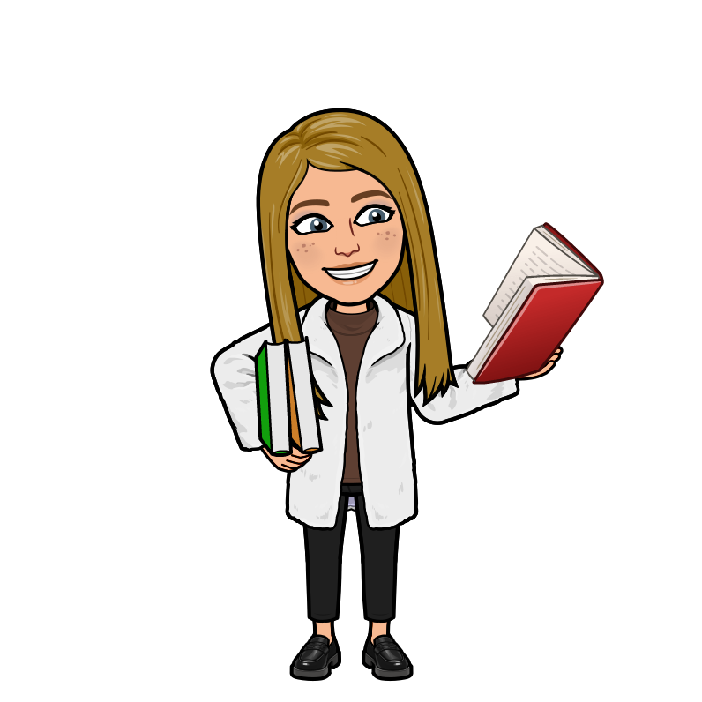
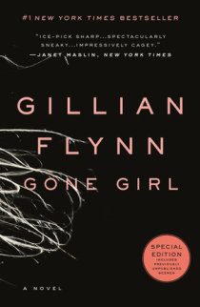
Ms Wakeling
2ic English
University: BA Hons University of Southampton English and Philosophy
PGCE University of Hertfordshire
Favourite book: Gone Girl, Gillian Flynn
Why? I love this book and could not put it down when I first read it. The twists in the plot are so cleverly executed by Gillian Flynn and it's a perfect example of an unreliable narrator.
Extract from the book: When I think of my wife, I always think of her head. The shape of it, to begin with. The very first time I saw her, it was the back of the head I saw, and there was something lovely about it, the angles of it. Like a shiny, hard corn kernel or a riverbed fossil. She had what the Victorians would call a finely shaped head. You could imagine the skull quite easily.

Slide 6
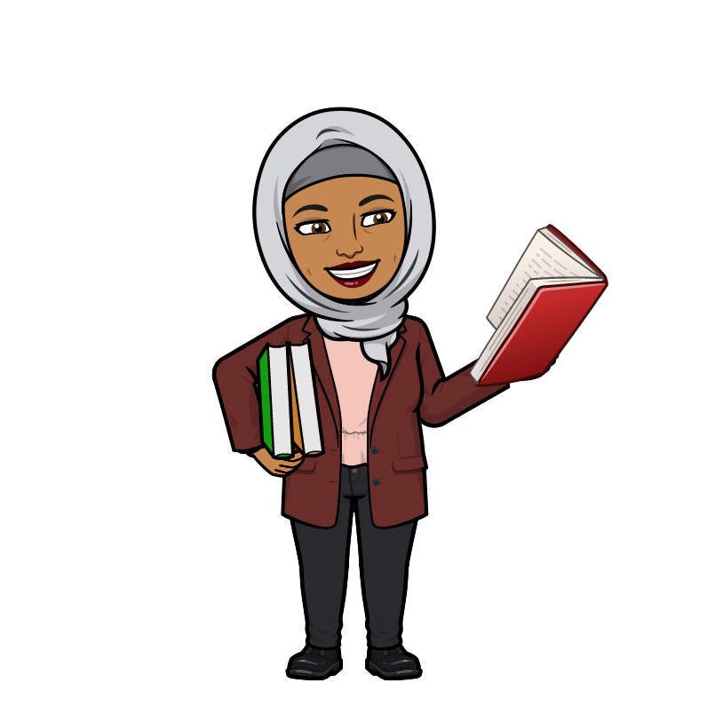
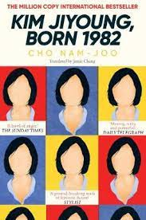
Ms Chowdhury
English Teacher
University: Queen Mary, University of London- Comparative Literature.
University College London- PGCE; Secondary English
Favourite book: Kim Jiyoung, Born 1982.
Why? It's casual narrative juxtaposes the blatant sexism that perpetuates not just Korean society, but every society. I often found myself living vicariously through the female characters and reflecting on my own experiences.

Slide 7
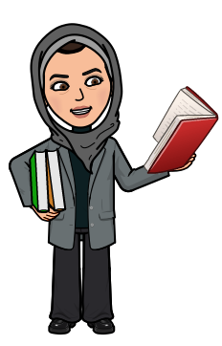
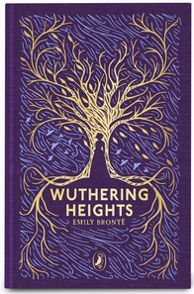
Ms Adam English Teacher
University: BA(Hons), English and History, Queen Mary University of London
PGCE, Pedagogy and Practice , University of Sussex
Favourite book: Wuthering Heights, Emily Bronte
Why?: Tragic. Dark. Gothic. Tears. Ghosts. Not words you would usually associate with a book on a list of the greatest love stories of all time. If you're looking to find an unconventional romance which delves into the pains of undying and forbidden love, then this is the book for you.

Slide 8
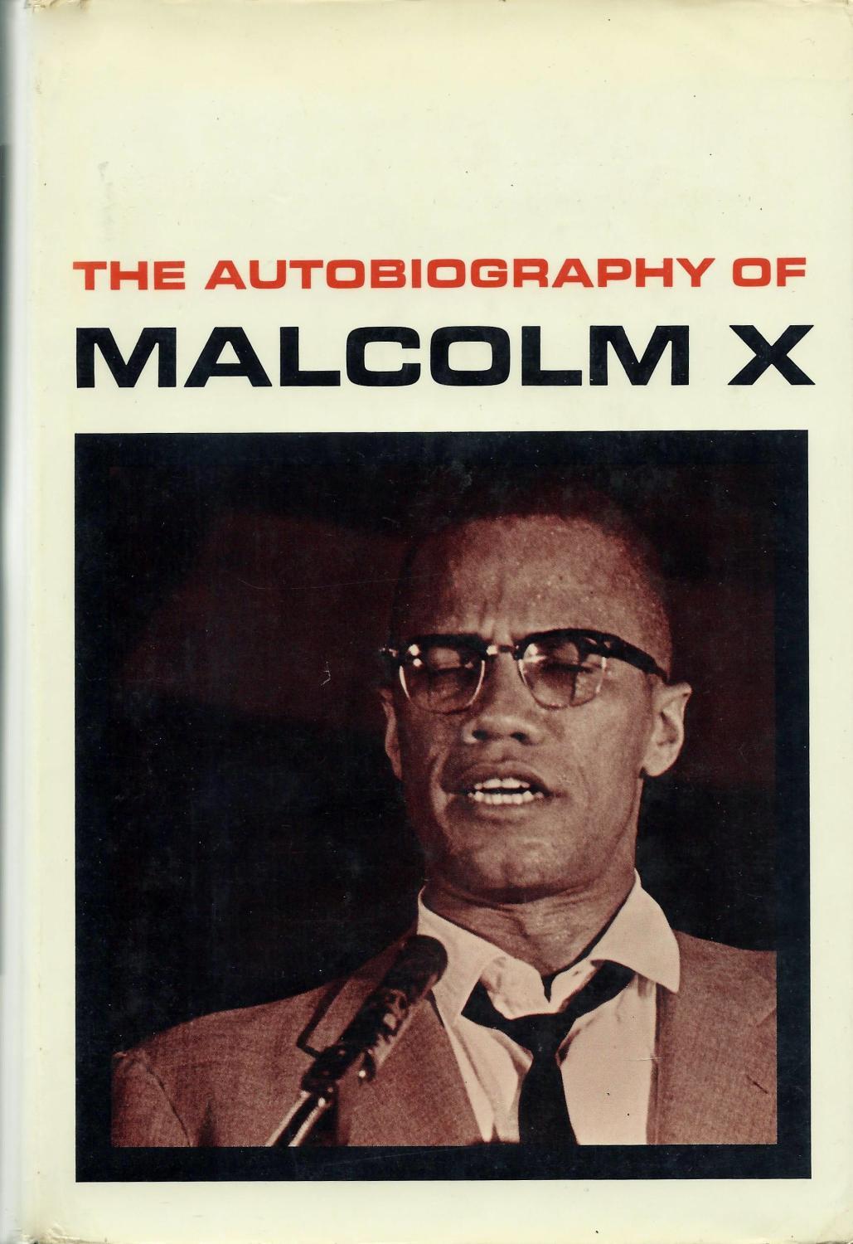
Mr Amin English Teacher
University: BA Hons English, PGCE English and Drama UCL/IOE
Favourite book: The Biography of Malcolm X
Why?: A remarkable autobiography recording one of the prominent figures during the civil rights movement in America. This unique account tells of a man who, despite humble beginnings and flaws, inspired many across the globe in his fight for justice and equality.

Slide 9
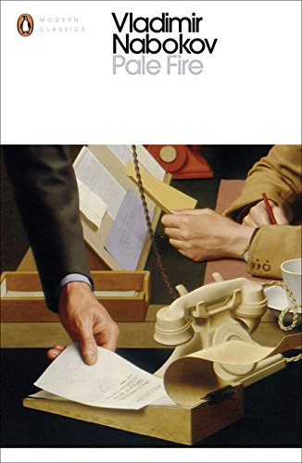
Mr McKenzie
Deputy Headteacher
University: BA(Hons) English, University of Strathclyde
MA, English and American Literature, University of Texas
PGCE; NPQH, Institute of Education, University of London
Favourite Book: Pale Fire, Vladimir Nabakov
Why? A book that offers you everything. It’s laugh out loud funny and a journey into the mind of someone who could be mad, a genius and definitely a fantasist. A book you can read over and again and it appears to be something new each time. A great extended joke on the reader and a mysterious whodunnit all at the same time.

Slide 10
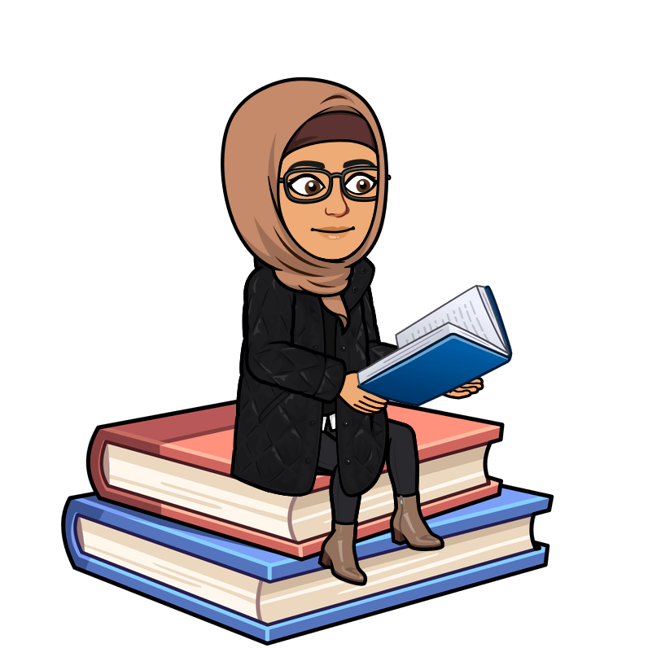
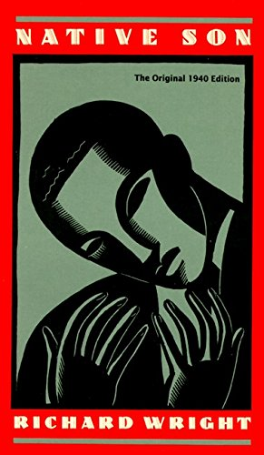
Ms Rahman
2ic Engish
University: English Ba Hons, UCL
Favourite book: Native Son , Richard Wright
Why?: It tells the story of 20-year-old Bigger Thomas, a black youth living in utter poverty in a poor area on Chicago's South Side in the 1930s. After he is accused of a terrible crime, questions about how much society makes an individual and vice versa comes into play. Why do I love this novel so much? Ideas about the duality of identity and the struggles of understanding who you are against stereotypes perpetuated by society resonated deeply with me when I read this. A must read for those who are looking for a dark and gritty read!

