Slide 1
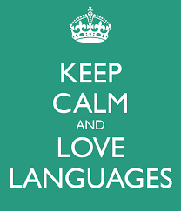

Slide 2



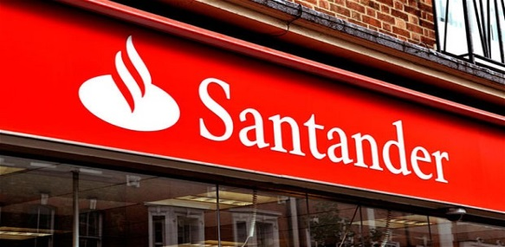






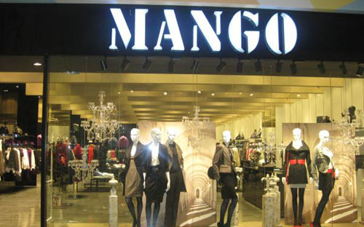




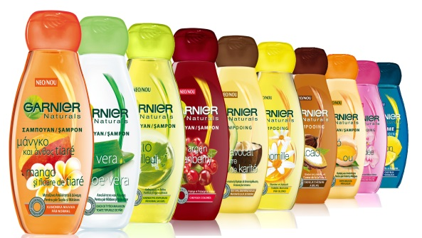


There are a lot of famous
French and Spanish brands with offices all over the world

Slide 3

What do you
really know about languages?

Slide 4

1. English is the most widely spoken language in the world.
True or False?
False
There are around 7000 different languages spoken in the world.
1st – Mandarin (Chinese)
2nd – Hindi
3rd – English
4th – Spanish
5th –Arabic
6th – French
7th – Russian
8th – Bengali
9th – Japanese
10th - Portuguese

Slide 5
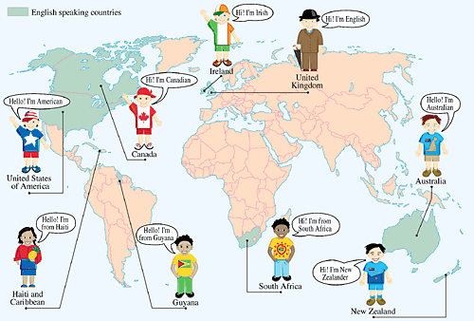
Around 75% of the world don’t speak English.
Studying a language improves your understanding of your own language as well as giving you the opportunity to explore the world and other cultures.

Slide 6

2. Being able to speak a second language is the most valued skill for employers after computer skills.
True or False
True
Employers think that people with language skills stand out in job
interviews because not many people in England have a GCSE
in a language.
Even for jobs that you might not think need languages. It shows
you have a certain type of intelligence to be able deal with what
is considered a difficult subject.

Slide 7

3. You have to speak a 2nd language perfectly for employers to think you are good enough.
True or False
False
You don’t have to be fluent. Most employers are happy to give a
job to someone with conversational skills – i.e. someone
with just a GCSE in a language.
Go on to study a 2nd language for A-Level and at university –
even better!!!

Slide 8

4. Taking a GCSE in a language will only lead to a job as a translator or a boring old teacher.
True or False
False
Having a GCSE in a language is highly valued in a wide range of
jobs and opens lots of doors in many different industries.
Such as with sports, fashion, music , technology etc.
Translating can earn you A LOT of money and teaching isn’t so
bad really.

Slide 9
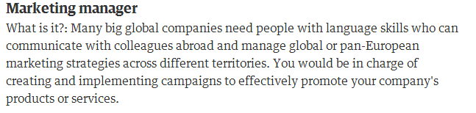
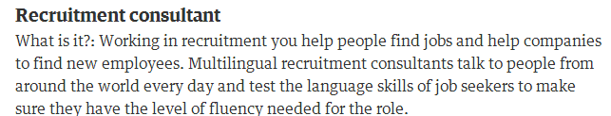
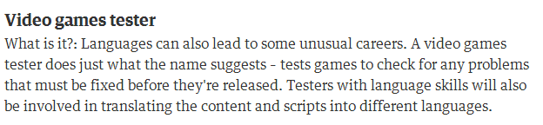
Career prospects
Translator
Banking
Trading
Working for the United Nation
Teaching
Reporter
Newspaper editor

Slide 10
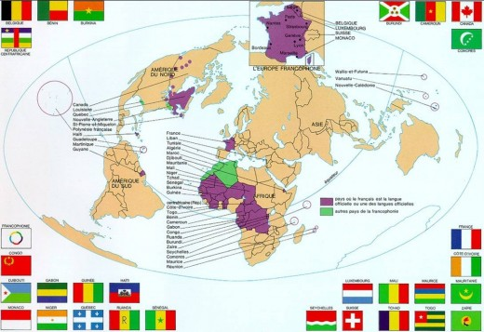

French is the official language in 16 countries and has 378 million speakers.

Slide 11
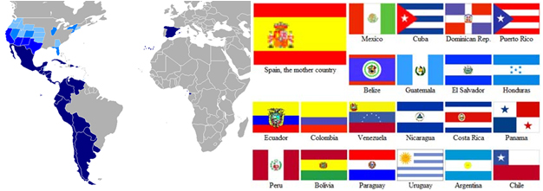

Spanish is the official language in 21 countries and has 400 million speakers!

Slide 12
What will you be studying in French?
TERM I Ca c’est moi-
Some of you may have study a bit of french and Spansih in year 6, this first term will be for us to catch up and look at basic vocabulary and verbs.
We will be talking about ourselves, saying our name, age, birthday talking about brothers and sisters and our personalities
TERM II Voici ma famille
The spring term will be looking at our family, pates and describing ourselves physically as well as building up a better understanding of grammar and sentence structures
TERM III Ce que j’aime-
The summer tem will be all about expressing our opinions about what we like and dislike, the food we prefer eating and the subjects we prefer studying
Notes:
12

Slide 13
What will you be studying in Spanish?
TERM I YO-me
Some of you may have study a bit of French and Spanish in year 6, this first term will be for us to catch up and look at basic vocabulary and verbs.
We will be talking about ourselves, saying our name, age, birthday talking about brothers and sisters and our personalities
TERM II Mi familia- my family
The spring term will be looking at our family, pates and describing ourselves physically as well as building up a better understanding of grammar and sentence structures
TERM III Mi Insti- my school
The summer tem will be all about school and talking about subjects and teachers
Notes:
13

Slide 14
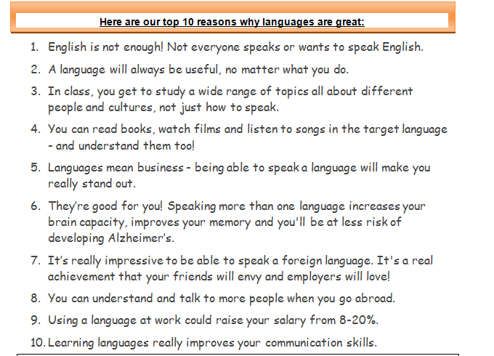
Top 10 reason to study languages

Slide 15
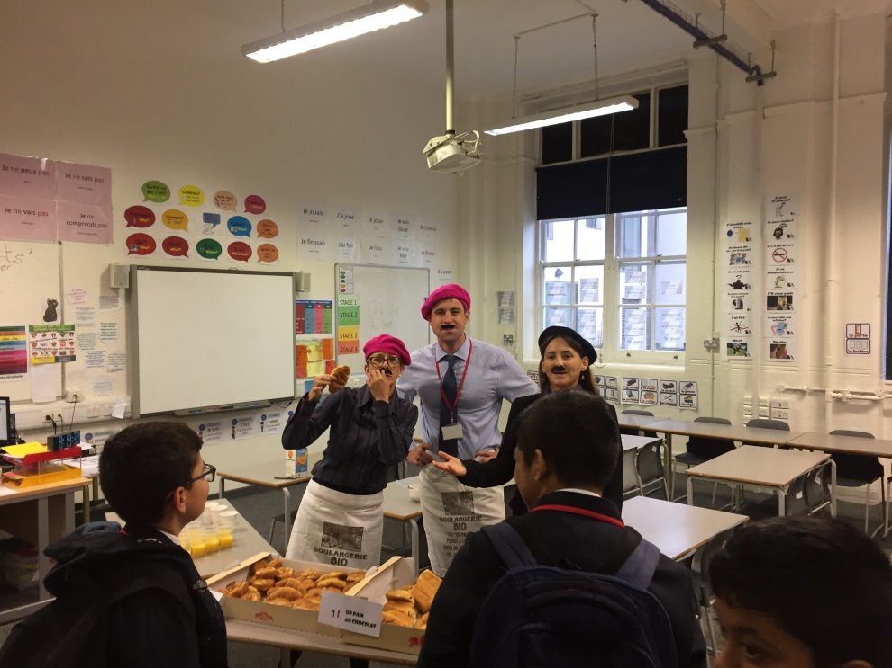
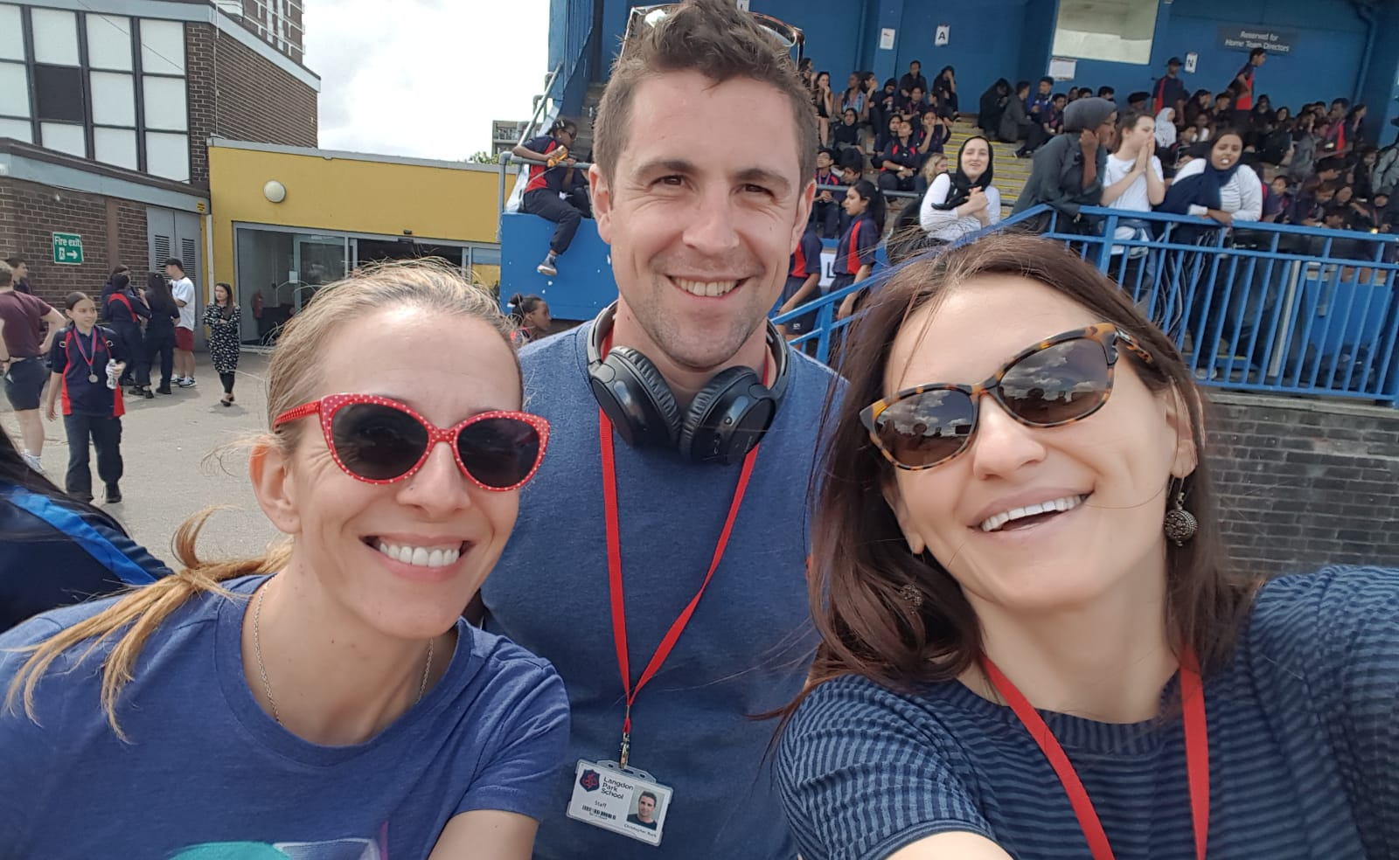
The MFL team
International week September 2019-
Giving free breakfast!
Sports day June 2019-

Slide 16
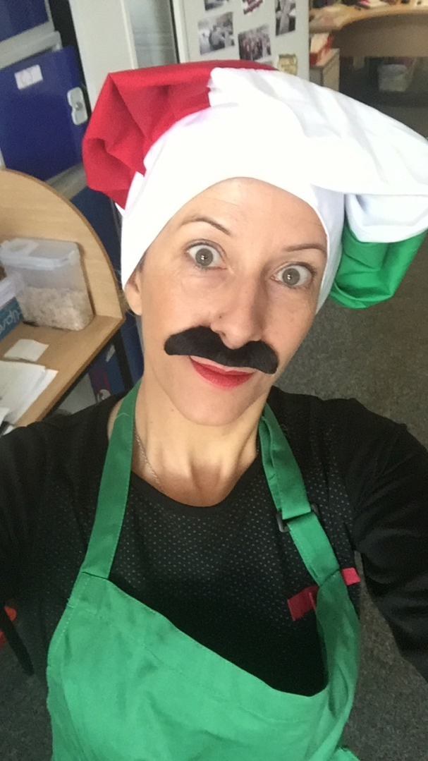
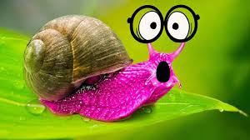
Miss Bailly
I am able to grow a moustache only for International week
My favourite food is snails - they are delicious!
I speak Franglish very well- do you know cette langue?

Slide 17
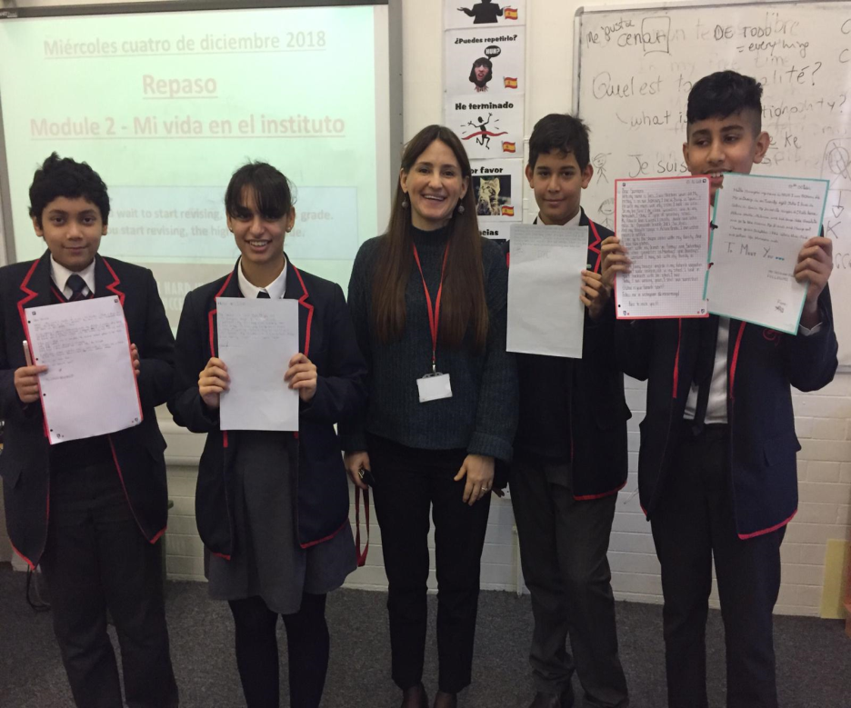
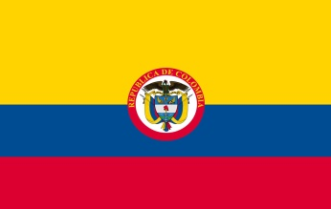
Miss Ranalli
I love to eat gelato and pizza. Can you guess where I am from?
I have been teaching Spanish at LPS for over a decade!
My favourite singers are from Colombia. Do you know any Spanish songs?

Slide 18
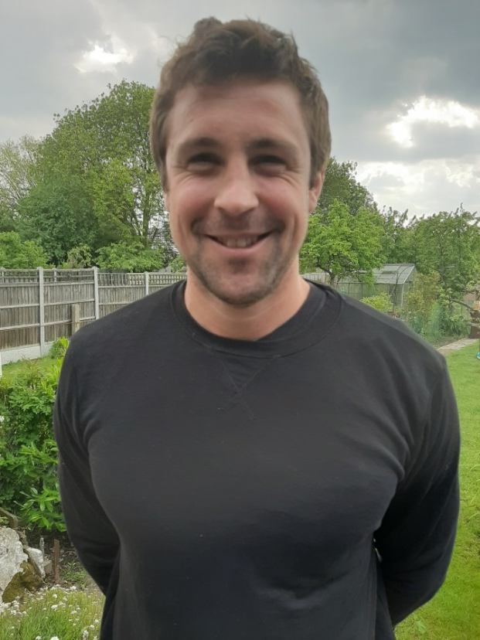
Monsieur Buck
As well as languages, I love cycling.
Can you guess how many bikes I own?
The last time I lived outside England, I ate lots of sushi.
Can you guess which capital city I lived in?
I like to cook, but I’m not very good.
My favourite thing to cook is Italian and includes pasta,
beef mince and tomatoes. Can you guess it?
Notes:
Answers: 6, Tokyo, spaghetti bolognaise

Slide 19
Quiz time
Who is Italian?
Who loves cycling?
Who lived in Japan?
Who has been in langdon park for over 10 years?
Who seems the craziest?

Slide 20

We are looking forward to meeting you all!
MFL team

