Slide 1
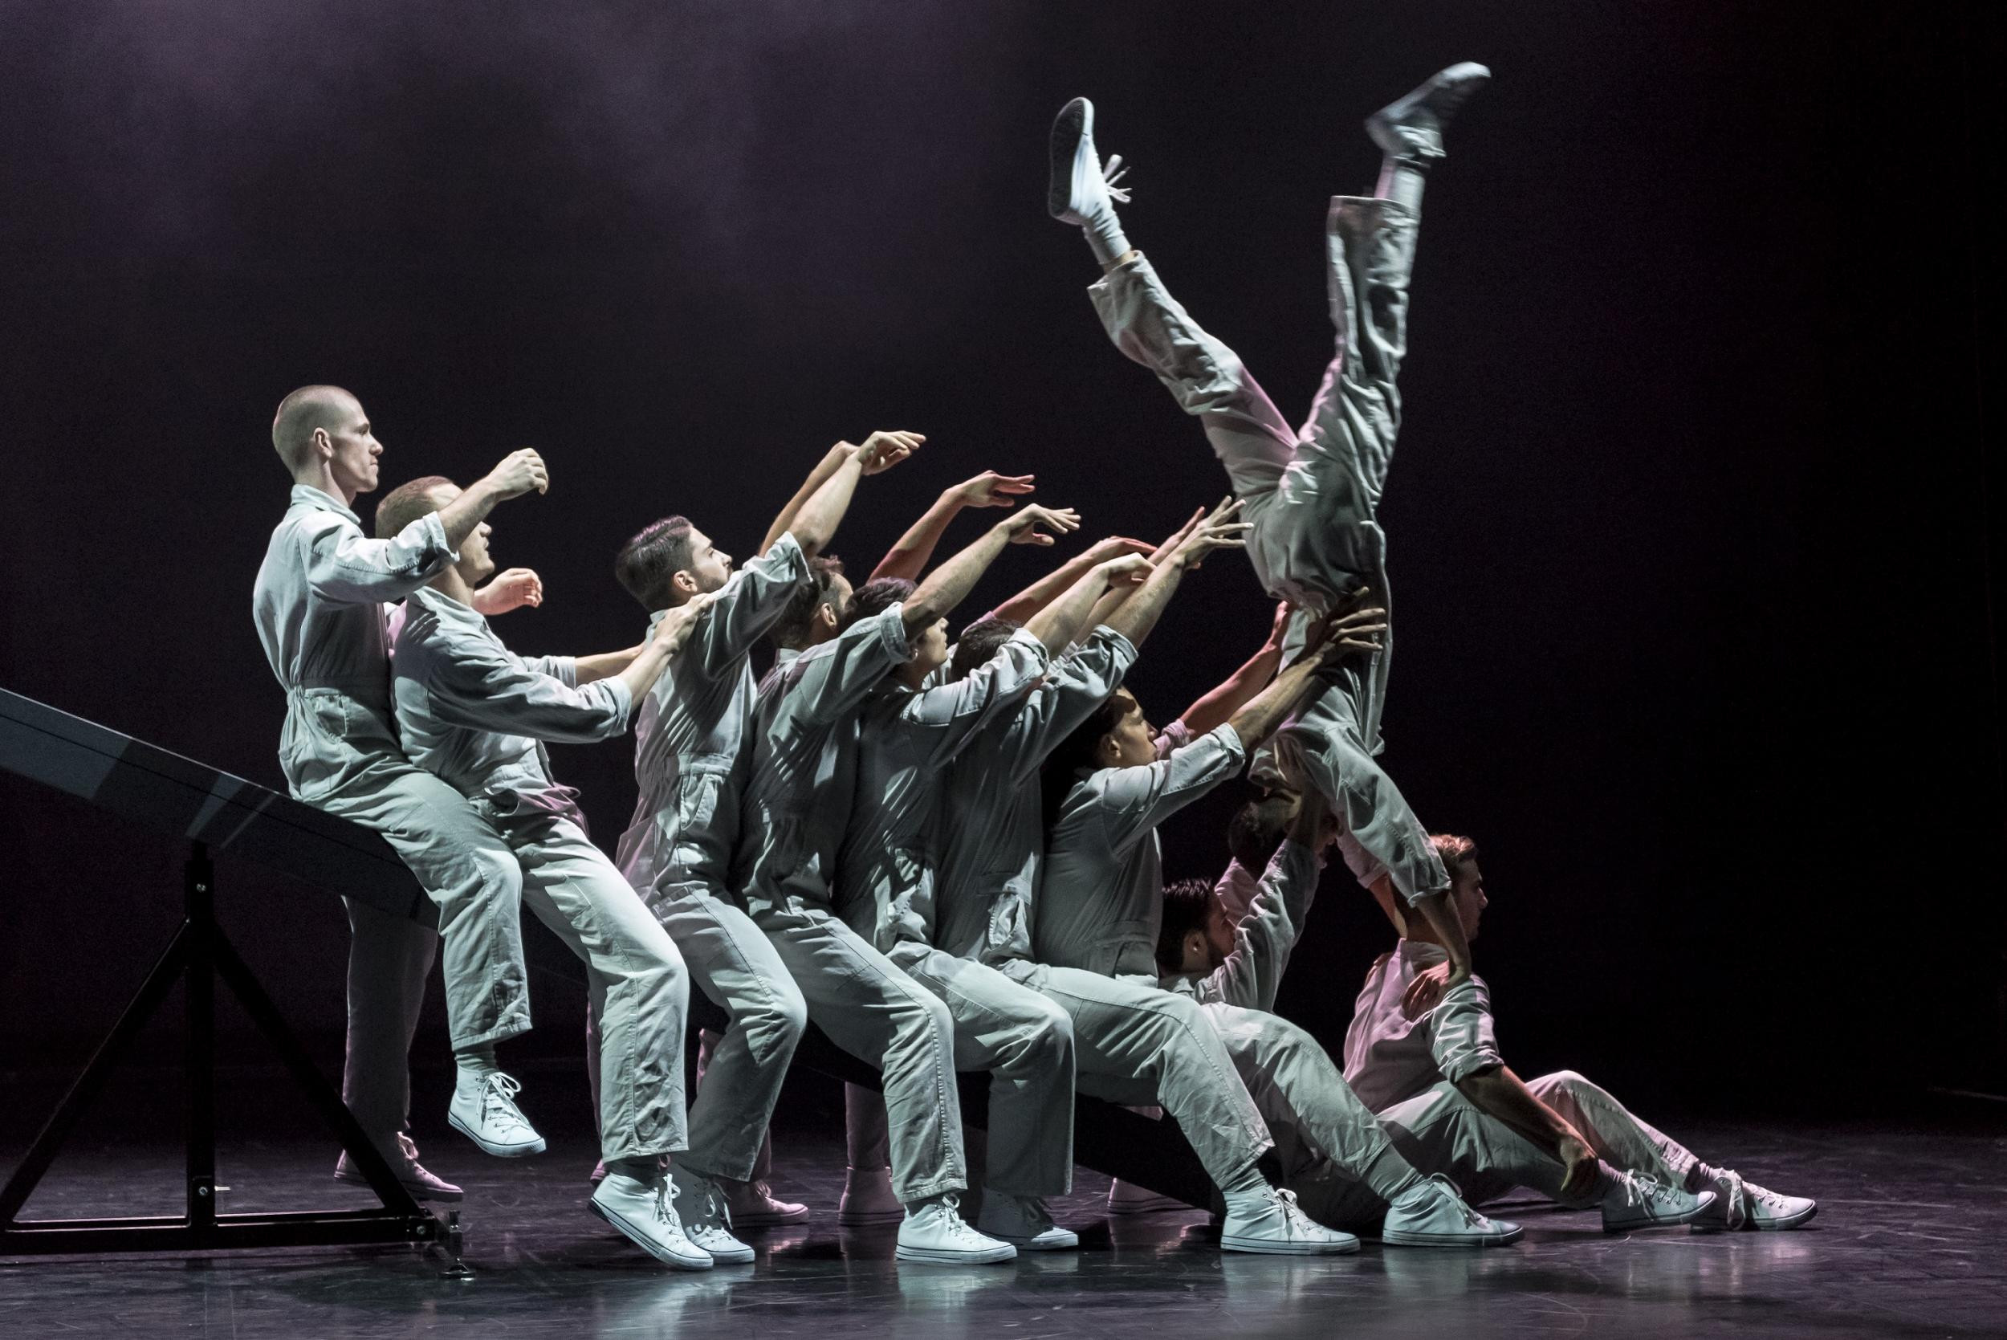

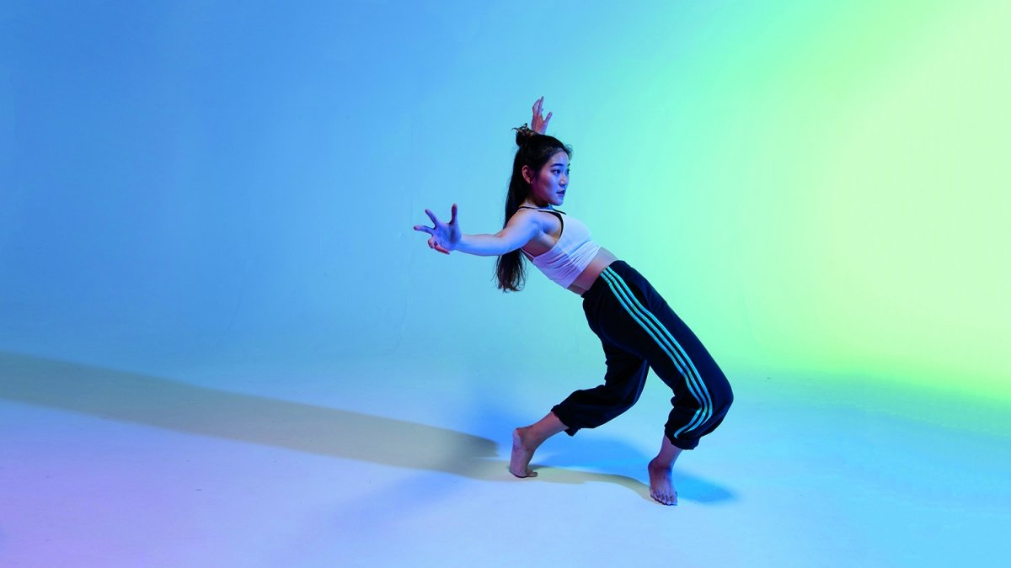
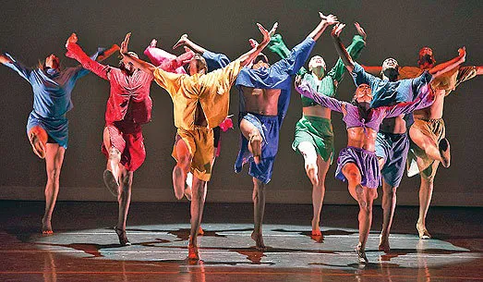
Year 7 dance
Langdon Park school

Slide 2
Introduction to Dance
Dance is a performing art form that is the rhythmic and expressive movement of the body accompanied by music or sounds. It has been said to be the mother of the arts, for it’s the oldest of the art which reflects human need to communicate different emotions such as joy, grief, excitement and many more!
Dance has evolved from healing rituals to Greek Dance, from dance in Indian culture to Contemporary dance and to social dance. All forms can be traced back to historical, traditional, ceremonial and ethnic dance.
You will learn to choreograph, perform and appreciate dances from different styles.

Slide 3


Reasons why people dance
We were born to dance – before we can walk we bounce to music!
It has been used to worship
It is an expression of the joy and emotions one feels
It breaks the monotony of daily activities
It serves to entertain others
It gives beauty and inspiration to others
It provides personal and effectiveness of communication
It asserts individuality
It can be used to celebrate, mourn, heal, give thanks, preserve cultural heritage
It develops memory and imagination when you choreograph and learn dances
It develops physical fitness, uplifts your mood and restores happiness
Can you think of any more reasons?

Slide 4
Why studying dance is important
Strong link between educational achievement and dance – dancers have strong discipline and commitment. Those who study dance are more self motivated and focused
Increase confidence
Develop transferrable skills – communication, resilience and leadership
Dance engages the artistic processes of creating, performing and critical analysis.
Requires lots of skills such as the ability to read symbols, implement critical thinking, nonverbal reasoning and expression, create and exchange ideas, work in collaboration with others, and understand different culture and societies.
Through dance, children can gain lots of important developments; sensory and spatial awareness, coordination, concentration and mobility.
At a time when children spend their time more and more in front of a computer or television, the escape Dance offers has never been more important.
It brings people together and working towards a joint goal
It gives a boost to a creative mind and helps to be more humble and compassionate to others.
It teaches us how to perform
People who dance tend to have higher self-esteem and are more positive
Above all, we come out of out comfort zone

Slide 5
What will you learn in year 7
Technical and Performing Skills in Dance Safe practice – warming up and cooling down Importance of engaging an audience Choreography - Actions, space, relationships and dynamics Expressive skills – focus, facial expressions, projection, musicality | Street Dance History of hip hop and street dance Features of street dance (actions, music, costumes, setting) Learn a motif and choreograph your own | Contemporary Dance Contemporary dance history Features of contemporary dance (actions, music, costumes, setting) Merce Cunningham and chance methods Learn a motif and choreograph your own

Slide 6
Fun facts about dance
A world record for the longest conga dance line was set by 119,986 people in Miami in 1988.
The dance world is full of superstitions. By saying "break a leg" before a show, people are saying the exact opposite of what they hope will happen on stage.
African slaves that were brought in Brazil 300-400 years ago were prohibited from practicing martial arts. Therefore, they developed the mix of dancing and fighting that is known today as capoeira.
Breakdancing was first created as a "less lethal" form of fighting between warring African-American street gangs in 1970s Bronx area of New York City. This form of dancing re-emerged into worldwide popularity during 1990s.
Some pop singers create their own dances to fit their songs. For example, Michael Jackson created the "moonwalk" for his hit "Thriller" in 1982
One of the earliest uses of structured dance was introduced in religious ceremonies that told the stories of ancient myths and gods. Egyptian priests used this kind of visual storytelling in their rituals.
Dancers have better than average peripheral vision
Around 30 thousand people are employed in UK dance industry today, maintaining around 200 dance companies.
Because of high physical demand on their bodies, most professional dances retire from dancing during their mid-30s.
Origin of tap-dancing comes from the tribal dances of African slaves. Their arrival in North America introduced that dance to the western audiences
Even people in wheelchairs can dance! Such dancing is very popular in Europe where there are even competitions in Latin dances with special wheelchair choreographies.

Slide 7
Dance Activities
Research the history of Dance and create a poster or timeline.
Research 5 facts about a particular style of dance (hip hop, contemporary, tap, jazz, ballet, Indian, Bollywood, African…)
Learn 3 new dance moves on YouTube from any dance style and teach them to somebody at home with you
Balance a light book on your head. How long can you dance for without the book falling off?
Create your own Tik Tok Dance
Watch a dance video on YouTube from The Greatest Dancer or Britain's Got Talent. Write a summary of what you watched and your opinion of the dance.

Slide 8

Dance Teacher at Langdon Park School
Miss Zicchi – Leader of Dance
Fun facts about Miss Zicchi
She danced on stage at the London Palladium
She loves to clean.
She has been dancing since a young age, but wanted to be a journalist, Spanish translator, and a marine biologist before wanting to be a dance teacher!
Miss Savage – Dance technician
Diane’s favourite style of dance is Traditional African Dance

Slide 9
Fun Quiz based on facts about
Miss Zicchi and Dance!
What is the London Palladium and where is it?
Dust is mainly made up of dead skin cells. True or false?
What does a marine biologist do?
What is the superstitious dance saying somebody might say before a show?
Where did tap dancing originate?
What type of vision do dancers have better than average of?
What is capoeira and why was it invented?
How many people formed the longest conga dance line?
People in wheelchairs can dance. True or false?
Where and when was break dancing first created?
What was one of the earliest uses of structured dance?
How many people are employed in the Dance industry today?

