Slide 1
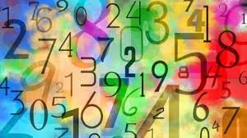
Transition from Primary to Secondary School
Maths at Langdon Park School

Slide 2
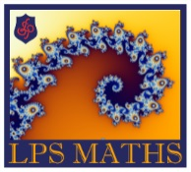
Introduction to Mathematics
Mathematics is fundamental to being human and we can appreciate the subject within our world, especially now in the same way as languages, literature, art or music.
The beauty of mathematics is that everybody can appreciate mathematics and think mathematically, given support and opportunity. This is what your teachers in secondary school will aim to do!

Slide 3


How is Maths different in secondary school?
In primary school, you develop your foundations for Maths and when you arrive at secondary school, your new teachers will help you to develop your wider skills to reason, communicate, think systematically, problem solve and work with others!
One of the best part of learning mathematics, is the journey you take towards your answer. In year 7, you will be asked to work in teams, explore some new mathematical ideas, justify your conjectures and prove them right!

Slide 4
What will you be learning about in Year 7?
In year 7 we explore some brand new ideas in some exciting units of work:
We explore new mathematical vocabulary, symbols and mathematical laws
We explore the history of our number system and explore special types of numbers
We channel our inner witches and wizards as we step into Hogwarts and explore the magic of proportion with a little help from Harry Potter and friends
We look at how data is used to collect important information and how it can be represented.
We use software to investigate the properties and patterns created with 2D shapes.
We generalise arithmetic and start looking into the world of the unknown!

Slide 5
Here are some reasons why we think Maths is the best…
It’s like solving a puzzle. You just need the right rule to get the answer.
The exploration…starting with 1+1, exploring with maths builds up and up to fractions, geometry, and beyond!
It is same/universal language at all over the world!
Maths lets us make better decisions!
Just as all substances are made up from the building blocks of the basic chemical elements, all whole numbers are built in a similar way from the basic elements of prime numbers. Primes are the elements of number!

Slide 6

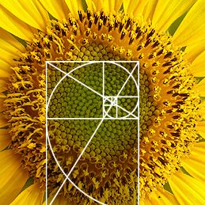
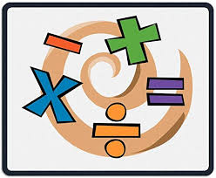
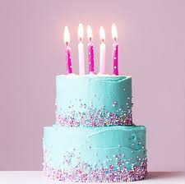
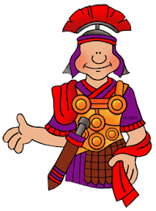
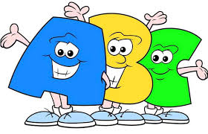
Some fun facts about maths that you may not know…!
If you write the famous number Pi to 2 decimal places, it spells Pie backwards!
The spiral shapes of sunflowers follow a Fibonacci sequence.
111,111,111 × 111,111,111 = 12,345,678,987,654,321.
In a room of just 23 people there’s a 50% chance that two people have the same birthday.
Zero is the only number that can't be represented in Roman numerals.
From 0 to 1000, the only number that has the letter “a” in it is “one thousand”.

Slide 7
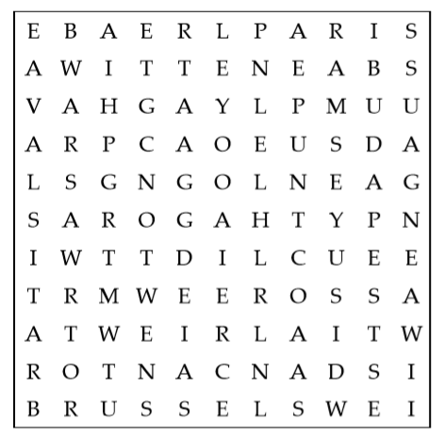
Mathematical Activities 1
How many of the following famous mathematicians can you find in the wordsearch?
Cantor
Euclid
Euler
Galois
Gauss
Godel
Newton
Pythagoras
Ramsey
Witten
Once you have found them all, choose one mathematician to research and find out what mathematical discovery made them famous and how it is used in the modern world today!

Slide 8
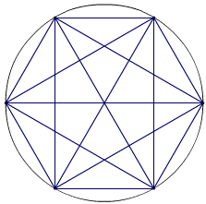
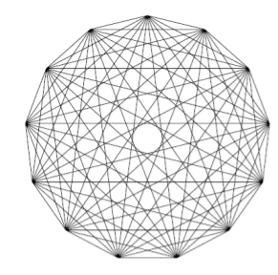
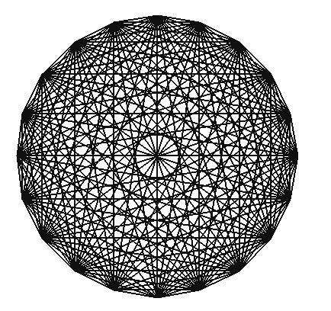
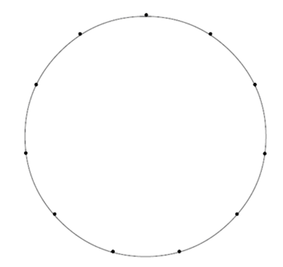
Mathematical Activities 2
A Mystic Rose is a beautiful image created by joining together points that are equally spaced around a circle.
Using the template or creating your own, can you make some beautiful patterns for yourself?
What happens to the number of lines when you have 3 dots? Or 4? Or 5?
Can you spot any patterns?
Make some conjectures (mathematical predictions)!

Slide 9
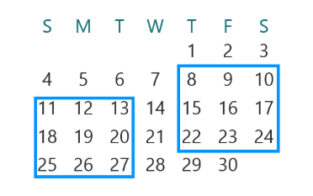
Mathematical Activities 3
Choose any three by three square of dates on a calendar page.
Add the numbers in the four corners. Try a few examples. What do you notice?
Can you explain why this happens?
Now try adding the numbers in each row, column and diagonal that passes through the centre number.
What do you notice?
Can you explain your results this time?

Slide 10
Mathematical Activities 4
Flora had a challenge for her friends.
She asked, "Can you make square numbers by adding two prime numbers together?“
What are square numbers? What are prime numbers?
Have a go yourself! Try with the squares of the numbers from 4 to 20.
Ollie had a think.
"Well, let me see... I know that 4 = 2 + 2. That's a good start!“

Slide 11
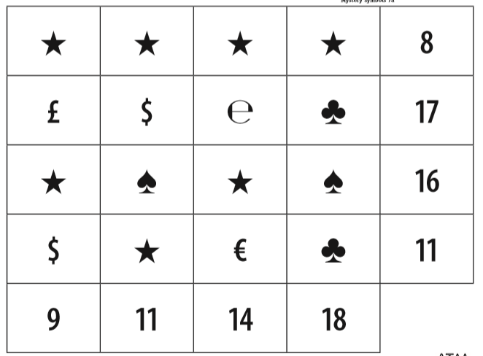
Mathematical Activities 5
Each symbol represents a different digit (from 1-9).
Can you work out which digit is represented by each symbol?

Slide 12
Fun Facts about your Maths teachers!
Mr. McGarr:
1) I climbed Mount Olympus in Greece
2) I wrote a book on the musical composer Mozart.
3) I have a large allotment and grow most of my own fruit and vegetable.
Ms. Begum:
1. I am a keen baker
2. I am double jointed (arm)
3. Multilingual
Ms. Duymaz:
1. If I could have any superpower, I would like to fly.
2. If I could keep any animal as a pet, I would choose 'Koala’.
3. My favourite season is spring because I love flowers and green parks.

Slide 13
Fun Facts about your Maths teachers!
Mr. MacDivitt:
1. I used to be a chef.
2. I lived in New Zealand for 7 years.
3. My favourite places are in the ocean or the top of a mountain.
Ms. Brower:
1. I have eaten McDonald's in 4 different countries. ​
2. I played on a college golf team.
3. I know all of the words to every Disney song.
Mr. Watson:
1. I've lived in all but one of the countries in the UK
2. Almost all of my immediate family speak German
3. I do amateur photography.

Slide 14
Fun Facts about your Maths teachers!
Mr. Perry:
1. I have a massive collection of trainers but nowadays I wished I didn’t (they take up too much space.)
2. I’ve have taught more than one subject at LPS.
3. I’ve been fortunate enough to have travelled to 32 different countries
Ms. Soni:
1. I am one of the biggest Harry Potter fans ever.
2. I am very competitive so be careful about asking to play a game with me!
3. I only ever use even numbers when I change the volume on the tv!
Mr. Patel:
1. I love doing origami in my spare time.
2. I love Indian food especially pakoras.
3. I enjoy reading spy novels.
Ms. Mamica:
a) I love traveling and exploring new places around the world.
b) I watch Friends(tv show) over and over again and I still laugh more each time.
C) I’m obsessed with flowers and nature

Slide 15
Quiz Time: How well do you know the teachers?
Which teacher loves watching the TV Show Friends?
Which teacher has more trainers than clothes?
Which teacher would bake you a cake?
Which teacher would you find on top of a mountain?
Which teacher has visited the supposed home of the Greek Gods?
Which teacher would adopt a Koala bear?
Which teacher would sing “Let it go” with you?
Which teacher wishes they were at Hogwarts?
Which teacher(s) can speak multiple languages?
Which teacher might win in a game of mini golf?
Which teacher likes to take photos?
Which teacher can make you a paper crane?

Slide 16
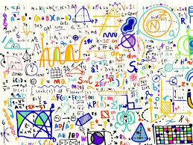
The Maths Faculty are looking forward to meeting you all and helping you in your new journey at Langdon Park School and learn some exciting and new mathematics!

