Slide 1
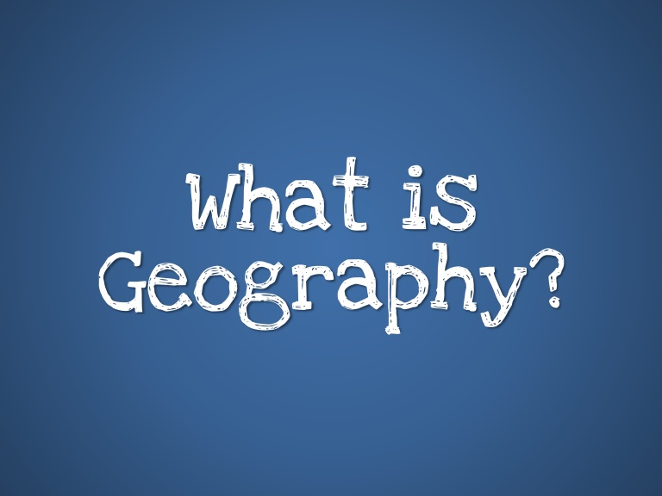
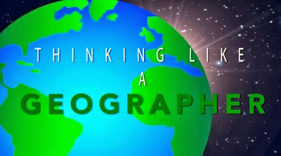
Introduction to Geography
What is geography?
Geography informs us about our planet and the world we live in. We will learn about different places, the continents and countries as well as the oceans, rivers, deserts on our planet. We will look at natural environments and environments that humans have created. We will study the planet’s great ecosystems and think about how they work, the people that live in these places and how humans are affecting these important environments in different parts of the world.
So in geography we will also learn about the effects that pollution, natural disasters, wars and conflict have on the people around the world and we will learn how to protect our environment so we can help to preserve the earth for future generations. Geography is an exciting subject that is constantly changing and is all around us all of the time so we can see it everyday. A good geographer is curious about the world we live in and will need to be able to make links between people and places. This is ‘thinking like a geographer’.
Click on the images below (or copy the link into your internet browser) to learn more about how and why we study Geography
https://www.youtube.com/watch?v=sgGb8BM2TBk
https://www.youtube.com/watch?v=YIPcOSNwVjw

Slide 2
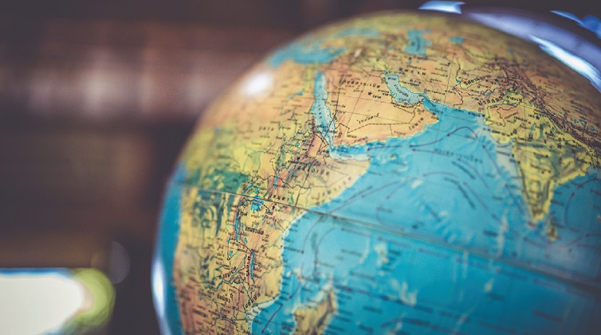
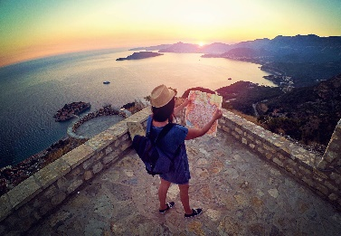
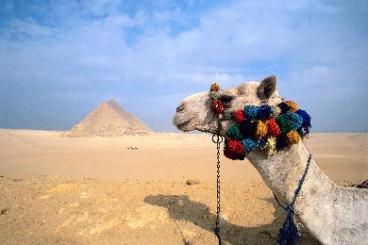
Year 7 Geography
What do we do when we study geography? We explore and learn about two main issues: places and people. There are two branches of geography, called ‘physical geography’ and ‘human geography’.
Physical geography examines the nature and environment and with it, natural hazards and their effects for example what happens when a volcano erupts or where and why does flooding occur.
Human geography studies the effects of our activities on the planet and what living in our environments on the lives and activities of the people means, such as why people move from villages into towns or even migrate from country to country or what it happens when we exploit the earth’s resources or why we experience the effects of global warming.
Geography at Home
There are many activities that you can do to develop your
knowledge and skills as a geographer.
These include:
World map and continents quiz
Geography word search
Geography of the UK
Making your own compass and reading maps
Treasure hunt map

Slide 3
Meet the teachers
Ms. Firmin
I am the Head of Geography at Langdon Park School
I'm originally from Burnley, Lancashire
I read at least 150 books a year
I love Science Fiction and Fantasy books
I've been teaching at LPS since 1991 ​
Fun fact about me: I have been a Liverpool FC fan since 1973!
Ms. O’Brien
I am the Deputy Headteacher LPS and I also teach Geography
I am from Cork in Southern Ireland
My favourite subject in school was Geography and my Geography teacher inspired me to become a teacher
My parents taught me how to love and appreciate the world and it’s why I have travelled to nearly every continent. Can you guess which one I haven’t visited?
Fun fact about me: I have jumped out of a plane and have climbed the highest mountain in Africa!
Mr. Brierley
I teach Geography from year 7 all the way to A-level
I have lived in Scotland, Norway and Cambodia
I am originally from… London!
I studied Geology at Aberdeen University
Fun fact about me: I love walking in the mountains and have climbed some of the highest volcanoes in the world!
Mr. Pearce
I am currently Head of Year 11 and a geography teacher
I enjoy travel, especially to Africa, and love spending time in the desert and mountains the most
I like going to countries that very few people go to, to experience lives very different to mine
Fun fact about me: I really enjoy running and walking to keep fit, to be outside and explore different places!

