Slide 1


Safeguarding education: raising standards and expectations
Every Child
Every Lesson
PROFESSIONALISM
INCLUSION
PEDAGOGY
CURRICULUM

Slide 2


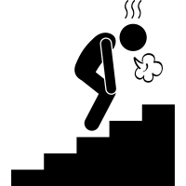

Curriculum: planning for progress
Summer 2021 enquiry question:
How can we ensure alignment and sequencing for progression within our unit enquiry questions, schemes of learning and individual lessons?
‘Pupils find it hard to link new ideas with what they already know and understand’
‘These weaknesses mean that pupils are not prepared effectively to study more demanding concepts in the future’
‘Many teachers do not routinely check that pupils understand what they have learned’
PROFESSIONALISM
INCLUSION
PEDAGOGY
CURRICULUM

Slide 3

Why Now?
Previously we have…
We are now…
In the future, we will…
Worked to improve students’ ability to articulate and recall the curriculum
Improving the frequency and quality of student responses to feedback on misconceptions
Embed lesson expectations through worked examples from across the school

Slide 4

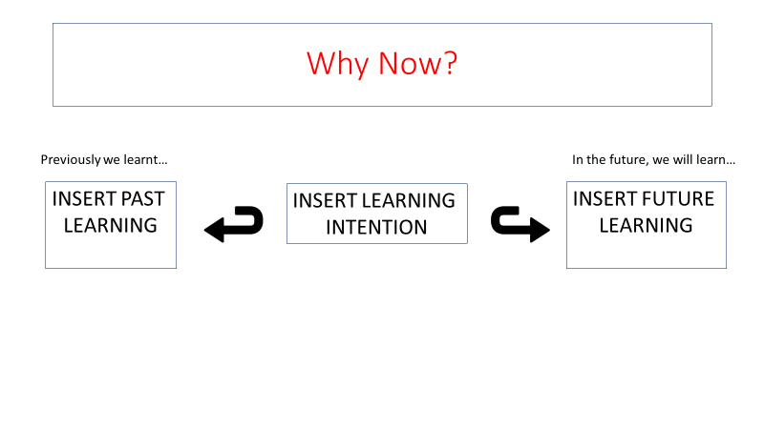
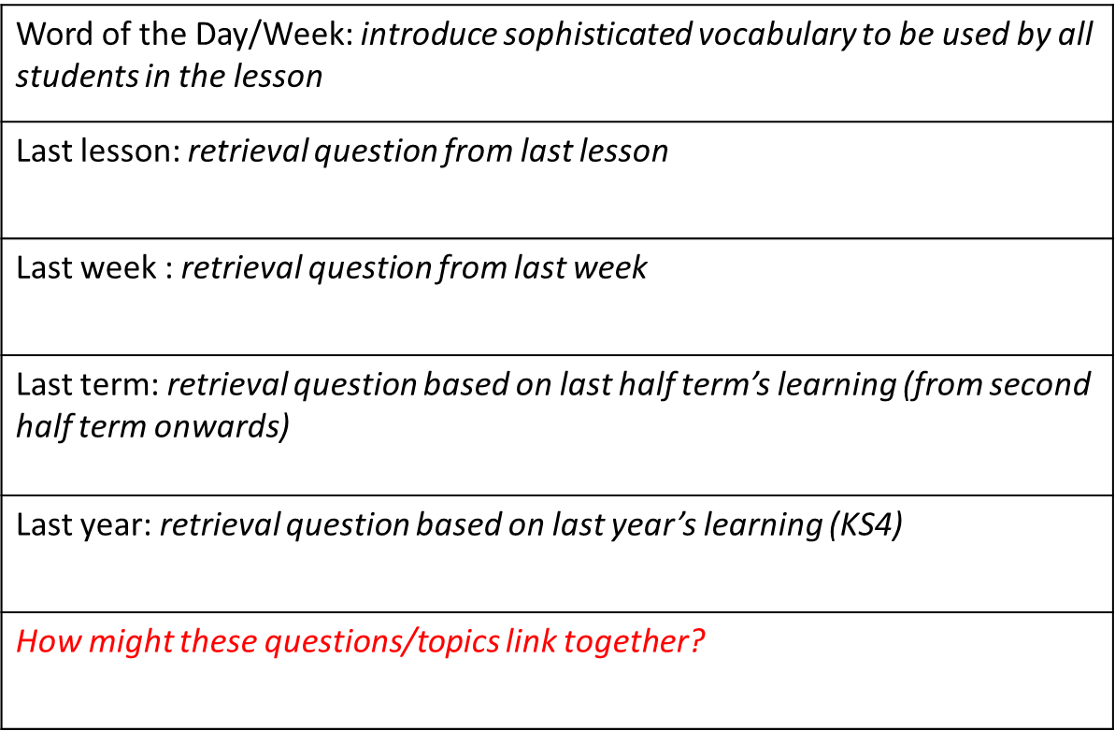
Why Now?
Previously we have…
We are now…
In the future, we will…
Worked to improve students’ ability to articulate and recall the curriculum
Improving the frequency and quality of student responses to feedback on misconceptions
Embed lesson expectations whilst reviewing examples across the school

Slide 5
Why Now?
Previously we have…
We are now…
In the future, we will…
Worked to improve students’ ability to articulate and recall the curriculum
Improving the frequency and quality of student responses to feedback on misconceptions
Embed lesson expectations through worked examples from across the school

Slide 6




Curriculum: planning for progress
National & Local Picture
Pedagogy & Strategies
Implementation
Aligning enquiry questions and assessments
PROFESSIONALISM
INCLUSION
PEDAGOGY
CURRICULUM

Slide 7




Landscape: what is the national picture?
Engagement and effort are essential characteristics of good learners.
Research indicates that children who start school socially and academically ahead of their peers tend to be more successful in school
This results in an achievement gap, which widens as children move through the school system if it persists.
One key factor is the perception of assessment; it can either strengthen or break their belief in their capabilities.
Help students to see their progress more often
Harrison, C (2013) Testing times: Reforming classroom teaching through assessment in Excellence and Equity: tackling educational disadvantage in England’s secondary schools, 2013
PROFESSIONALISM
INCLUSION
PEDAGOGY
CURRICULUM

Slide 8
What is the question?
Pedagogy
Feedback
Learning stops
PROFESSIONALISM
INCLUSION
PEDAGOGY
CURRICULUM

Slide 9




Landscape: what is the national picture?
A bad curriculum well taught is invariably a better experience for students than a good curriculum badly taught
Feedback should cause thinking…it should be more work for the recipient than the donor…. [it should] increase the extent to which students are owners of their own learning
Learners remember responses they generate themselves better than those responses that are given to them
As soon as students get a grade, the learning stops.
Learning how to learn is a survival skill
PROFESSIONALISM
INCLUSION
PEDAGOGY
CURRICULUM

Slide 10
A bad curriculum well taught is invariably a better experience for students than a good curriculum badly taught: pedagogy trumps curriculum. Or more precisely, pedagogy is curriculum, because what matters is how things are taught, rather than what is taught.
Feedback should cause thinking. It should be focused; it should relate to the learning goals that have been shared with the students; and it should be more work for the recipient than the donor. Indeed, the whole purpose of feedback should be to increase the extent to which students are owners of their own learning
Feedback functions formatively only if the information fed back to the learner is used by the learner in improving performance.
It has long been known that learners remember responses they generate themselves better than those responses that are given to them, and this is now often called the generation effect (Slamecka & Graf, 1978). In particular, one hour students spend writing test questions on what they have been studying results in more learning for them than one hour spent working with a study guide, answering practice tests, or leaving the students to their own devices (Foos, Mora, & Tkacz, 1994)
As soon as students get a grade, the learning stops. We may not like it, but the research reviewed here shows that this is a relatively stable feature of how human minds work
The shorter the time interval between eliciting the evidence [what have students learnt?] and using it to improve instruction, the bigger the likely impact on learning
Learning how to learn used to be an optional extra in education; today, it’s a survival skill.
Wiliam, D (2011) Embedded Formative Assessment
Notes:
HANDOUT

Slide 11
Landscape: what is the local picture?
HPA report – January 2021:
Observations from analysing 15 HPA students’ exercise books, including at least three books from each pupil:
Students are not responding to feedback in depth to evidence progress and closing knowledge and skills gaps, particularly in Y7 & Y8
Evidence of exemplar models are not present
There is little/infrequent evidence of explicit challenge in KS3 books. Books look similar to MPA books
Depth of extended writing and complexity of work is not clearly distinguishable from MPAs
Infrequent evidence of self and peer reflection/assessment
In some subjects, knowledge and skills development on occasions did not match end of unit assessments. Clarity of what the assessment focus on occasions was also unclear
PROFESSIONALISM
INCLUSION
PEDAGOGY
CURRICULUM

Slide 12








Unit/SoL Feedback and Assessment
“Feedback should be more work for the recipient than the donor.”
Shared unit overview
Self
Assessment
Worked examples/model answers
Mid assessment point. Whole class feedback
(2 weeks – core
3 weeks – non-core)
Peer
assessment
Summative
assessment
Unit overview evaluation
‘Many teachers do not routinely check that pupils understand what they have learned’
‘These weaknesses mean that pupils are not prepared effectively to study more demanding concepts in the future’
Expected green pen reflection
Students self assess using shared/created success criteria
Students analyse models for knowledge and skills
Students review and respond to WCF in depth
Students peer assess using shared/created success criteria
Summative assessments completed in exercise books
Students complete unit overview evaluation
Essential
PROFESSIONALISM
INCLUSION
PEDAGOGY
CURRICULUM

Slide 13



Feedback: Capturing and Responding
The best form of feedback is feedback immediately given and actioned
Verbal feedback: the best form of feedback is immediate
Whole class feedback on success and misconceptions
Live modelling: modelling the thought/production process
Live written feedback: live marking to support and challenge
Expected green pen reflection
Direct students to capture feedback and respond immediately
Students review and respond to in class WCF in depth
Performing/Writing/typing live models for students to see, glue in, analyse, & build upon
Students self assessing after seeing live marking through the use of visualisers
Desirable
PROFESSIONALISM
INCLUSION
PEDAGOGY
CURRICULUM

Slide 14
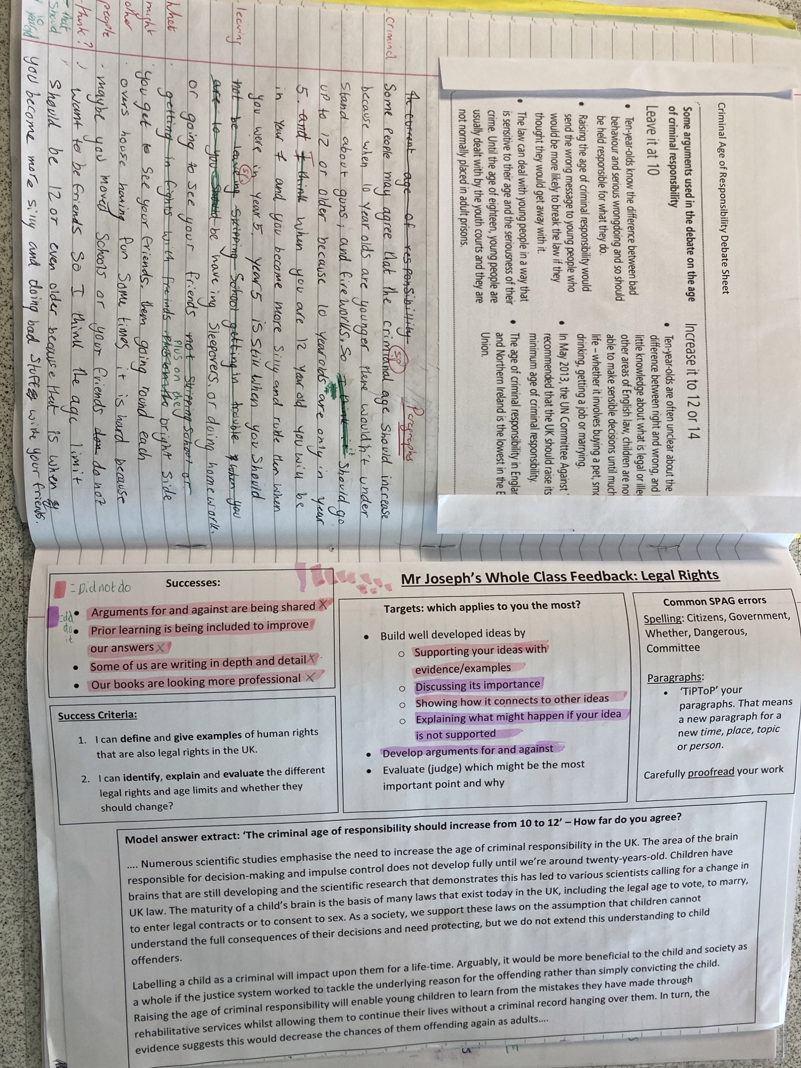
LPA – Year 7 student (reading age 7:08)

Slide 15
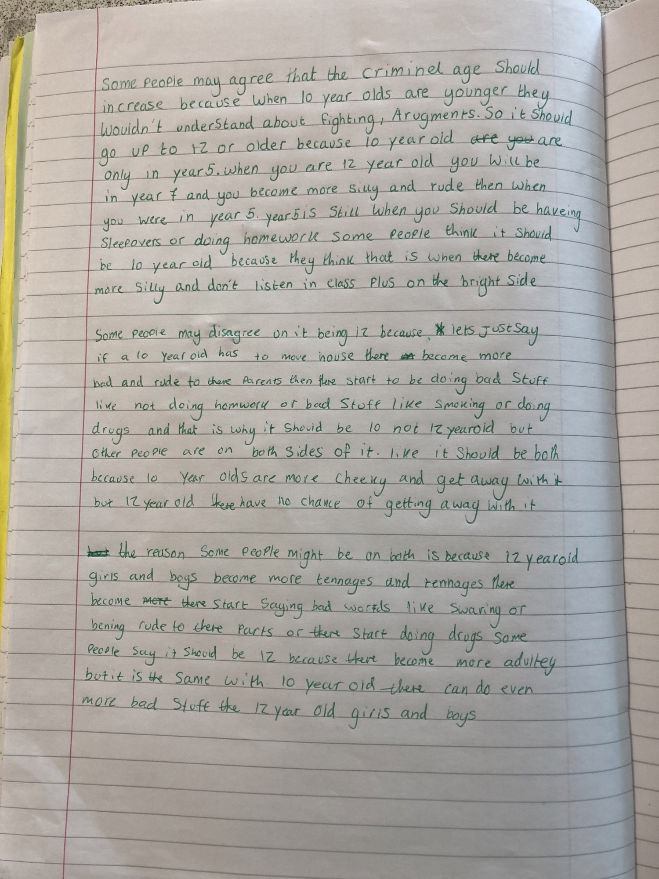
LPA – Year 7 student (reading age 7:08)
Redraft

Slide 16
Evidencing students’ responses to feedback
UNIT OVERVIEW: Parenting toddlers
ENQUIRY:
Is behaviour by nature or nurture?
Unit intention: To understand…
Success criteria… |  |  | X
Topic Sequence Mother is always right Sharing is caring Don’t hit people, especially your older brother Be grateful for the little things Crying does not work Apologise and mean it No right now does not mean no forever Try, fail and try again Assessment - End of unit evaluation | Recommended reading: … Places to visit: …
Self
Assessment
Shared unit overview
Mid assessment point. Whole class feedback
Worked examples/model answers
Peer
assessment
Unit overview evaluation
Summative
assessment
PROFESSIONALISM
INCLUSION
PEDAGOGY
CURRICULUM

Slide 17
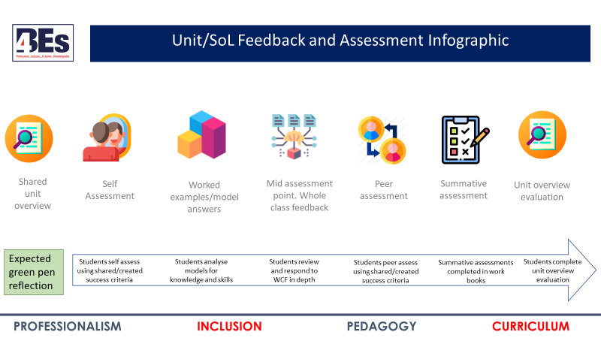


Assessments in Curriculum Design: Takeaway actions
s
Discuss
Create
How are our students going to show us - and evidence in their exercise books* - their responses to feedback given by us and their peers?
*where applicable
Signpost where students are going to evidence detailed responses to feedback
  This should be clear to students and teachers. Could this be signposted in PowerPoints?
Plan for, expect and demand quality and detailed responses to feedback
PROFESSIONALISM
INCLUSION
PEDAGOGY
CURRICULUM

Slide 18

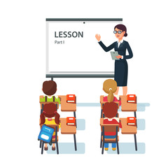







LPS Lesson Expectations - Students
I will be
Greeted
I will be greeted at the door whilst starter is displayed
Prepared
Out: planners + pencil case Away: outdoor clothing & bags
Silent during the register & starter
Conducted and checked whilst students complete starter
Professional
My presentation & effort will be challenged and celebrated
Inclusive
Listen to the views of others with care & consideration
A learner
Completing all work and reflections to my best
Rewarded
Class recognition of excellence in the 4BEs
Respectful
Tidy; stand behind chairs; calm & orderly dismissal

Slide 19








LPS Lesson Expectations - Teachers
Retrieval - Think Hard
Starter questions: last lesson; week/fortnight; term; year
Why Now?
Link present to past and future learning
Self/Peer Assessment
Reflection & feedback on past or current learning
Modelling
Models/modelling of new knowledge or skills
Talk Partners
Think (wait), Pair, Prepare (write*), Share
*In applicable subjects
Stretch + Challenge
‘Teach to the top’ with separate S & C tasks/questions
Independent Work
Expect, direct & manage independent application
Consolidate learning
Review learning; discuss next steps; celebrate good work & the 4BEs*
*Award achievement points

Slide 20


Assessment in Curriculum Design: reflection
s
Every Child
Every Lesson
Findings and observations
Q&A
LPS Lesson Expectations:
All students will produce quality and detailed* green pen responses to regular purposeful feedback in their exercise books.
Feedback points will be signposted in schemes of learning and resources to minimize variation across departments
PROFESSIONALISM
INCLUSION
PEDAGOGY
CURRICULUM

