Slide 1
Safeguarding education: raising standards and expectations
We will be starting in…
Every Child
Every Lesson
PROFESSIONALISM
INCLUSION
PEDAGOGY
CURRICULUM

Slide 2
Safeguarding education: raising standards and expectations
What are your faculty’s QET targets?
Stretch:
Which four areas for improvement from Ofsted has AJO shared in each of the last three CPD sessions?
Challenge:
Explain how you have used the QET to address specific areas of your DIP/YIP and SIP, the progress made and your next steps
Every Child
Every Lesson
PROFESSIONALISM
INCLUSION
PEDAGOGY
CURRICULUM

Slide 3
Safeguarding education: raising standards and expectations
‘Pupils find it hard to link new ideas with what they already know and understand’
‘Some teaching is not focused on ensuring that pupils understand and remember’
‘Many teachers do not routinely check that pupils understand what they have learned’
‘These weaknesses mean that pupils are not prepared effectively to study more demanding concepts in the future’
‘Some teaching does not introduce pupils to content in a useful way’
The LPS Lesson Expectations
Feedback & Assessment Policy
Stretch + Challenge
& The QET
Why Now?
‘Leaders have not planned pupils’ learning well’
‘Sometimes, pupils’ errors or misconceptions are not corrected’
‘Gaps in pupils’ understanding’
PROFESSIONALISM
INCLUSION
PEDAGOGY
CURRICULUM

Slide 4
Why Now?
Previously we had…
We are now…
In the future, we will…
Begun to embed LPS Lesson Expectations through best practice from WalkThrus2
Improving QET targets by agreeing on standards and expectations
Review QET progress and SEND and feedback strategies

Slide 5
The LPS Book
National & Local Picture
Pedagogy & Strategies
QET & the LPS Book: standards and expectations
Implementation
PROFESSIONALISM
INCLUSION
PEDAGOGY
CURRICULUM

Slide 6
National: characteristics of high performing schools
Insisting on excellence in quality of teaching
Systems are used to audit quality
High aspirations for all students
Knowledgeable of what can and should be achieved at each stage
‘Leaders rigourously enforce the basics’
In assessment, challenging targets are to set
Dougill P, Raleigh M, Blatchford R, Fryer L, Dr Robinson C, Richmond J (2010) - To the next level: good schools becoming outstanding
PROFESSIONALISM
INCLUSION
PEDAGOGY
CURRICULUM

Slide 7
‘Systems are used to audit quality’ - QET
QET
Check
Targets
for improvement
Follow up
Dougill P, Raleigh M, Blatchford R, Fryer L, Dr Robinson C, Richmond J (2010) - To the next level: good schools becoming outstanding
PROFESSIONALISM
INCLUSION
PEDAGOGY
CURRICULUM

Slide 8
Local: QET Work Scrutiny Findings & Actions
Whole School Strengths
Whole School Targets
Whole School Actions
Leadership:
Leaders are questioning how they can capture greater evidence of progress
T&L:
Proformas are present and presentation is generally good
Curriculum is consistently being followed
Some subjects are excelling in various areas e.g. HPA standards in Maths, modelling in English and extended writing in MFL
Leadership:
Rigorous implementation of follow up actions across all Key Stages
T&L:
Quantity of work in books
Capturing of learning/conversations in books
Scaffolding for SEND
Visible increased challenge and expectations for HPAs
Responses to feedback and self/peer assessment
Leadership:
Implement a Leadership Review model (part of QET) to quality assure findings and actions. The model aims to look at curriculum impact from students’ perspective.
T&L:
CPD sessions on targets
Training on capturing learning and Feedback Policy methods
Guidance on SEND resource creation
Designated CPD leads across the school
Student voice on progress and impact
PROFESSIONALISM
INCLUSION
PEDAGOGY
CURRICULUM

Slide 9
The LPS Book: standards & expectations
Individually reflect on the questions in boxes 1-4
Stretch: Which impactful strategies have you used in the past or have heard of that could used?
Challenge: how could you lead on these strategies to ensure all teachers in your area regularly implement them?
Write down your current and future strategies/ideas
Share your strategies with those on your table
PROFESSIONALISM
INCLUSION
PEDAGOGY
CURRICULUM

Slide 10
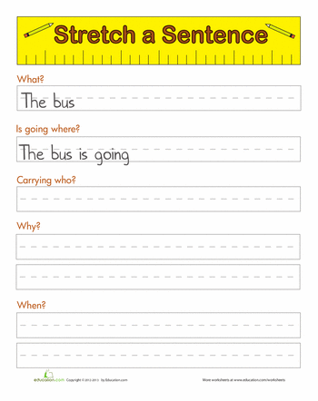
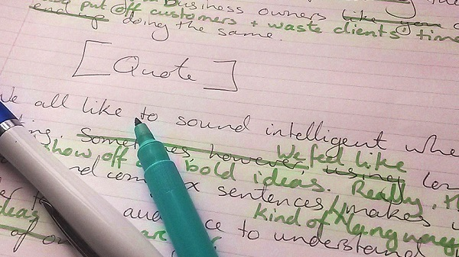
The LPS Book: standards & expectations
HPA
Leave a post-it-note
Strengths
Suggestions for improvements
To what extent do the books in front of you achieve the standards and expectations you have written down?
LPA
SEND
Are HPA books visibly different to MPA books?
Volume & quality of work
Visible evidence of HPA challenge
Visible evidence of SEND support
Frequent green pen responses to misconceptions
PROFESSIONALISM
INCLUSION
PEDAGOGY
CURRICULUM

Slide 11
The LPS Book: standards & expectations
Reflect on the questions in boxes 5-7
Stretch: if improved, which area might make the biggest impact in your students’ outcomes?
Challenge: how could you lead on these strategies to ensure all teachers in your area regularly implement them?
Write down your moving forward and follow up actions
Share these with your chosen accountability partner and line manager
PROFESSIONALISM
INCLUSION
PEDAGOGY
CURRICULUM

Slide 12
The LPS Book: standards & expectations
Are HPA books visibly different to MPA books?
Volume & quality of work
Visible evidence of HPA challenge
Visible evidence of SEND support
Frequent green pen responses to misconceptions
KS3 = two pages per lesson*
KS4/5 = ?
*where applicable
Subtitles to signpost challenge activities
PPT lesson outlines
Hard copies of scaffolds
A culture of self & peer assessment in every lesson
Verbal & live written feedback
Following the feedback cycle
PROFESSIONALISM
INCLUSION
PEDAGOGY
CURRICULUM

Slide 13
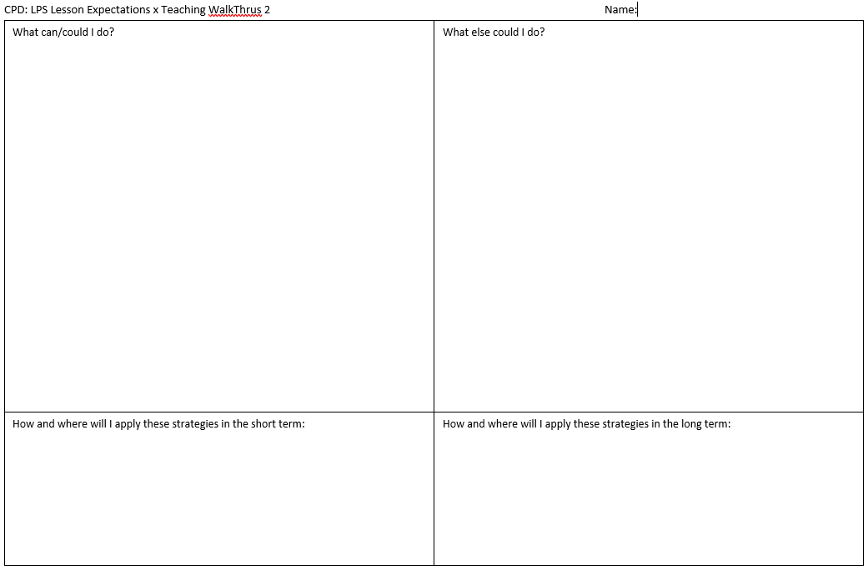
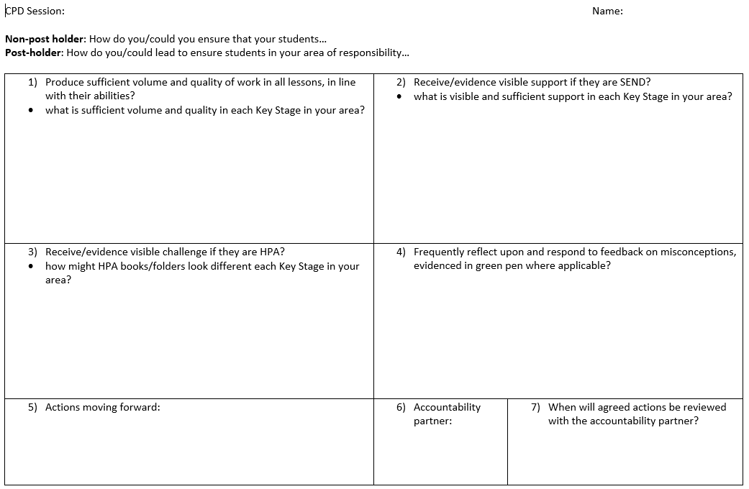
LPS Lesson Expectations x Teaching Walkthrus 2: Takeaway actions
s
Reflect
Implement
If their exercise books are a reflection of their progress and learning, what should the books of the following students in my class look like?
Implement the strategies
created
LPA
MPA
HPA
SEND
PROFESSIONALISM
INCLUSION
PEDAGOGY
CURRICULUM

