Slide 1
Safeguarding education: raising standards and expectations
‘What is clear from more fine-grained analysis carried out over recent years is that it matters very much which teachers are teaching you.’
Dylan Wiliam – The Importance of Teaching
Every Child
Every Lesson
PROFESSIONALISM
INCLUSION
PEDAGOGY
CURRICULUM

Slide 2
Safeguarding education: raising standards and expectations
‘Pupils find it hard to link new ideas with what they already know and understand’
‘Some teaching is not focused on ensuring that pupils understand and remember’
‘Many teachers do not routinely check that pupils understand what they have learned’
‘These weaknesses mean that pupils are not prepared effectively to study more demanding concepts in the future’
PROFESSIONALISM
INCLUSION
PEDAGOGY
CURRICULUM

Slide 3
Why Now?
Previously we have…
We are now…
In the future, we will…
Started improving students’ exposure to higher order thinking skills and expectations
Embedding lesson expectations through best practice from WalkThrus2
Address QET targets & embed lesson expectations through best practice from across the school

Slide 4
LPS Lesson Expectations
National & Local Picture
Pedagogy & Strategies
Collaboratively pursuing excellence together
Implementation
PROFESSIONALISM
INCLUSION
PEDAGOGY
CURRICULUM

Slide 5
Landscape: what is the national picture?
s
‘Implementing change in schools is challenging. One of the characteristics that distinguishes effective and less-effective schools, in addition to what they implement, is how they put those new approaches into practice.’
EEF (2019) Putting Evidence to Work: A School’s Guide to Implementation.
See: https://d2tic4wvo1iusb.cloudfront.net/guidance-reports/a-schools-guide-to-implementation/EEF_Implementation_Guidance_Report_2019.pdf (last accessed October 2021)
PROFESSIONALISM
INCLUSION
PEDAGOGY
CURRICULUM

Slide 6
Landscape: what is the national picture?
s
Treat implementation as a process, not an event; plan and execute it in stages
Create a leadership environment and school climate that is conducive to good implementation
Define the problem you want to solve and identify appropriate programmes or practices to implement
Create a clear implementation plan, judge the readiness of the school to deliver that plan, then prepare staff and resources
Support staff, monitor progress, solve problems, and adapt strategies as the approach is used for the first time
Plan for sustaining and scaling an intervention from the outset and continually acknowledge and nurture its use
EEF (2019) Putting Evidence to Work: A School’s Guide to Implementation.
See: https://d2tic4wvo1iusb.cloudfront.net/guidance-reports/a-schools-guide-to-implementation/EEF_Implementation_Guidance_Report_2019.pdf (last accessed October 2021)

Slide 7
Landscape: what is the local picture?
Retrieval - Think Hard
Starter questions: last lesson; week/fortnight; term; year
Why Now?
Link present to past and future learning
Self/Peer Assessment
Reflection & feedback on past or current learning
Modelling
Models/modelling of new knowledge or skills
Talk Partners
Think (wait), Pair, Prepare (write*), Share
*In applicable subjects
Stretch + Challenge
‘Teach to the top’ with separate S & C tasks/questions
Independent Work
Expect, direct & manage independent application
Consolidate + reward learning
Review learning; discuss next steps; celebrate good work & the 4BEs*
*Award achievement points

Slide 8
Local Picture: 256 students’ responses
Retrieval - Think Hard
Yes or Mostly: 93%
Why Now?
Yes or Mostly: 72.2%
78.2%
Self/Peer Assessment
Yes or Mostly: 68.4%
Modelling
Yes or Mostly: 55.3%
77%
56.9%
Talk Partners
Yes or Mostly: 67.7%
Stretch + Challenge
Yes or Mostly: 75.2%
Independent Work
Yes or Mostly: 84.2%
Consolidate + reward learning
Yes or Mostly: 30.5%

Slide 9
LPS Lesson Expectations x Teaching Walkthrus 2
Retrieval - Think Hard
Page 116-117, 122-123, 128-129
Why Now?
Link present to past and future learning
Self/Peer Assessment
Page 110-113
Modelling
Page 84-87, 94-95
Talk Partners
Page 54-55, 100-101
Stretch + Challenge
Page 68-71
Independent Work
Page 42-45, 144-145
Consolidate + reward learning
Page 64-65, 110-111

Slide 10
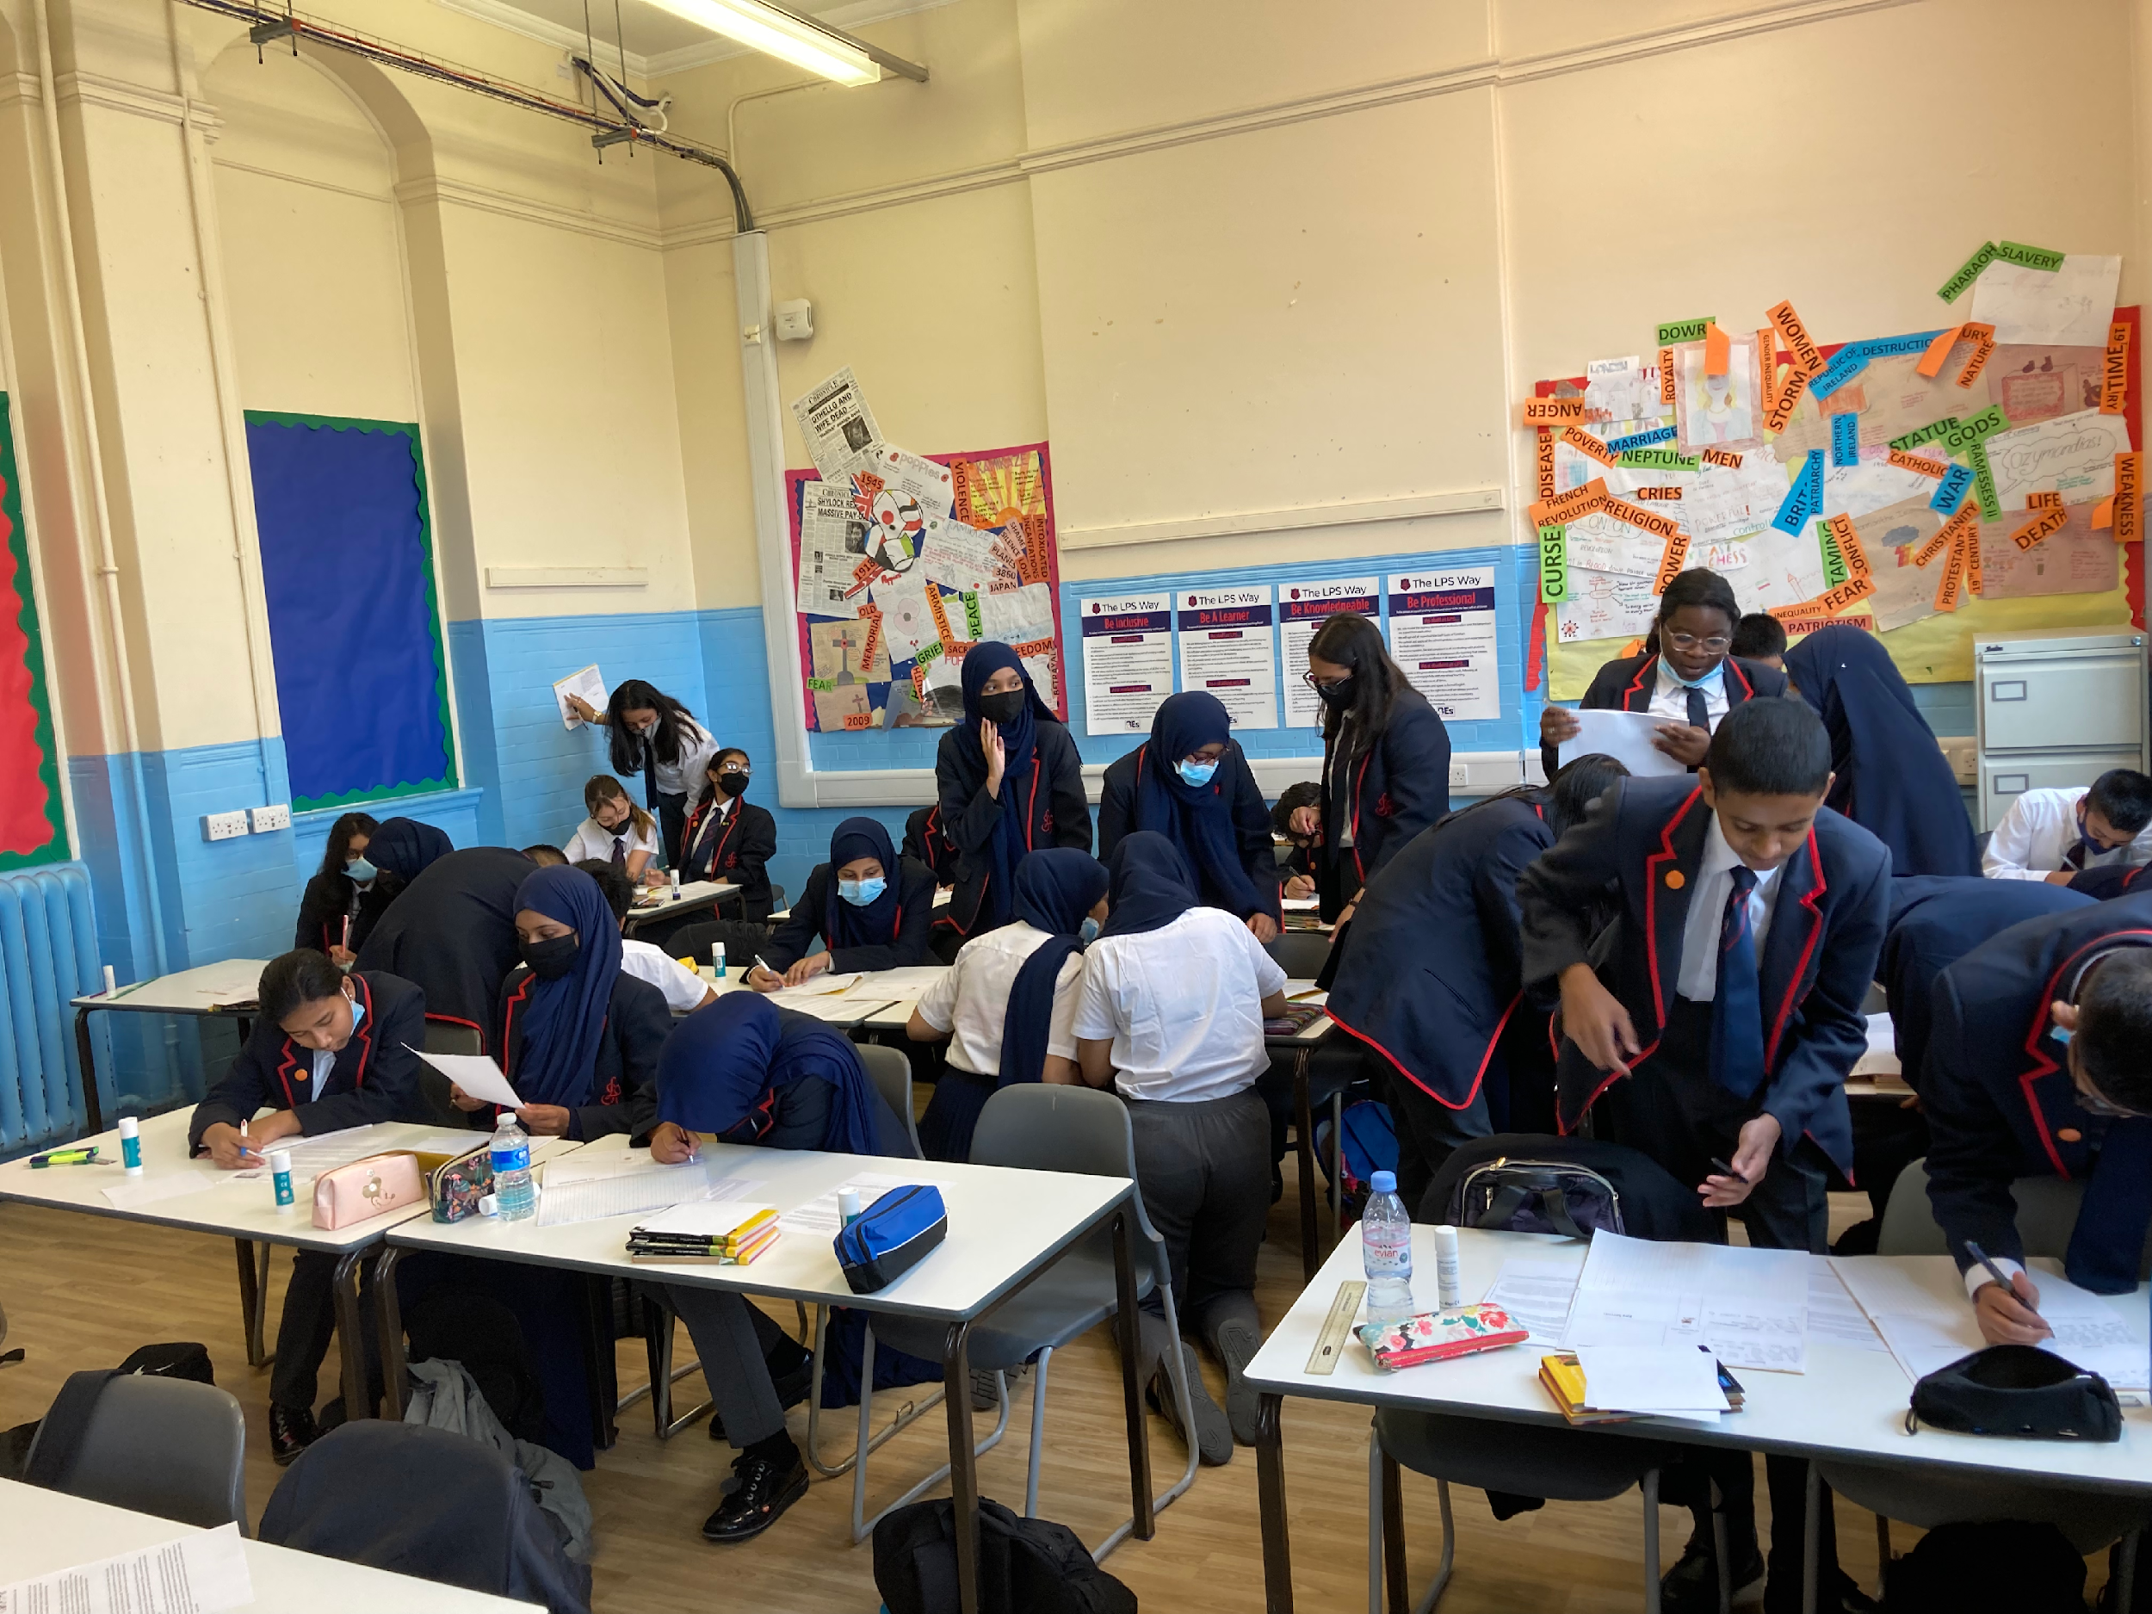
LPS Lesson Expectations x Teaching Walkthrus 2
What can/could I do?
What else could I do?
How and where will I apply these strategies in the short term:
How and where will I apply these strategies in the long term:
PROFESSIONALISM
INCLUSION
PEDAGOGY
CURRICULUM

Slide 11
LPS Lesson Expectations x Teaching Walkthrus 2
Retrieval - Think Hard
Page 116-117, 122-123, 128-129
Why Now?
Link present to past and future learning
Self/Peer Assessment
Page 110-113
Modelling
Page 84-87, 94-95
Talk Partners
Page 54-55, 100-101
Stretch + Challenge
Page 68-71
Independent Work
Page 42-45, 144-145
Consolidate + reward learning
Page 64-65, 110-111

Slide 12
LPS Lesson Expectations x Teaching Walkthrus 2: Takeaway actions
s
Reflect
Create
“Every teacher needs to improve, not because they are not good enough, but because they can be even better.”
- Dylan Wiliam
Create opportunities for your students to excel everyday
What can/could I do? | What else could I do?
Implementation short term: | Implementation long term:
PROFESSIONALISM
INCLUSION
PEDAGOGY
CURRICULUM

