Slide 1
Safeguarding education: raising standards and expectations
Professor Reis distinguishes between:
Responsiveness
which improves relationships
Unresponsiveness
which worsens relationships
Blindly offering care
which is egoistical for the giver, and does not improve relationships.
We will be starting in…
Reis, H. (2007). Steps toward the ripening of relationship science. Personal Relationships, 14, pp.1–23
PROFESSIONALISM
INCLUSION
PEDAGOGY
CURRICULUM

Slide 2
QET & The LPS Book
National & Local Picture
QET Progress Review
Faculty reflection
QET & The LPS Book: standards and expectations
PROFESSIONALISM
INCLUSION
PEDAGOGY
CURRICULUM

Slide 3
Why Now?
Previously we have…
We are now…
In the future, we will…
Reviewed how the Lesson Expectations can be used as response teaching tools
Reviewing the progress of QET targets
Analyse KS5 standards and facilitate subject-specific CPD

Slide 4
Landscape: what is the local picture?
s
What percentage of our Year 10s are HPAs?
30%
40%
50%
Year 9 = 44.7%
PROFESSIONALISM
INCLUSION
PEDAGOGY
CURRICULUM

Slide 5
Landscape: what is the national picture?
s
Most able students nationally perform reasonably well compared to national standards
However do fail to reach their potential; this is particularly evident with disadvantaged students.
Leaders had not embedded an ethos in which academic excellence was championed with sufficient urgency
Too often, the curriculum did not ensure that work was hard enough for the most able students in Key Stage 3
In some schools, teaching for the most able lacked sufficient challenge in Key Stage 3
Inspectors found that the secondary schools visited were not using transition information from primary schools effectively to get the most able off to a flying start in Key Stage 3
Ofsted (2015) The most able students. An update on progress since June 2013. See: https://assets.publishing.service.gov.uk/government/uploads/system/uploads/attachment_data/file/408909/The_most_able_students_an_update_on_progress_since_June_2013.pdf (last accessed July 2021)

Slide 6
Landscape: what is the local picture?
s
Historical trend of high prior attaining students (HPA)
PROFESSIONALISM
INCLUSION
PEDAGOGY
CURRICULUM

Slide 7
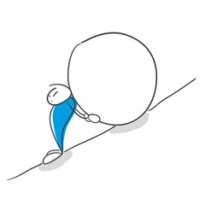
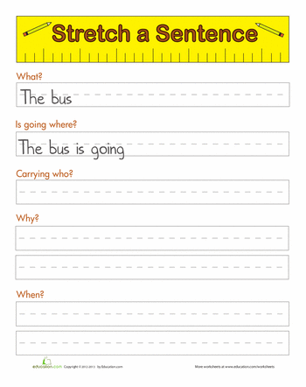
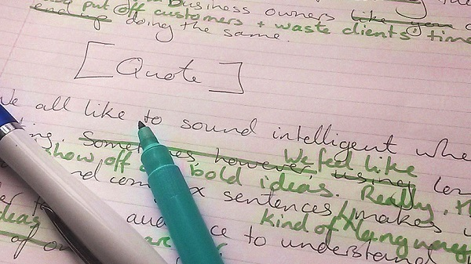
The LPS Book: standards & expectations
Rank the priorities for the faculty e.g:
1
4
3
2
How much progress have we made in these areas?
Which is the priority in each faculty?
HPA
SEND
Are HPA books visibly different to MPA books?
Volume & quality of work
Visible evidence of HPA challenge
Visible evidence of SEND support
Frequent green pen responses to misconceptions
PROFESSIONALISM
INCLUSION
PEDAGOGY
CURRICULUM

Slide 8
The LPS Book: faculty reflection
Which of the four priority areas might be my individual area for development?
Discuss how you could support one another in these areas
HoF/HoD take note of teachers’ areas for development
PROFESSIONALISM
INCLUSION
PEDAGOGY
CURRICULUM

Slide 9
QET & The LPS Book: Takeaway actions
s
Reflect
Implement
CPD: To what extent am I responsive, unresponsive or blindly offering care?
ELT: To what extent am I a responsive leader?
QET Learning Walk follow up: 19/04 – 06/05
QET Work Scrutiny follow up: 13/06 – 04/07
PROFESSIONALISM
INCLUSION
PEDAGOGY
CURRICULUM

