Slide 1
Safeguarding education: raising standards and expectations
“There is a lot of change and it feels scary, but I feel like I will be safe”
Every Child
Every Lesson
PROFESSIONALISM
INCLUSION
PEDAGOGY
CURRICULUM

Slide 2
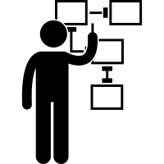
Leadership: consistency is what transforms average into excellence
‘Leaders have not made sure that teachers follow these plan consistently’
‘Leaders should ensure that plans set out what knowledge pupils should study’
‘Leaders should ensure that teachers check pupils’ understanding and adapt planning ’
PROFESSIONALISM
INCLUSION
PEDAGOGY
CURRICULUM

Slide 3
LPS Lesson Expectations - Teachers
Retrieval - Think Hard
Starter questions: last lesson; week/fortnight; term; year
Why Now?
Link present to past and future learning
Self/Peer Assessment
Reflection & feedback on past or current learning
Modelling
Models/modelling of new knowledge or skills
Talk Partners
Think (wait), Pair, Prepare (write*), Share
*In applicable subjects
Stretch + Challenge
‘Teach to the top’ with separate S & C tasks/questions
Independent Work
Expect, direct & manage independent application
Consolidate learning
Review learning; discuss next steps; celebrate good work & the 4BEs*
*Award achievement points

Slide 4
Why Now?
Previously we have…
We are now…
In the future, we will…
Introduced lesson expectations to improve students’ progress
Improving students’ exposure to higher order thinking skills and expectations
Embed lesson expectations through worked examples from across the school

Slide 5
Inclusion: adjusting learning and expectations for progress
National & Local Picture
Pedagogy & Strategies
Implementation
How can we get learners to think harder?
PROFESSIONALISM
INCLUSION
PEDAGOGY
CURRICULUM

Slide 6
Landscape: what is the national picture?
s
Most able students nationally perform reasonably well compared to national standards
However do fail to reach their potential; this is particularly evident with disadvantaged students.
Leaders had not embedded an ethos in which academic excellence was championed with sufficient urgency
Too often, the curriculum did not ensure that work was hard enough for the most able students in Key Stage 3
In some schools, teaching for the most able lacked sufficient challenge in Key Stage 3
Inspectors found that the secondary schools visited were not using transition information from primary schools effectively to get the most able off to a flying start in Key Stage 3
Ofsted (2015) The most able students. An update on progress since June 2013. See: https://assets.publishing.service.gov.uk/government/uploads/system/uploads/attachment_data/file/408909/The_most_able_students_an_update_on_progress_since_June_2013.pdf (last accessed July 2021)

Slide 7
Landscape: what is the local picture?
s
Historical trend of high prior attaining students (HPA)
PROFESSIONALISM
INCLUSION
PEDAGOGY
CURRICULUM

Slide 8
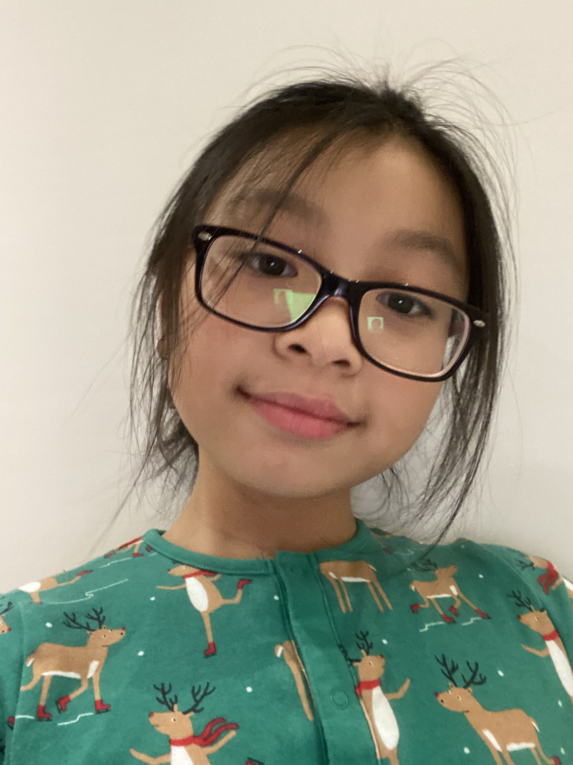
Assessment without Levels in KS3
KS2 prior attainment will be based on primary best work & TAGs
Evidence of students’ best work will be in Year 7 books*. Likewise from Y7-Y8**
Worked examples/model answers will be used for comparative judgement
Frequent and signposted formative assessment
Progress reports
Year 9 end of Key Stage exam
Inspectors found that the secondary schools visited were not using transition information from primary schools effectively to get the most able off to a flying start in Key Stage 3
Assessment for learning practices
*Where applicable best work will be used as a measure of progress and standards. **From 2022 onwards
Students work is compared to exemplar work to identify targets and gauge progress
Students receive daily opportunities to address misconceptions
Attitude to learning and qualitative subject specific targets are shared as opposed to grades
GCSE grades and mark schemes are used during two data collections
PROFESSIONALISM
INCLUSION
PEDAGOGY
CURRICULUM

Slide 9
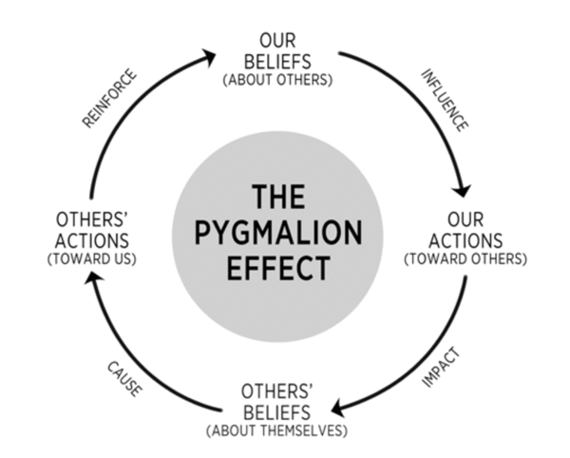
The Pygmalion Effect
PROFESSIONALISM
INCLUSION
PEDAGOGY
CURRICULUM

Slide 10
The Pygmalion Effect
Which examples can we recall as both students and teachers?
PROFESSIONALISM
INCLUSION
PEDAGOGY
CURRICULUM

Slide 11
The Pygmalion Effect & Expectations
“The mischievous monkey was swinging through the emerald green vines. He was chattering and laughing, the joy on his face was something to behold”
Hemiplegia (mild form of cerebral palsy)
EHCP
Challenges with processing information, sequencing and structuring
Which year group might this student be in?
Year 3
Year 5
Year 7
Year 9
PROFESSIONALISM
INCLUSION
PEDAGOGY
CURRICULUM

Slide 12
Stretch + Challenge
“The mischievous monkey was swinging through the emerald green vines. He was chattering and laughing, the joy on his face was something to behold”
What might the Year 3 teacher have done do to enable the student to produce this?
Stretch: What might be the difference between stretch and challenge?
Challenge: Which cognitive processes might occur in ‘challenge’ that might not occur in ‘stretch’?
Talk Partners
Think (wait), Pair, Prepare (write), Share
PROFESSIONALISM
INCLUSION
PEDAGOGY
CURRICULUM

Slide 13
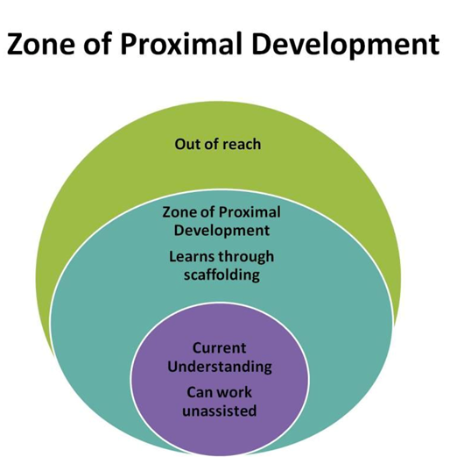
Stretch + Challenge
Curious but reluctant, frustrated, fearful
Challenged, willing to risk, alive
Comfortable, bored, lifeless
PROFESSIONALISM
INCLUSION
PEDAGOGY
CURRICULUM

Slide 14
Stretch + Challenge
Vygotsky suggested that: ‘all that is internal in the higher mental functions was at one time external’ (Fisher 2009: 10).
According to Jackie Acree Walsh and Beth Dankert Sattes ‘many of us have gotten into the habit of moving quickly-not recognizing the potential value of slowing down to encourage thinking’ (Walsh and Sattes 2004: 80).
Newman & Schwager suggest, pupils weigh up the ‘social costs’ before asking a question or sharing an idea (Newman, R.S., & Schwager, M.T. 1992: 11)
PROFESSIONALISM
INCLUSION
PEDAGOGY
CURRICULUM

Slide 15
Stretch + Challenge: scaffolding struggle
Collaboratively planning all key questions:
How many victims are there in the play Macbeth?
Stretch: Analyse how the murder of King Duncan might be interpreted by a Jacobean audience? [analysis]
Challenge: Macbeth is a play full of victims: to what extent is Macbeth one of those victims? [evaluation]
Robert Fisher suggests ‘a good question, whether closed or open, should pose an intellectual challenge – provoking what Piaget called the “cognitive conflict” which can help to challenge children’s thinking’ (Fisher 2009: 31)
Storing and sharing great spontaneous questions:
Can you tell me what happened with the five loaves and two fishes without using the word miracle?
What makes us human?
If we had to lose one of the four mathematical functions (+ , - , x , ÷) which one would you lose and why?
How can we scaffold struggle?
PROFESSIONALISM
INCLUSION
PEDAGOGY
CURRICULUM

Slide 16
Stretch + Challenge
Thinking of a lesson that you will be teaching, what might the separate stretch and challenge tasks/questions? State the class and ability group/set in mind.
Main task:
Stretch: (what could students do with more effort and greater thought?)
Challenge: (what would students do to exceed optimal standards and expectations for their ability?)
PROFESSIONALISM
INCLUSION
PEDAGOGY
CURRICULUM

Slide 17
LPS Lesson Expectations - Teachers
Retrieval - Think Hard
Starter questions: last lesson; week/fortnight; term; year
Why Now?
Link present to past and future learning
Self/Peer Assessment
Reflection & feedback on past or current learning
Modelling
Models/modelling of new knowledge or skills
Talk Partners
Think (wait), Pair, Prepare (write*), Share
*In applicable subjects
Stretch + Challenge
‘Teach to the top’ with separate S & C tasks/questions
Independent Work
Expect, direct & manage independent application
Consolidate learning
Review learning; discuss next steps; celebrate good work & the 4BEs*
*Award achievement points

Slide 18
Stretch + Challenge: Takeaway actions
s
Glue
Discuss
Create
How are we teaching to the top in every lesson/SoL?
What evidence is there of this?
Where should we be expecting students to lead on their learning?
What subject specific CPD could be provided in house?
Faculty meeting: 14 & 28th September (10 mins)
Stretch: within the main task and in relation to the ability of students, what could students do with more effort and greater thought?
Challenge: with optimal standards or end of key stage target grades in mind, what would students do to exceed optimal standards and expectations for their ability?
LPS Google Shared Drive folder: Year 6 Best Work*
Due date: Fri 1st Oct
*Where exercise books are at used
PROFESSIONALISM
INCLUSION
PEDAGOGY
CURRICULUM

