Slide 1


Safeguarding education: raising standards and expectations
Our brains have developed such a rich knowledge of reading that it doesn't really matter if we read words with radically different fonts.’
Every Child
Every Lesson
‘Every teacher is of course an expert reader, but that does not necessarily mean we are experts in how to teach reading successfully.
Quigley, A. Closing the Reading Gap. Routledge, London, 2020
PROFESSIONALISM
INCLUSION
PEDAGOGY
CURRICULUM

Slide 2





An ambitious, challenging and demanding curriculum
Evidence-based Research
Our Strategy
Implementation
Be Ambitious:
Curriculum
PROFESSIONALISM
INCLUSION
PEDAGOGY
CURRICULUM

Slide 3




‘Why Now?’
Think/Speak
Read
Write*
Be Ambitious
CPD Theme 2022-24
=
Oracy
Curriculum
Responsive Teaching
*Different for performance based subjects
Term 1 & 4
Term 2 & 5
Term 3 & 6
PROFESSIONALISM
INCLUSION
PEDAGOGY
CURRICULUM

Slide 4






An ambitious, challenging and demanding curriculum
Think of the highest performing school you know
Think
In that school, what might Y7, Y9, Y11 and Y13 students have been expected to read in your subject last half term?
Share
Write
PROFESSIONALISM
INCLUSION
PEDAGOGY
CURRICULUM

Slide 5
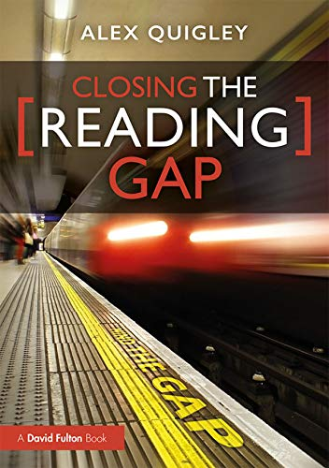
CPD Overview 2022-24
Read
Be Ambitious
CPD Theme 2022-24
=
Curriculum
Term 2 & 5
PROFESSIONALISM
INCLUSION
PEDAGOGY
CURRICULUM

Slide 6


‘The reading rich get richer & the reading poor get poorer’
What might evidence-based research have said about the importance of reading and teachers increasing opportunities for reading?
‘Only a third (31%) of children are read to at home daily’
‘14 year olds who read often and independently know 26% more words’
‘It is reading that determines exam success’
Quigley, A. Closing the Reading Gap. Routledge, London, 2020
PROFESSIONALISM
INCLUSION
PEDAGOGY
CURRICULUM

Slide 7
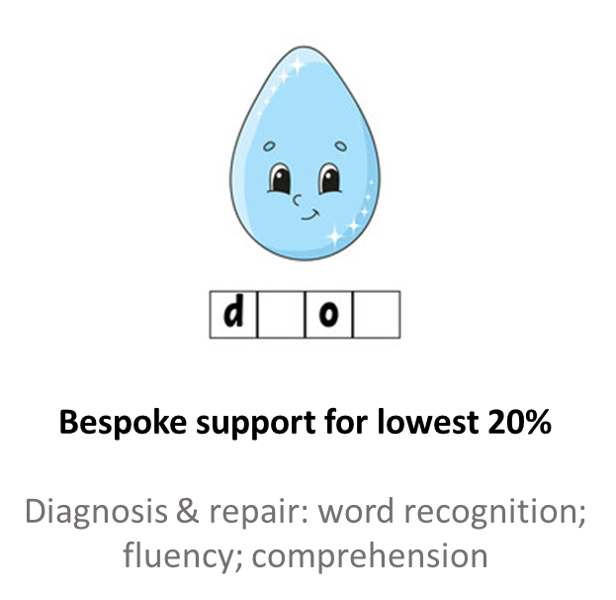
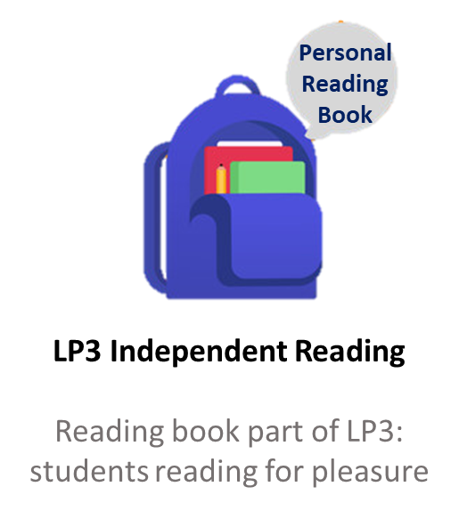
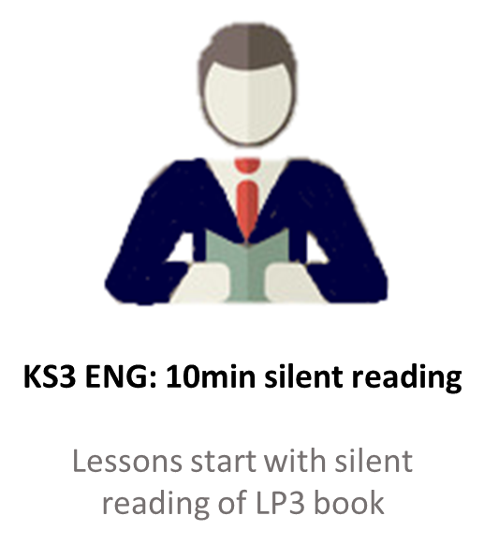
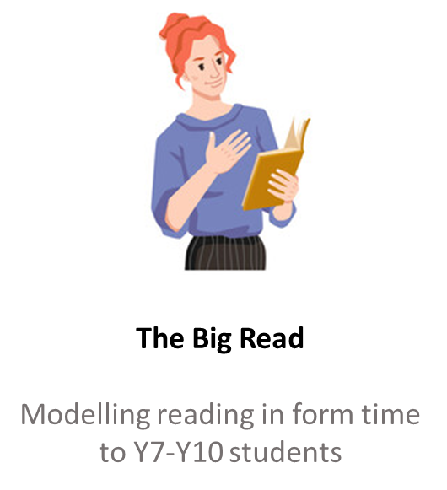

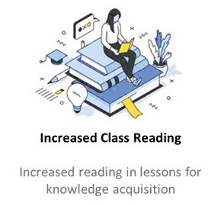
A Visible & Impactful Reading Culture: Strategy
Learning Support
All staff aware of strategies & intervention
Form tutors & English
Reading for pleasure
All staff
An ambitious curriculum
PROFESSIONALISM
INCLUSION
PEDAGOGY
CURRICULUM

Slide 8
Reciprocal Reading Strategy – What is it for?
To develop confidence dealing with a variety of texts
To help students get ‘past the words’ so they can demonstrate their subject knowledge.
Why?
The more they read around a subject, the more they can mimic that subject.
Simply put it’s about making the learning processes that expert readers do implicitly explicit for novices
PROFESSIONALISM
INCLUSION
PEDAGOGY
CURRICULUM

Slide 9


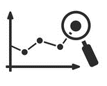

Reciprocal Reading Strategy
Predict
The predictor predicts what could happen next in the text
Clarify
Clarifer addresses confusing parts and attempts to answer questions posed
Which words and phrases do we need to find the meaning of?
Question
Questioner poses questions on what the new information means and how it might relate to other things
Summarise
Summariser highlights key ideas and information
PROFESSIONALISM
INCLUSION
PEDAGOGY
CURRICULUM

Slide 10
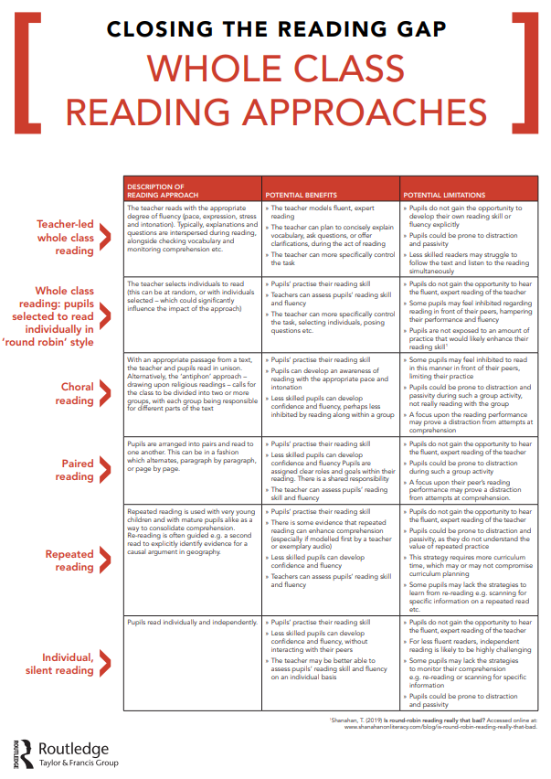




Assign roles:
Questioner
Clarifer
Summariser
Pause after reading the paired strategies
Discuss each pair using the reciprocal reading roles

Slide 11
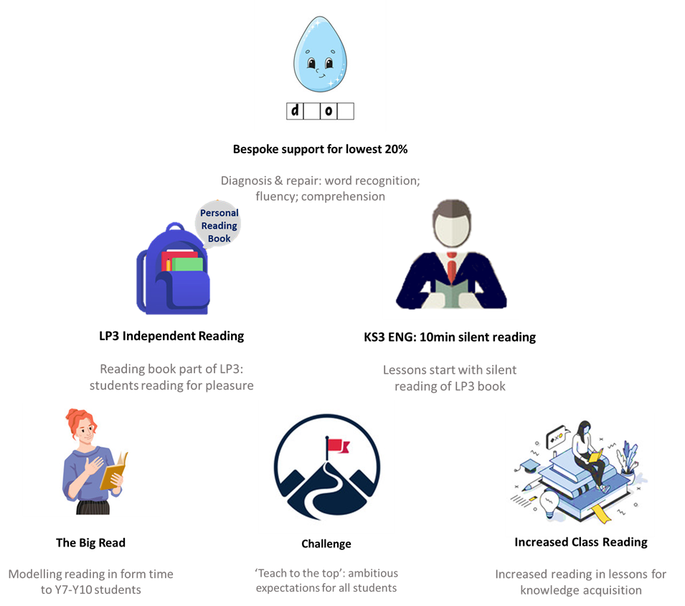
An ambitious, challenging and demanding curriculum
What could Y7, Y9, Y11 and Y13 students be supported to read in class in your subject?
English: how can we make ‘recommended reading’ real?
Practical subjects: what could be read in theory lessons to improve knowledge acquisition
Maths: more multi-step word problems? What might it mean to read like a mathematician?
PROFESSIONALISM
INCLUSION
PEDAGOGY
CURRICULUM

Slide 12

Be Ambitious – Curriculum : Takeaway actions
Reflect
Implement
‘In schools that get safeguarding right, leaders create a culture that safeguarding is “everyone’s business, all of the time”. In this school, leaders seem to have done the same with reading.’
- ‘Now the whole school is reading’ | Ofsted article
Faculty Twilight (29th Nov)
Be Ambitious: Reading | what could we support our students to read?
KS3 AWOL standardization/moderation
https://www.gov.uk/government/publications/now-the-whole-school-is-reading-supporting-struggling-readers-in-secondary-school/now-the-whole-school-is-reading-supporting-struggling-readers-in-secondary-school
PROFESSIONALISM
INCLUSION
PEDAGOGY
CURRICULUM

