Slide 1
Curriculum: planning for progress
Summer 2021 enquiry question:
How can we ensure alignment and sequencing for progression within our unit enquiry questions, schemes of learning and individual lessons?
‘Pupils find it hard to link new ideas with what they already know and understand’
‘These weaknesses mean that pupils are not prepared effectively to study more demanding concepts in the future’
‘Many teachers do not routinely check that pupils understand what they have learned’
PROFESSIONALISM
INCLUSION
PEDAGOGY
CURRICULUM

Slide 2
Cognitive Science in Curriculum Design
National & Local Picture
Pedagogy & Strategies
Implementation
Cognitive Science in Curriculum Design
PROFESSIONALISM
INCLUSION
PEDAGOGY
CURRICULUM

Slide 3
Why Now?
Previously we have…
We are now…
In the future, we will…
Developed curriculum overviews, learning journeys and unit overviews
Developing staff and students’ ability to articulate the curriculum
Develop greater alignment with enquiry questions and assessments

Slide 4
Landscape: what is the national picture?
“Humans seek patterns and connections and we are depriving our children of crucial intellectual development if we do not show them how information fits into the bigger whole.”
“When you only practise one skill over and over, the brain knows what is coming next and doesn’t have to work as hard. With interleaving, the brain is forced to figure out what each skill each practice problem calls for.”
Myatt, M (2018) The Curriculum: gallimaufry to coherence - John Catt Publishing
Didau, D (2015) What if Everything you Knew About Education Was Wrong? - Crown House Publishing
PROFESSIONALISM
INCLUSION
PEDAGOGY
CURRICULUM

Slide 5
Landscape: what is the local picture?
Can pupils explain in their own words what they are learning and how it links to the bigger picture?
When we rush through content quickly without a clear shared structure, pupils will struggle to say in their own words what they have learnt and how it relates to the bigger picture.
Moving through the curriculum content can be valued more highly than checking whether pupils understood what they were doing, why it is important and how it might fit into other things they have learnt or going to learn
Links are not explicitly being made to deep knowledge/concepts
Which of these might be most prevalent and why?
PROFESSIONALISM
INCLUSION
PEDAGOGY
CURRICULUM

Slide 6
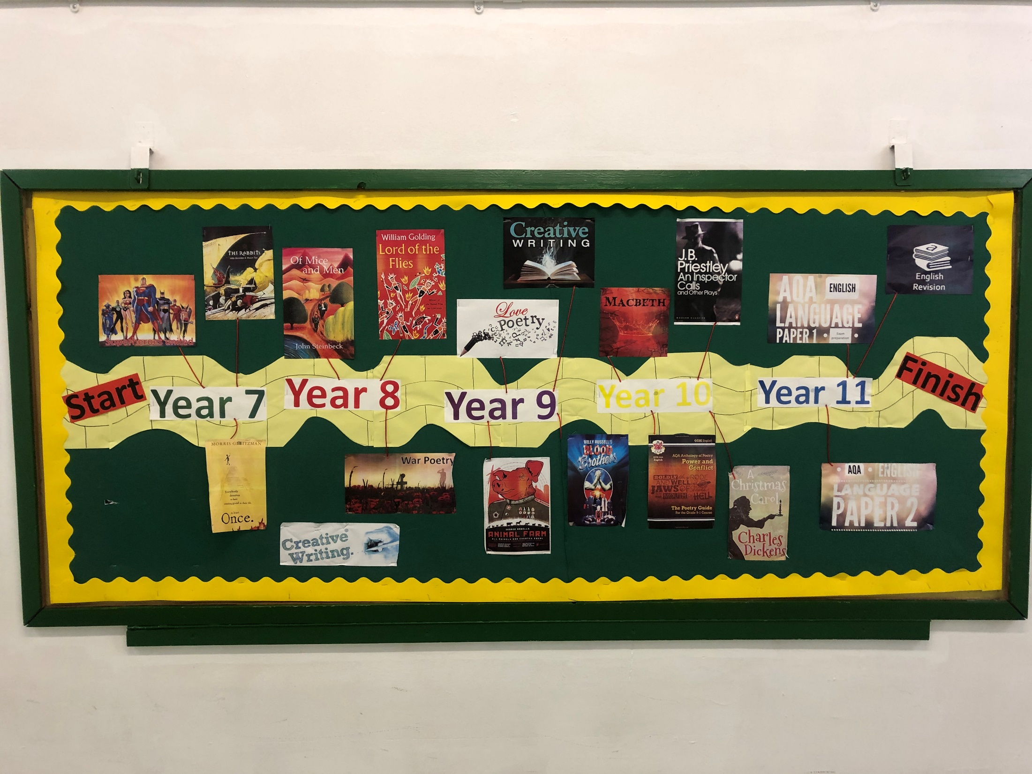

Slide 7
English model
Strands:
Reading
Writing
Speaking & Listening
7
8
9
Creative Writing
Writing
‘Once’
Reading
Superheroes
Writing
Speaking & Listening
‘Rabbits’/Ad You Like it
Reading
Speaking & Listening
Power
‘Of Mice and Men’
Reading
Controversy
Writing/S & L
Poetry – WW1
Reading
Reading
Gothic fiction
Writing
‘Othello’
Key Stage 3
Identity
‘Blood Brothers’
Reading
Poetry - identity
Writing
Dystopian Creative Writing
Writing
Speaking & Listening
‘Animal Farm’
Reading
Speaking & Listening
Class

Slide 8
Why Now?
Previously we learnt…
In the future, we will learn…
INSERT PAST
LEARNING
INSERT LEARNING
INTENTION
INSERT FUTURE
LEARNING
‘Pupils find it hard to link new ideas with what they already know and understand’
Knowledge builds on knowledge: teacher informs or guides learners to reflect on why they are doing what they are doing now

Slide 9
Why Now?
Previously we learnt…
In the future, we will learn…
The Holy Books in the Quran
To learn crucial facts about Prophet Muhammad
The Five Pillars of Islam

Slide 10
“Memory is the residue of thought”
PROFESSIONALISM
INCLUSION
PEDAGOGY
CURRICULUM

Slide 11
“Memory is the residue of thought”
PROFESSIONALISM
INCLUSION
PEDAGOGY
CURRICULUM

Slide 12
“Memory is the residue of thought”
PROFESSIONALISM
INCLUSION
PEDAGOGY
CURRICULUM

Slide 13
“Memory is the residue of thought”
Learning Intention:
Success Criteria:
1)
2)
3)
Word of the Day/Week: introduce sophisticated vocabulary to be used by all students in the lesson
Last lesson: retrieval question from last lesson
Last week/fortnight : retrieval question from last week
Last term: retrieval question based on last half term’s learning (from second half term onwards)
Last year: retrieval question based on last year’s learning (KS4)
Challenge: How might these questions/topics link together?
Low stakes high challenge ‘do now’ silent quiz whilst register is being taken. Misconceptions are corrected by students sharing answers and correcting in green pen
‘Many teachers do not routinely check that pupils understand what they have learned’

Slide 14
Five Pillars of Islam
c\w
LI: To develop understanding on the Five Pillars of Islam and how the affect Muslims’ lives
SUCCESS CRITERIA:
Recap prior learning on the Islam unit of work so far
Identify what some sources of authority are for Muslims
Prepare a presentation on one of the five Pillars of Islam
Word of the Day/Week: Shahadah: For Muslims this is a declaration (announcement) of faith
Last lesson: What happened to Prophet Muhammad when he was 40 and 54?
Two weeks ago: Which significant events happened in Prophet Muhammad’s early life and how might they have affected him?
Two weeks ago: Name three similarities between the Abrahamic faiths?
Last term: Name three ways active citizens can protest

Slide 15
Cognitive Science in Curriculum Design: Takeaway actions
s
Discuss
Create
Why is our curriculum structured this way?
What is the overarching big idea in each year group?
What might need to be edited and why?
When will this take place?
PROFESSIONALISM
INCLUSION
PEDAGOGY
CURRICULUM

Slide 16
Cognitive Science in Curriculum Design: reflection
s
Every Child
Every Lesson
Findings and observations
Q&A
LPS Lesson Expectations:
‘Why Now?’
Challenge in retrieval over time
PROFESSIONALISM
INCLUSION
PEDAGOGY
CURRICULUM

Slide 17
Why Now?
Previously we learnt…
In the future, we will learn…
INSERT PAST
LEARNING
INSERT LEARNING
INTENTION
INSERT FUTURE
LEARNING
Knowledge builds on knowledge: teacher informs or guides learners to reflect on why they are doing what they are doing now

Slide 18
“Memory is the residue of thought”
Learning Intention:
Success Criteria:
1)
2)
3)
Word of the Day/Week: introduce sophisticated vocabulary to be used by all students in the lesson
Last lesson: retrieval question from last lesson
Last week/fortnight : retrieval question from last week
Last term: retrieval question based on last half term’s learning (from second half term onwards)
Last year: retrieval question based on last year’s learning (KS4)
Challenge: How might these questions/topics link together?
Low stakes high challenge ‘do now’ silent quiz whilst register is being taken. Misconceptions are corrected by students sharing answers and correcting in green pen

