Slide 1
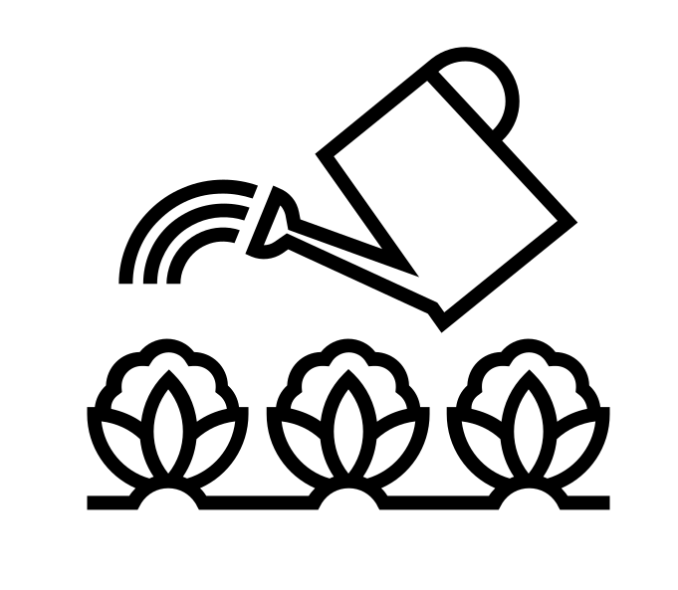
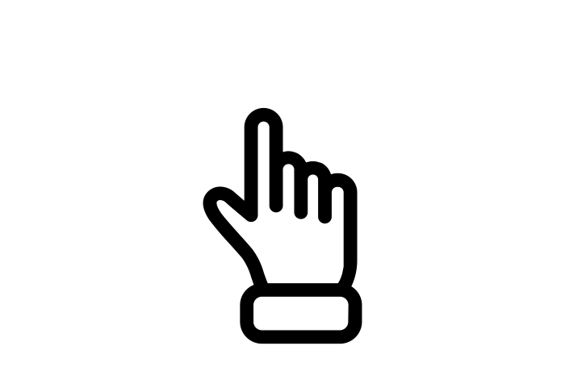
Responsive Curriculum Planning
Why responsiveness matters?
What is responsive curriculum planning?
Responsive Curriculum Planning
Faculty implementation
PROFESSIONALISM
INCLUSION
PEDAGOGY
CURRICULUM

Slide 2
Why Now?
Previously we have…
We are now…
In the future, we will…
Explored how to be responsive within the LPS Lesson Expectations
Exploring responsive curriculum planning
Have curriculum planning time & see the CPD plan for 2022-2024

Slide 3
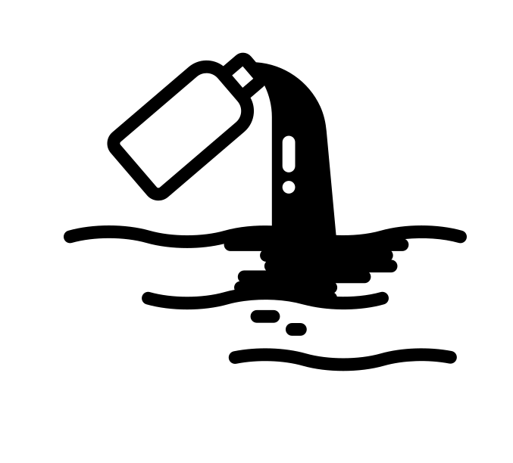
Why does responsiveness matter?
Professor Reis distinguishes between:
Responsiveness
which improves relationships
Unresponsiveness
which worsens relationships
Blindly offering care
is egoistical for the giver and does not improve relationships
Reis, H. (2007). Steps toward the ripening of relationship science. Personal Relationships, 14, pp.1–23
PROFESSIONALISM
INCLUSION
PEDAGOGY
CURRICULUM

Slide 4
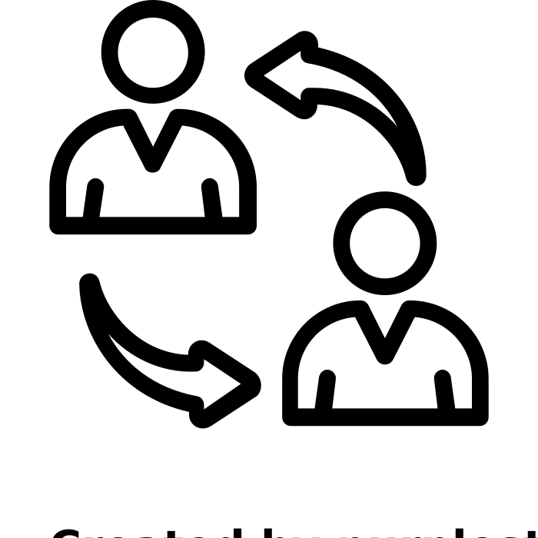
Responsive Curriculum Planning
Responsive teaching
Responding: adapting our live teaching to support students to do better
Responsive curriculum implementation
Adapting upcoming lessons so that curriculum intentions and optimal standards are realized, particularly for underachieving students
PROFESSIONALISM
INCLUSION
PEDAGOGY
CURRICULUM

Slide 5
Responsive Curriculum Planning: How to guide
Speculation
What do you think Year X are missing in knowledge and skills to be prepared and equipped for Year Y?
Confirmation
Is there evidence of this? (QLA, work scrutiny, mini tests, one larger assessment etc)
Adaptation*
How will you tweak* lessons from term 6 until the end of the academic year?
Faculty actions
Discuss as a faculty: Y9, Y10 and or Y12
Gather evidence to support speculation
*add/update models, explanations, retrieval activities, main tasks etc
PROFESSIONALISM
INCLUSION
PEDAGOGY
CURRICULUM

