Slide 1
Safeguarding education: raising standards and expectations
We will be starting in…
Every Child
Every Lesson
PROFESSIONALISM
INCLUSION
PEDAGOGY
CURRICULUM

Slide 2
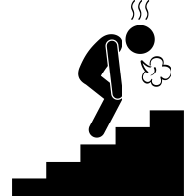
Where might we have made the most progress and how?
‘Pupils find it hard to link new ideas with what they already know and understand’
‘Some teaching is not focused on ensuring that pupils understand and remember’
‘Many teachers do not routinely check that pupils understand what they have learned’
‘These weaknesses mean that pupils are not prepared effectively to study more demanding concepts in the future’
‘Some teaching does not introduce pupils to content in a useful way’
The LPS Lesson Expectations
Feedback & Assessment Policy
Stretch + Challenge
& The QET
Why Now?
‘Leaders have not planned pupils’ learning well’
‘Sometimes, pupils’ errors or misconceptions are not corrected’
‘Gaps in pupils’ understanding’
PROFESSIONALISM
INCLUSION
PEDAGOGY
CURRICULUM

Slide 3
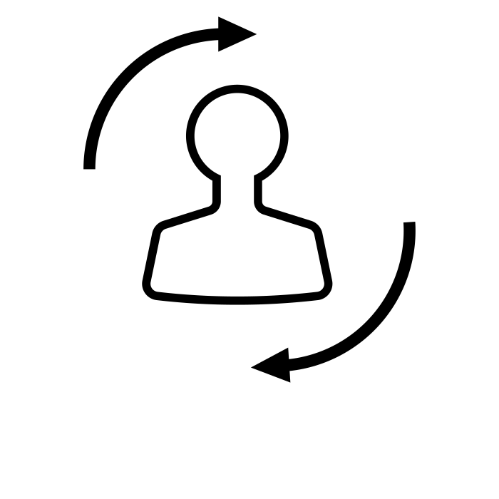
Responsive teaching & LPS Lesson Expectations
National & Local Picture
Pedagogy & Strategies
Responsive teaching & LPS Lesson Expectations
Implementation
PROFESSIONALISM
INCLUSION
PEDAGOGY
CURRICULUM

Slide 4
Why Now?
Previously we have…
We are now…
In the future, we will…
Reviewed what success looks like for all students in each Key Stage
Reviewing how the Lesson Expectations can be used as response teaching tools
Analyse KS5 standards and facilitate subject-specific CPD

Slide 5
How can we ‘routinely check’?
‘Sometimes, pupils’ errors or misconceptions are not corrected’
Feedback & Assessment Policy
‘Many teachers do not routinely check that pupils understand what they have learned’
PROFESSIONALISM
INCLUSION
PEDAGOGY
CURRICULUM

Slide 6
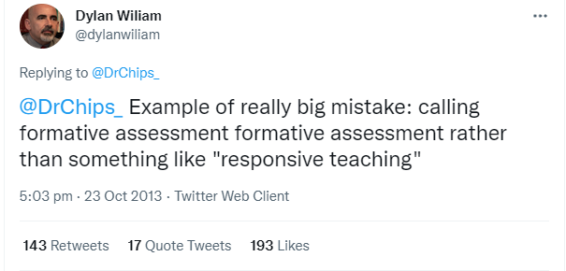
National Picture: responsive teaching and not AfL?
... the moment-to-moment decisions that you make as you observe and analyse your students' behaviours
Not as effective if they do not inform…
PROFESSIONALISM
INCLUSION
PEDAGOGY
CURRICULUM

Slide 7
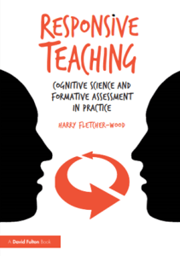
National Picture: responsive teaching and not AfL?
His working definition of responsive teaching is that it is:
Setting clear goals and planning learning carefully
Identifying what students have understood and where they are struggling
Responding, adapting our teaching to support students to do better.
PROFESSIONALISM
INCLUSION
PEDAGOGY
CURRICULUM

Slide 8
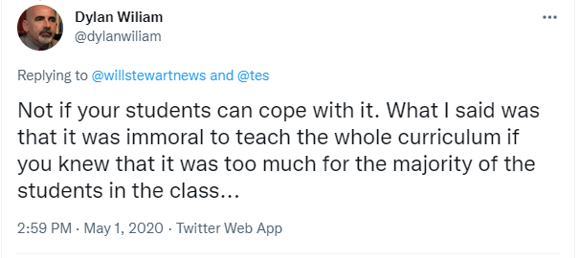
Why aren’t we always responsive?
Professor Reis distinguishes between:
Responsiveness – which improves relationships
Unresponsiveness – which worsens them
Blindly offering care – which is egoistical for the giver, and does not improve relationships.
Reis, H. (2007). Steps toward the ripening of relationship science. Personal Relationships, 14, pp.1–23
PROFESSIONALISM
INCLUSION
PEDAGOGY
CURRICULUM

Slide 9
Why must we always be responsive?
“Cognizant of” – aware of how students are: what have they understood? Where are they stuck? What do they need?
“Sensitive to” – caring about how students are doing; accepting that missteps and misconceptions are inevitable in learning and that it is our duty as teachers to help students beyond them
“Behaviorally supportive” – taking steps to support students: adapting teaching to meet their needs
Reis, H. (2007). Steps toward the ripening of relationship science. Personal Relationships, 14, pp.1–23
PROFESSIONALISM
INCLUSION
PEDAGOGY
CURRICULUM

Slide 10
How could we make each of these a responsive tool?
Retrieval - Think Hard
Why Now?
Self/Peer Assessment
Modelling
Talk Partners
Stretch + Challenge
Independent Work
Consolidate learning
PROFESSIONALISM
INCLUSION
PEDAGOGY
CURRICULUM

Slide 11
Responsive teaching
Individually reflect on how you might use the Lesson Expectations responsively
Stretch: Which impactful strategies have you used in the past or have heard of that could used?
Challenge: how could you lead on these strategies to ensure all teachers in your area regularly implement them?
Write down your strategies/ideas
Share your strategies with those on your table and capture new ideas
PROFESSIONALISM
INCLUSION
PEDAGOGY
CURRICULUM

Slide 12
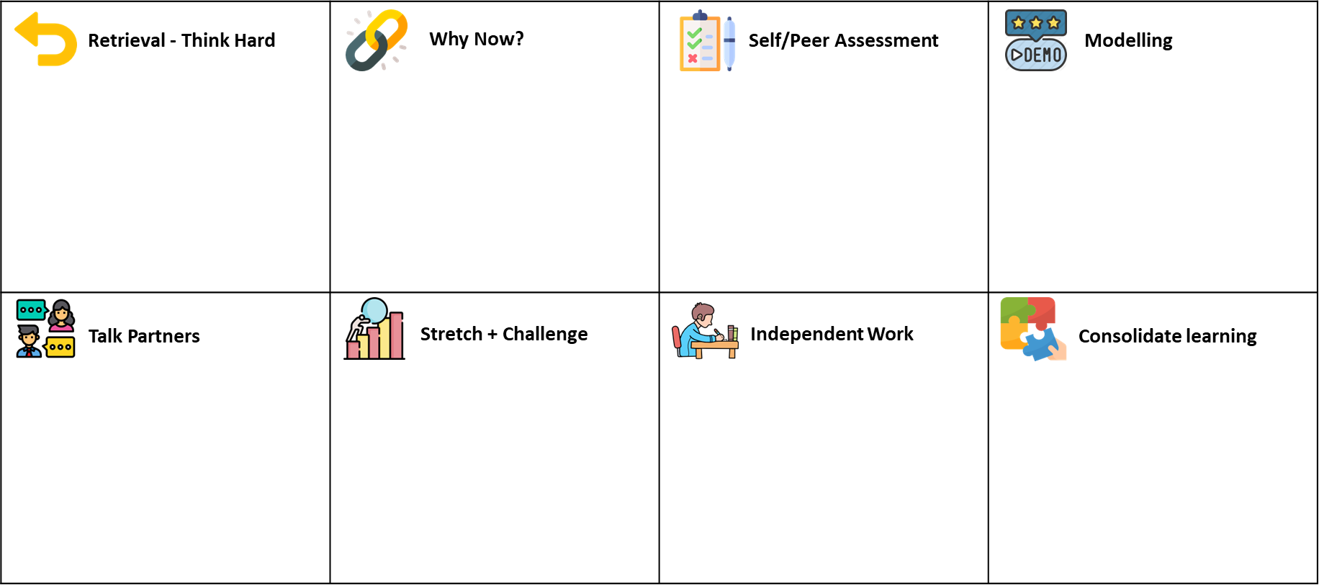
Responsive teaching : Takeaway actions
s
QET Learning Walk follow up: 19/4 – 06/05
Reflect
Implement
To what extent am I responsive, unresponsive or blindly offering care?
How often am I racing through to get to the end/assessment/exam without adapting my teaching?
Follow the learning: each technique should be used to check learning and adapt teaching
PROFESSIONALISM
INCLUSION
PEDAGOGY
CURRICULUM

