Slide 1
Safeguarding education: raising standards and expectations
‘What is clear from more fine-grained analysis carried out over recent years is that it matters very much which teachers are teaching you.’
Dylan Wiliam – The Importance of Teaching
Every Child
Every Lesson
PROFESSIONALISM
INCLUSION
PEDAGOGY
CURRICULUM

Slide 2
LPS Lesson Expectations
Students behind the numbers
Minimising variation
Collaborative planning
Revisiting the LPS Lesson Expectations
PROFESSIONALISM
INCLUSION
PEDAGOGY
CURRICULUM

Slide 3
Why Now?
Previously we have…
We are now…
In the future, we will…
Explored how to be responsive within the LPS Lesson Expectations
Revisiting the LPS Lesson Expectations to minimize variation
Launch the CPD programme for 2022-24 themed: ‘Be Ambitious’

Slide 4
Safeguarding education: barriers to success
Every Child
Every Lesson
PROFESSIONALISM
INCLUSION
PEDAGOGY
CURRICULUM

Slide 5
Safeguarding education: minimising variation
‘What is clear from more fine-grained analysis carried out over recent years is that it matters very much which teachers are teaching you.’
Dylan Wiliam – The Importance of Teaching
PROFESSIONALISM
INCLUSION
PEDAGOGY
CURRICULUM

Slide 6
LPS Lesson Expectations
Retrieval - Think Hard
Starter questions: last lesson; week/fortnight; term; year
Why Now?
Link present to past and future learning
Self/Peer Assessment
Reflection & feedback on past or current learning
Modelling
Models/modelling of new knowledge or skills
Talk Partners
Think (wait), Pair, Prepare (write*), Share
*In applicable subjects
Stretch + Challenge
‘Teach to the top’ with separate S & C tasks/questions
Independent Work
Expect, direct & manage independent application
Consolidate learning
Review learning; discuss next steps; celebrate good work & the 4BEs*
*Award achievement points

Slide 7
Safeguarding education: collaborative planning
Which unit, topic, skill or procedure do yours students find the most challenging?
What might you do in each of the LPS Lesson Expectations to address this?
In pairs/trios, share your expertise and plan one lesson
PROFESSIONALISM
INCLUSION
PEDAGOGY
CURRICULUM

Slide 8
Safeguarding education: collaborative planning
1) Challenging area:
Literary theory (psychoanalytical theory; Marxist theory; postcolonial theory; feminist theory; moral theory etc)
2) Stimulus for the lesson:
Which topic, skill or procedure do yours students find the most challenging?
PROFESSIONALISM
INCLUSION
PEDAGOGY
CURRICULUM

Slide 9
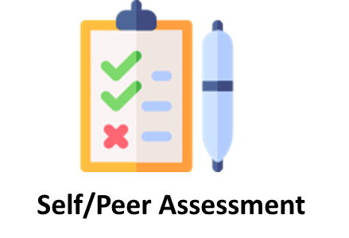
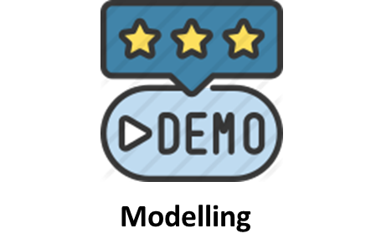
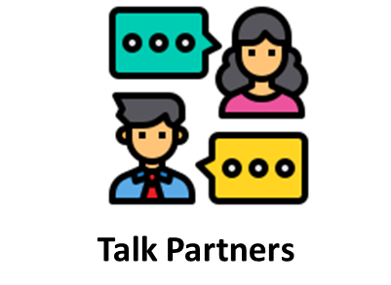
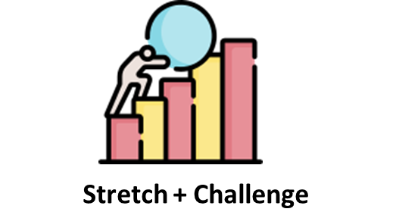
Class:
Year 12
A Level English
Questions relating to the presentation of women, races and social classes in texts they have studied in the past
Past – own interpretations
Present – wider readings of texts
Future – comparing contrasting readings
Introduce and model the use of one of the critical theory perspectives in the analysis of Where the Wild Things Are
Questions peer assessed
Students discuss how their assigned critical perspective could be seen in Where the Wild Things Are
Summaries the inferences developed from their critical perspective being applied to Where the Wild Things Are
Students are stretched to apply multiple critical perspectives, and challenged to develop thoughtful interpretations on texts previously studied
Students explain what the critical perspectives are and how they could be used in literary analysis
PROFESSIONALISM
INCLUSION
PEDAGOGY
CURRICULUM

Slide 10
Safeguarding education: collaborative planning
Which topic, skill or procedure do yours students find the most challenging?
What might you do in each of the LPS Lesson Expectations to address this?
In pairs/trios, share your expertise and plan one lesson
PROFESSIONALISM
INCLUSION
PEDAGOGY
CURRICULUM

Slide 11
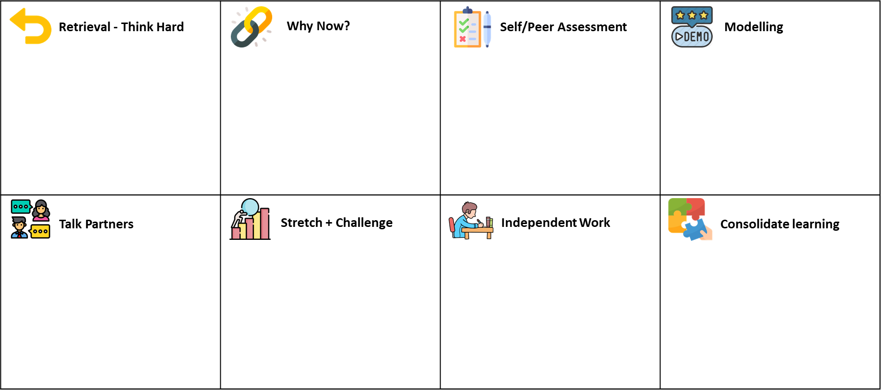
LPS Lesson Expectations: Takeaway actions
s
Reflect
Implement
How could time be saved and impact be improved through collaborative planning?
How could curriculum implementation be improved through collaborative planning?
Responsive teaching: each technique should be used to check learning and adapt teaching
LPS Lesson Expectations examples can be found in our Google Classroom
PROFESSIONALISM
INCLUSION
PEDAGOGY
CURRICULUM

