Slide 1
Safeguarding education: raising standards and expectations
“One of the reasons why talk is undervalued is that there is a tendency to see its function as primarily social… but... talk in classrooms is cognitive and cultural as well as social.”
Alexander, Robin John, Improving oracy and classroom talk: achievements and challenges. (2013)
Every Child
Every Lesson
PROFESSIONALISM
INCLUSION
PEDAGOGY
CURRICULUM

Slide 2
Oracy - Evaluated
Retrieve our learning on the importance of oracy
Faculty implementation
Class teacher implementation
Be Ambitious:
Oracy
PROFESSIONALISM
INCLUSION
PEDAGOGY
CURRICULUM

Slide 3
Why Now?
Previously we …
We are now…
In the future, we will…
Reviewed how improving our students’ oracy can improve their life chances
Evaluating our thought stems and how we will effectively implement them
Explore the importance of reading and how we can be ambitious in our curriculum

Slide 4
CPD Overview 2022-24
Think/Speak
Read
Write*
Be Ambitious
CPD Theme 2022-24
=
Oracy
Curriculum
Responsive Teaching
*Different for performance based subjects
Term 1 & 4
Term 2 & 5
Term 3 & 6
PROFESSIONALISM
INCLUSION
PEDAGOGY
CURRICULUM

Slide 5
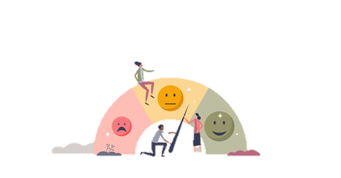
CPD Implementation 2022-24
….Arsenal are top of the premier league
Explained
(06/09/22)
Explored
(faculty twilight 20/09/22)
Evaluated
(04/10/22)
PROFESSIONALISM
INCLUSION
PEDAGOGY
CURRICULUM

Slide 6
National Picture – ‘reading and writing float on a sea of talk’
‘75% arrive to school below average in ………………………….’
‘Teachers at ………………………. place far greater emphasis on developing their students’ verbal communication’
‘To suggest to young people that ……..…….and …………….. alone are enough to land jobs in the top professions does a disservice to young people’
In classrooms where there are ………………………….., teachers ……….. & students …………
Britton, J. Language and Learning. Coral Gables, FL: University of Miami Press, 1970
National Literacy Trust, Literacy: State of the Nation – A Picture of Literacy in the UK Today, 2010
Gaunt and Stott, Transform Teaching and Learning Through Talk, 2019
Lingard, Hayes & Mills, Teachers & Schooling Making a Difference, Allen & Unwin 2006
PROFESSIONALISM
INCLUSION
PEDAGOGY
CURRICULUM

Slide 7
Is there a right or wrong way to speak?
PROFESSIONAL
INCLUSIVE
LEARNER
KNOWLEDGEABLE

Slide 8
Be Ambitious: thinking & speaking
LPS students code switch and the most successful are aware of their code switching
Socialising
Family
Place of worship
Classroom
PROFESSIONAL
INCLUSIVE
LEARNER
KNOWLEDGEABLE

Slide 10
When the independent variable increases the dependent variable…
My hypothesis for this investigation is…
Looking at the results………
Having analysed
the data……
Can we prove that…………
The Language of Answering Questions in Science Practicals
There are many advantages
/disadvantages…
The method for this practical is……
The anomalous result is…
This practical can be improved by…
In conclusion…….

Slide 11
CPD Overview 2022-24
Think/Speak
Be Ambitious
CPD Theme 2022-24
=
Oracy
Term 1 & 4
PROFESSIONALISM
INCLUSION
PEDAGOGY
CURRICULUM

Slide 12
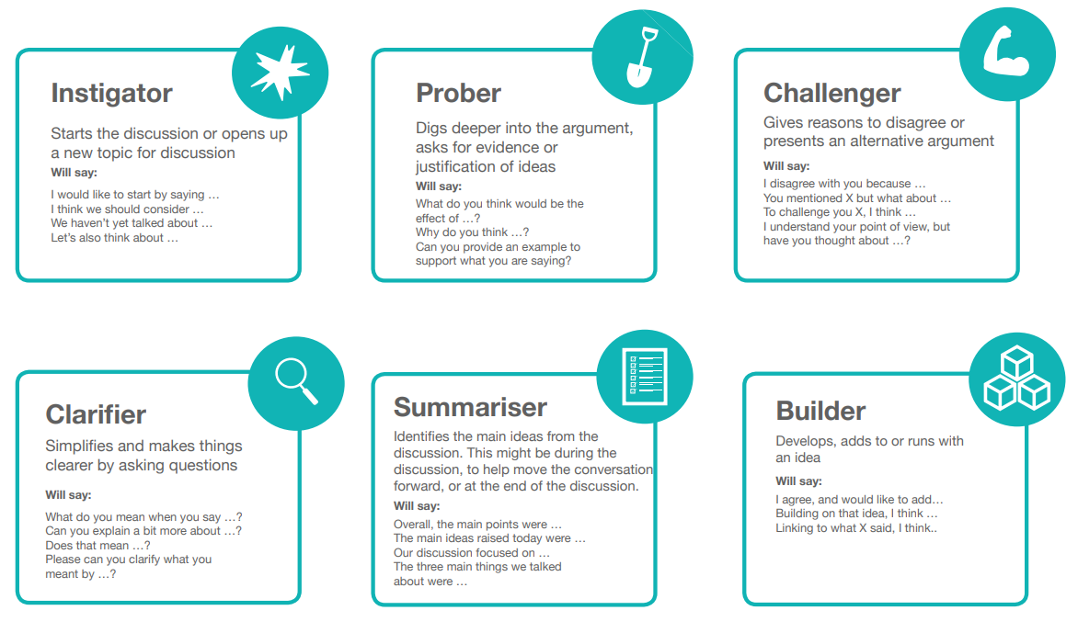
Discussion Roles
Handwriting should be phased out in schools…
PROFESSIONALISM
INCLUSION
PEDAGOGY
CURRICULUM

Slide 13
Thought Stems Implementation
How might you encourage and develop students to use thought stems effectively?
How might you share best practice in the use of thought stems?
How might you check and adapt the use of thought stems?
PROFESSIONALISM
INCLUSION
PEDAGOGY
CURRICULUM

Slide 14
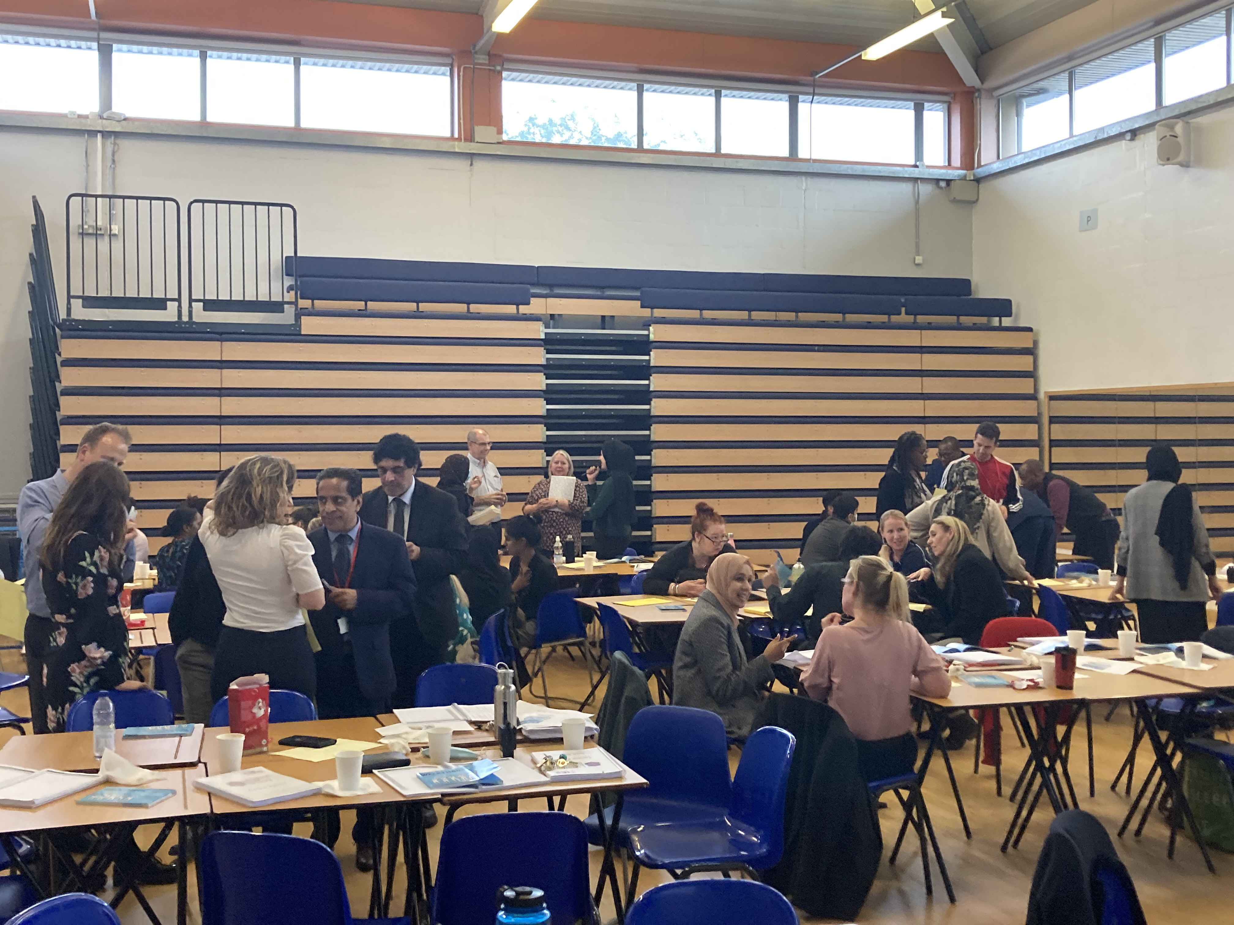
Thought Stems: Knowledge Exchange
One or two teachers will remain seated to present department/faculty thought stems
Teachers will join tables and listen and ask questions about the thought stems
Which thought stems might you find most useful? Might there be any changes you would like to make?
PROFESSIONALISM
INCLUSION
PEDAGOGY
CURRICULUM

Slide 15
‘Words are the clothing that thoughts wear’
We can only say what we can think
We can only write what we can say
David Didua https://learningspy.co.uk/literacy/theory-writing/
Accessed September 2022
PROFESSIONALISM
INCLUSION
PEDAGOGY
CURRICULUM

Slide 16
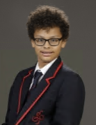
Improving Students’ Life Chances: Oracy
Reflection (06/09/2022)
Spoken language ‘forms a constraint, a ceiling not only on the ability to comprehend but also on the ability to write, beyond which literacy cannot progress’
Damian Eugene
HPA (High Prior Attainment)
Target Grade 7
Current Grade 1 (May PPE)
Myhill and Fisher
PROFESSIONALISM
INCLUSION
PEDAGOGY
CURRICULUM

Slide 17
Be Ambitious – Oracy : Takeaway actions
Reflect
Implement
How could I use
LPS Rules for Communication
Thought Stems and
Ambitious subject specific vocabulary
regularly to ensure the life skill of effective communication is developed in my students and across my faculty?
1) Rules for Communication & Thought Stems
Use to support ambitious curriculum intentions
2) Display Thought Stems
AJO to request how many posters to be created on 5/10/22
PROFESSIONALISM
INCLUSION
PEDAGOGY
CURRICULUM

