Slide 1
Safeguarding education: raising standards and expectations
Professor Reis distinguishes between:
Responsiveness
which improves relationships
Unresponsiveness
which worsens relationships
Blindly offering care
which is egoistical for the giver, and does not improve relationships.
We will be starting in…
Reis, H. (2007). Steps toward the ripening of relationship science. Personal Relationships, 14, pp.1–23
PROFESSIONALISM
INCLUSION
PEDAGOGY
CURRICULUM

Slide 2
KS5 QET & The LPS Book
National & Local Picture
QET Progress Review
KS5 QET & The LPS Book: standards and expectations
Faculty reflection
PROFESSIONALISM
INCLUSION
PEDAGOGY
CURRICULUM

Slide 3
Why Now?
Previously we have…
We are now…
In the future, we will…
Reviewed the progress of QET targets in KS3& KS4
Reviewing the progress of QET targets in KS5
Responsive curriculum plan in response to internal exams and data

Slide 4
Landscape: what is the local picture?
s
Excelling
Underachieving
Name: ………….
Year: 12
Current grade: CCA*
Target grade: DDD
Name: ………….
Year: 12
Current grade: CD-C
Target grade: ABB
PROFESSIONALISM
INCLUSION
PEDAGOGY
CURRICULUM

Slide 5
Landscape: what is the national picture?
s
Shortly you will see six questions relating to the quality of education offered in the sixth form:
How would you answer these questions if you were directed to?
*evidence would include examples of this in the students’ books/folders
Which questions might you feel you/your students will have the least evidence* for?
PROFESSIONALISM
INCLUSION
PEDAGOGY
CURRICULUM

Slide 6
Landscape: what is the national picture?
s
How does teaching and the curriculum build students’ retention of new knowledge?
What should I expect to see in students’ books/folders? How do you ensure common expectations are met?
Independence? How do you know these aspects of the curriculum are effective?
How is reading built into the sixth form curriculum? How are you fostering a culture of academic scholarship?
Tell me how assessment works in the sixth form. How do you ensure that information from assessments is used meaningfully?
How well are students with lower target grades learning the curriculum? How do you know?

Slide 7
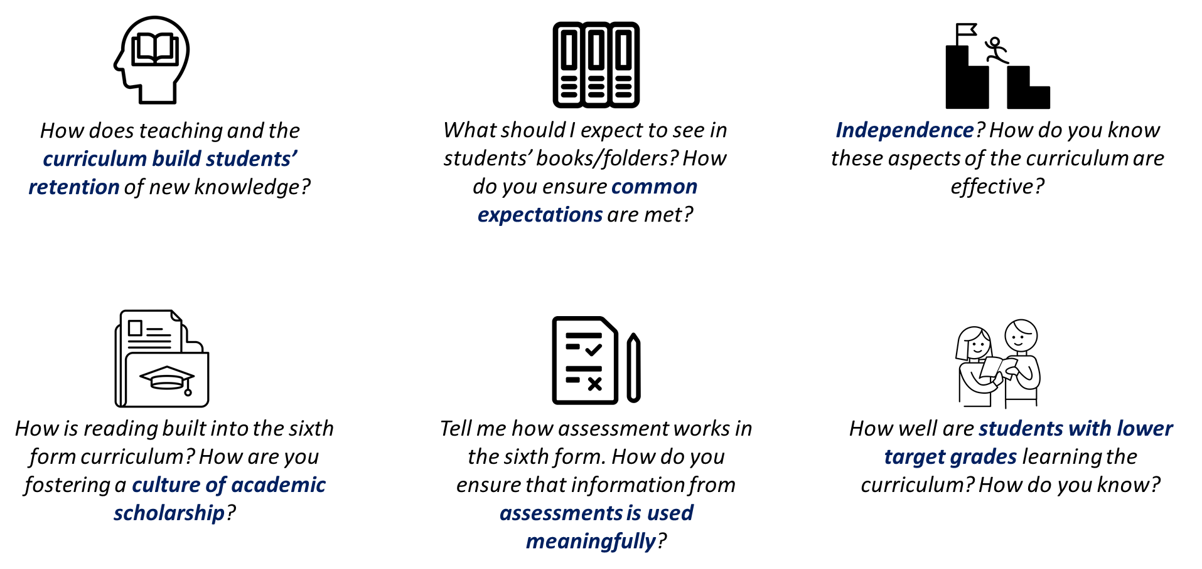
Landscape: what is the national picture?
s
How would you answer these questions if you were directed to?
Which questions might you feel you/your students will have the least evidence* for?
Annotate ideas on how each of these could be evidenced
PROFESSIONALISM
INCLUSION
PEDAGOGY
CURRICULUM

Slide 8
Potential strategies that can be used
How does teaching and the curriculum build students’ retention of new knowledge?
Retrieval slides as with KS3/4
Consolidation through homework
Assessments based on previous learning evidenced through an assessment overview for the year/course.
Revision lessons planned into curriculum map
Homework schedule based on retrieval of previous units.
Independence? How do you know these aspects of the curriculum are effective?
Evidence of flip learning. All work to be dated, even when completed out of lessons.
Evidence of consolidation independently.
All homework tasks to be dated and labelled.
Evidence of super-curriculum tasks.
What should I expect to see in students’ books/folders? How do you ensure common expectations are met?
See KS5 Work Scrutiny Guidance
How is reading built into the sixth form curriculum? How are you fostering a culture of academic scholarship?
Flip learning where pupils read and take notes independently prior to the lesson.
Unit overviews have a list of extended reading, articles, podcasts, documentaries..
Folders of HPA students contain evidence of academic scholarship – notes that are dates and labelled.
Teacher feedback and challenge activities.
How well are students with lower target grades learning the curriculum? How do you know?
Data analysis shows good progress of pupils with lower target grades.
The quality and volume of work is meeting expectations.
There is evidence of additional support provided to students where they are under-achieving to help close the gap.
Tell me how assessment works in the sixth form. How do you ensure that information from assessments is used meaningfully?
Use a tracking sheet documenting feedback and progress on assessments.
Assessments, PEQs (and extended writing if relevant) with diagnostic marking and pupils responding to teacher feedback.
Evidence of responsive teaching include re-teaching topics if necessary.

Slide 9
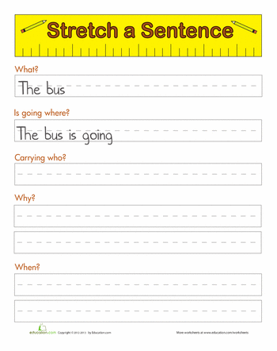
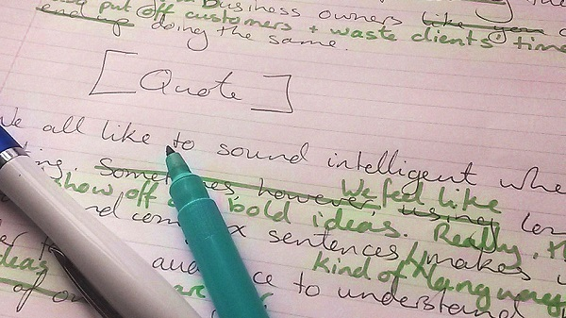
The LPS Book: standards & expectations
Are HPA books visibly different to MPA books?
Volume & quality of work
Visible evidence of HPA challenge
Visible evidence of SEND support
Frequent green pen responses to misconceptions
Differentiation/Reasonable adjustments & support
PROFESSIONALISM
INCLUSION
PEDAGOGY
CURRICULUM

Slide 10
The LPS Book: faculty reflection
Which of the four priority areas might be the greatest area for development in your faculty?
Discuss how you could support one another in these areas
HoF/HoD take note of teachers’ areas for development
PROFESSIONALISM
INCLUSION
PEDAGOGY
CURRICULUM

Slide 11
KS5 QET & The LPS Book: Takeaway actions
s
Reflect
Implement
Should standards evidenced on KS5 books be the same or better than KS3 & KS4?
QET Work Scrutiny follow up: 13/06 – 04/07
PROFESSIONALISM
INCLUSION
PEDAGOGY
CURRICULUM

