Slide 1
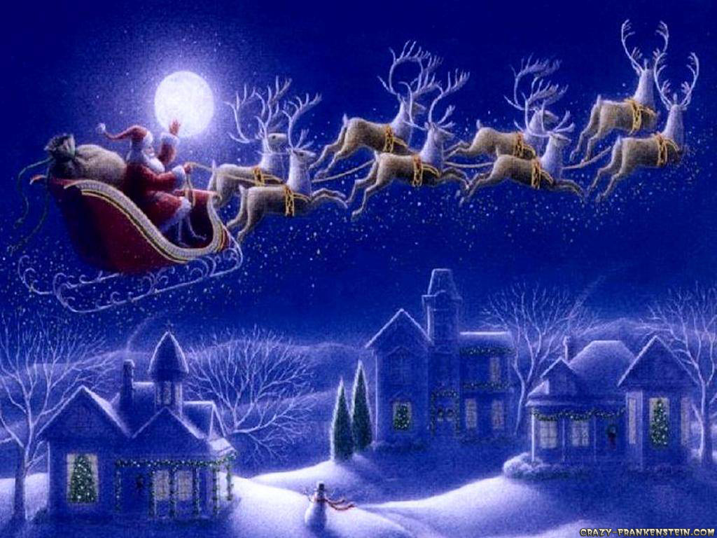
Miss Sattaur Presents: Cultural Capital Wednesday
Week: 13 | Topic: (Special Edition) Christmas
Cultural Capital
Wednesday
Week 13: Christmas.

Slide 2
Miss Sattaur Presents: Cultural Capital Wednesday
Week: 13 | Topic: (Special Edition) Christmas
Level : Easy
How many name can you think of for Santa Claus?
Father Christmas (U.K.)
Santa Claus
Babbo Natale
(Italy)
Pere Noel
(France & Belgium)
Joulupukki
(Finland)
Papai Noel
(Brazil)
Kerstman
(Netherlands)
Viejo Pascuero
(Chile)
Dun Che Lao Ren
(China)
Kanakaloka
(Hawaii)
Weihnachtsmann
(Germany)

Slide 3
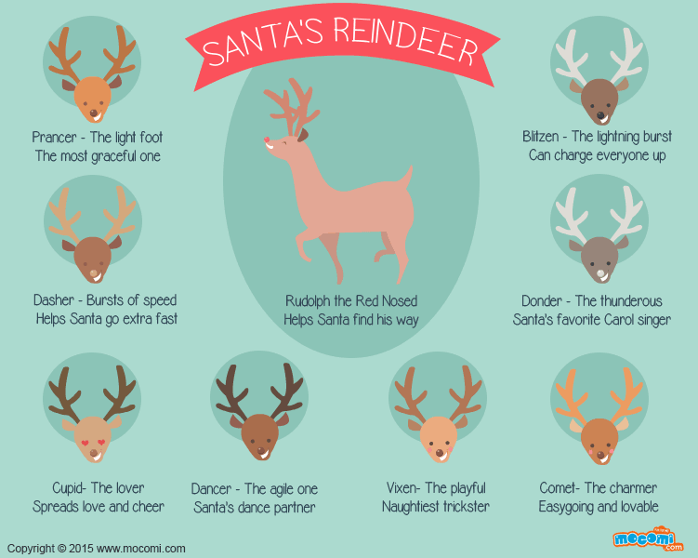
Miss Sattaur Presents: Cultural Capital Wednesday
Week: 13 | Topic: (Special Edition) Christmas
Level: Medium
Can you name all of Santa’s reindeer?
?
?
?
?
?
?
?
?
?

Slide 4
Miss Sattaur Presents: Cultural Capital Wednesday
Week: 13 | Topic: (Special Edition) Christmas
Level : Difficult
Can you name these Christmas songs?
Dashing through the snow/In a one-horse open sleigh/ Over the fields we go/ laughing all the way/ Bells on bobtail ring/ making spirits bright/…
You better watch out/ You better not cry/ You better not pout/ I’m telling you why /…
I don’t want a lot for Christmas/ There is just one thing I need/ I don’t care about the presents underneath the Christmas tree/…
Santa Claus in Coming to Town
All I Want for Christmas Is You
Jingle Bells
Chestnuts roasting on an open/ Jack Frost nippin’ at you nose/ Yuletide carols being sung by a choir/ And folks dressed up like Eskimos/…
Sleigh bells ring, are you listening?/In the lane, snow is glistening/ A beautiful sight/ we’re happy tonight/…
Should auld acquaintance be forgot/ and never brought to mind/ Should auld acquaintance be forgot/ and days of…
The Christmas Song
Walking in a Winter Wonderland
Auld Lang Syne

Slide 5
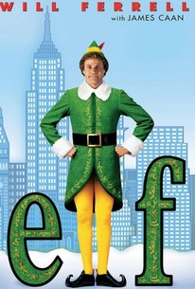
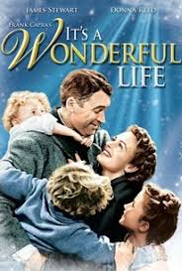
Miss Sattaur Presents: Cultural Capital Wednesday
Week: 13 | Topic: (Special Edition) Christmas
Level : Impossible
Can you name these Christmas movies?
?
?
?
?
?
?

Slide 6
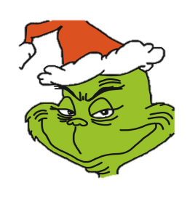
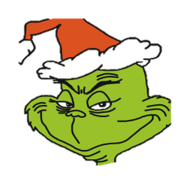
Miss Sattaur Presents: Cultural Capital Wednesday
Week: 13 |  | Topic: (Special Edition) Christmas
21-24
17-20
How well did you do?
13-16
9-12
5-8
0-4

