Slide 1
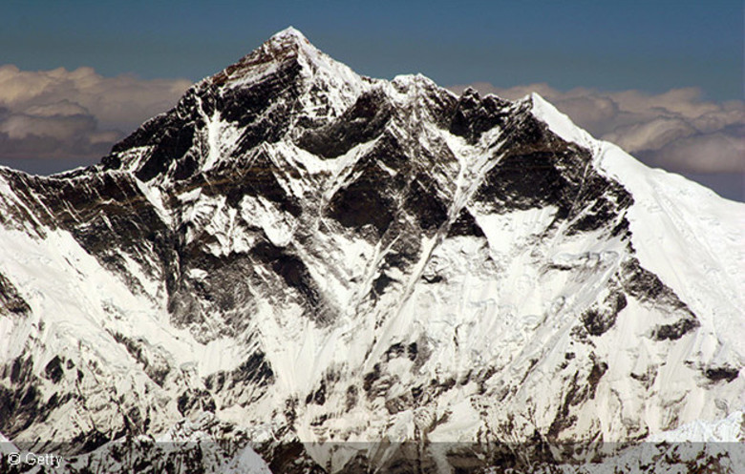
Miss Sattaur Presents: Cultural Capital Wednesday
Week: 22 | Topic: Guinness World Record Holders
Cultural Capital
Wednesday
Week 22: Guinness World Record holders

Slide 2
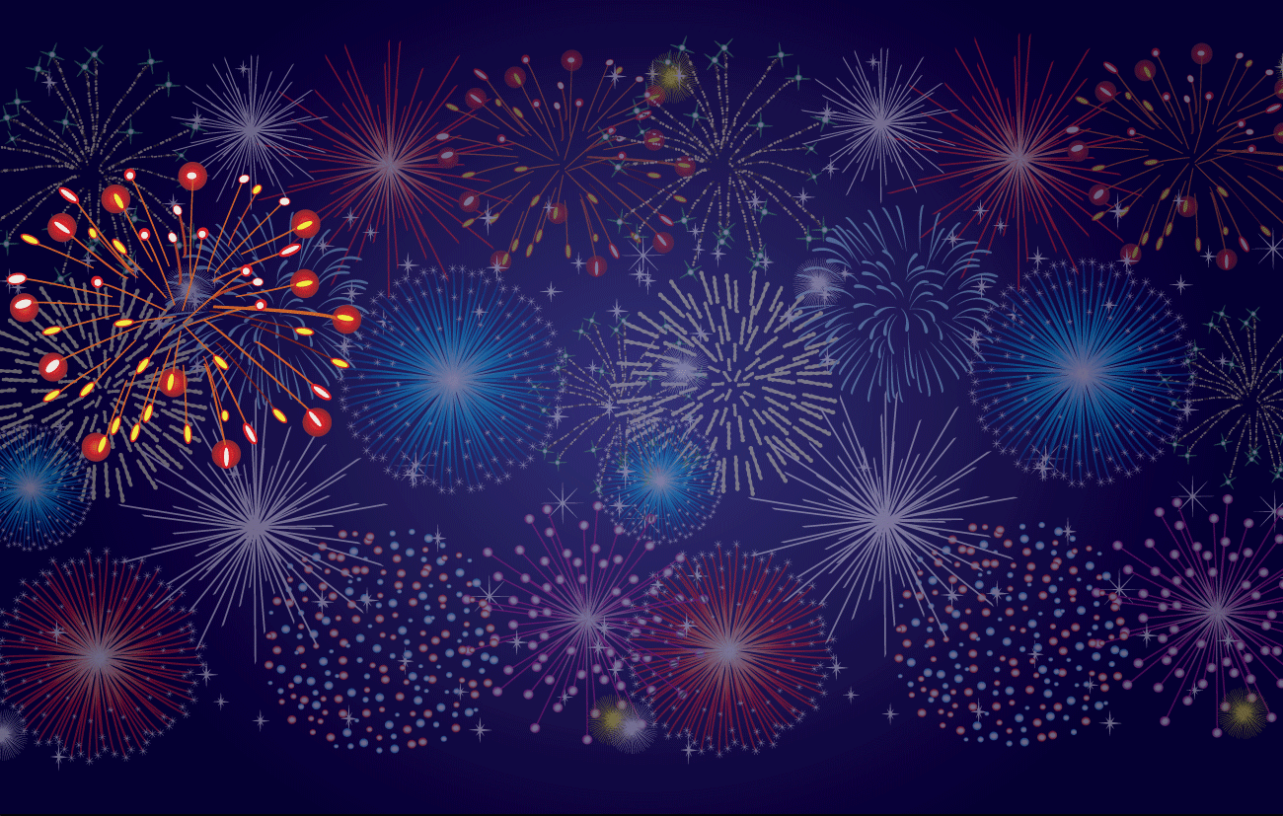
The cleverest
forms are…
8G
9A
This could have been you.

Slide 3
Didn’t see your name or form?
Try again next quiz.
The cleverest
students are…
Yusuf 8G
Ibrahim 8G
Muktasid 8G
Basit 8G
Alesha 8G
Sajid 8G
Nehaeh 8G
Masud 8G
Humaira 8G
Ismam 8G

Slide 4
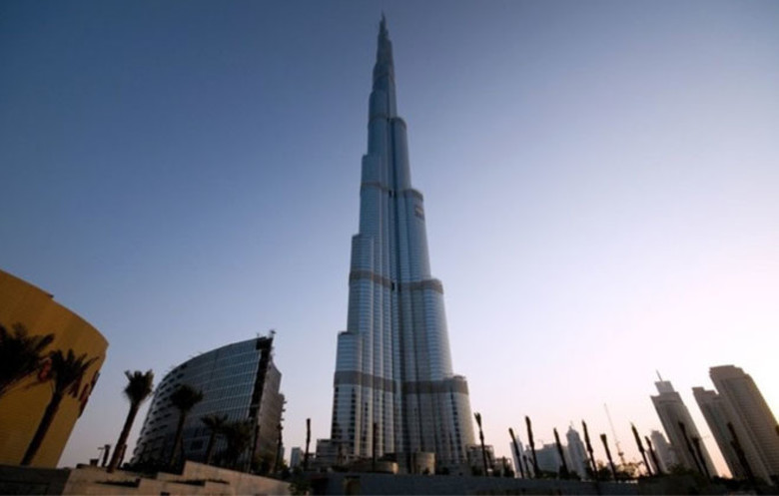
Miss Sattaur Presents: Cultural Capital Wednesday
Week: 22 |  | Topic: Guinness World Record Holders
Level : Easy
The Burj Khalifa (Khalifa Tower) measures 828 m (2,716 ft 6 in) tall. |  |  | What record does the Burj Kalifa hold?
 |  |  | A) The tallest man-made structure on land.
 |  |  | B) The tallest man-made structure ever.
 |  |  | C) The tallest man-made structure on land.
 |  |  | D) The tallest man-made business structure.

Slide 5
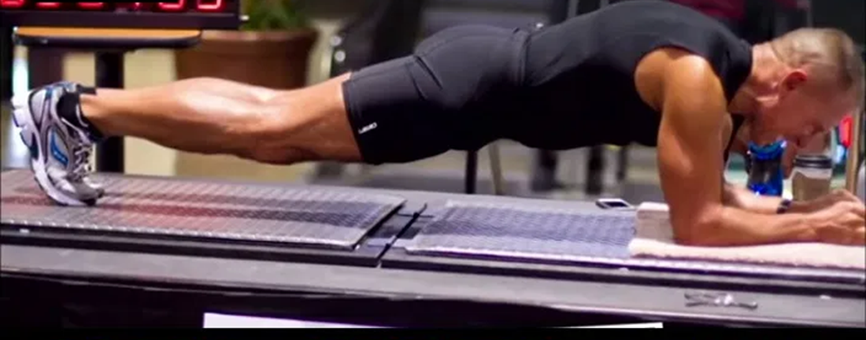
Miss Sattaur Presents: Cultural Capital Wednesday
Week: 22 |  | Topic: Guinness World Record Holders
Level : Medium
This is George Hood. He is a former US marine and has recently set the Guinness world record for holding the world’s longest plank.
 | How long was he able to hold his plank?
 | A) 4Hrs 2mins |  | B) 6Hrs 9mins | C) 8Hrs 15mins | D) 14Hrs 1mins

Slide 6
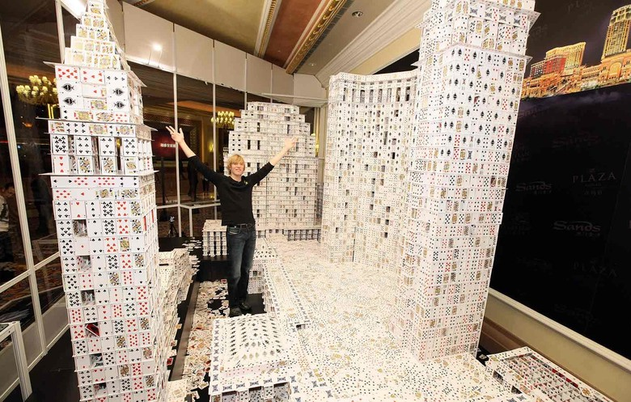
Miss Sattaur Presents: Cultural Capital Wednesday
Week: 22 |  | Topic: Guinness World Record Holders
Level : Difficult
Bryan Berg holds the Guinness world record for largest structure made with playing cards. It is 10.39 m long, 2.88 m tall and 3.54 m wide and took 44 days to complete. |  |  | How many playing cards did Bryan use?
 |  |  | A) 109, 554
 |  |  | B) 219, 792
 |  |  | C) 313, 222
 |  |  | D) 400, 000

Slide 7
Miss Sattaur Presents: Cultural Capital Wednesday
Week: 22 |  | Topic: Guinness World Record Holders
Level : Impossible
Mount Everest (in China and Nepal) was discovered to be the world's highest mountain in 1856 by the Survey Department of the Government of India. |  |  | How tall is the highest peak of Mount Everest?
 |  |  | A) 8848m
 |  |  | B) 9948m
 |  |  | C) 10,048m
 |  |  | D) 11,048m

Slide 8
Miss Sattaur Presents: Cultural Capital Wednesday
Week: 22 |  | Topic: Guinness World Record Holders
4
Great!
How well did you do?
3
Good.
2
Decent.
1
bad.
0
You should read more.

