Slide 1
Cultural Capital Contest
Name & Form:
01.
02.
03.
04.
05.
06.
07.
08.
09.
10.
11.
12.
13.
14.
15.
Cultural Capital Contest
Name & Form:
01.
02.
03.
04.
05.
06.
07.
08.
09.
10.
11.
12.
13.
14.
15.
Cultural Capital Contest
Name & Form:
01.
02.
03.
04.
05.
06.
07.
08.
09.
10.
11.
12.
13.
14.
15.

Slide 2
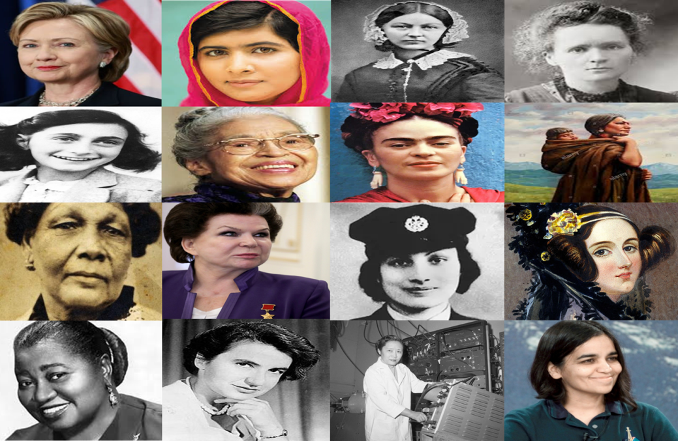
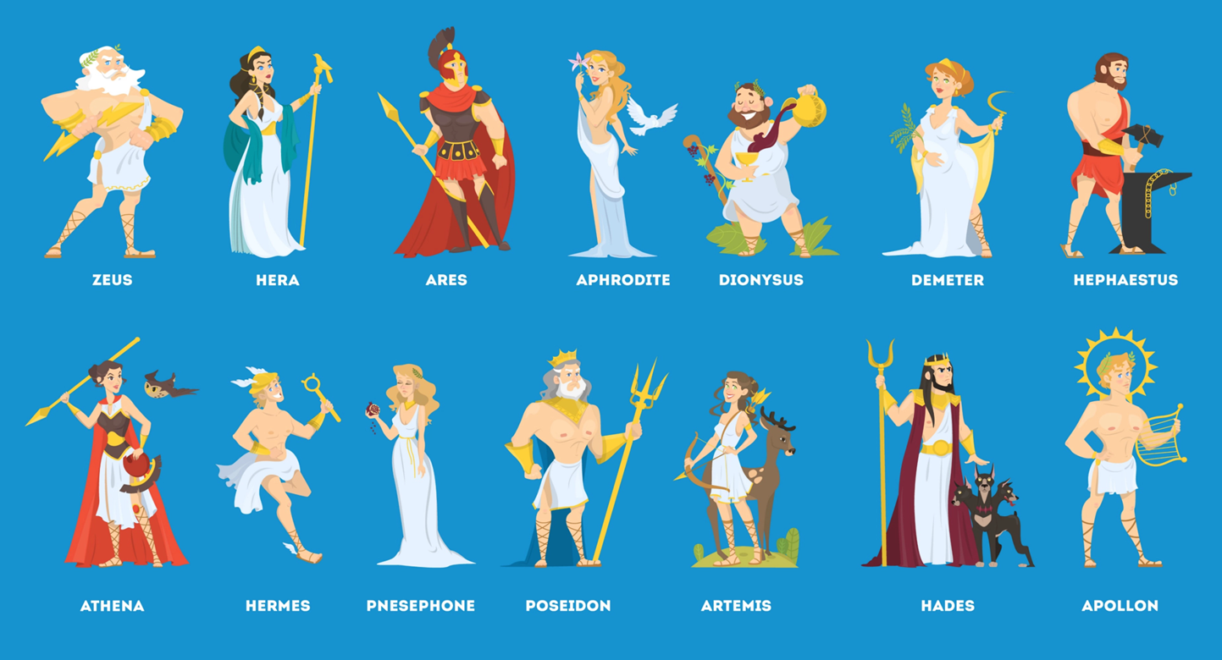
Miss Sattaur Presents: Cultural Capital Wednesday
Week: 21 | Topic: QUIZ 5
Cultural
Capital
Wednesday
Week 21: Quiz 5

Slide 3
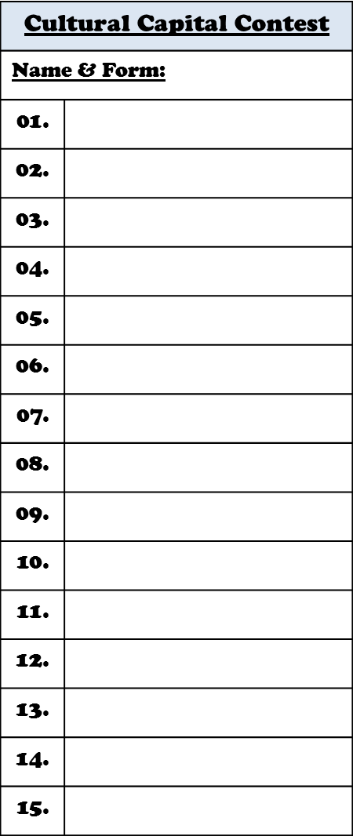
Miss Sattaur Presents: Cultural Capital Wednesday
Week: 21 | Topic: QUIZ 5
Instructions:
 |  | STUDENTS: Using the Cultural Capital Contest ballot sheet provided to you by your form tutor, fill-in the correct answers to questions on the following slide. Submit your ballot sheet to HUM2. Students who get all the answer correct will be named on next weeks slide as one of the “cleverest students in the school.” Forms that get the most answers right as group will also be named “cleverest form in the school.”

Slide 4
In case you forgot, last months winners were…

Slide 5
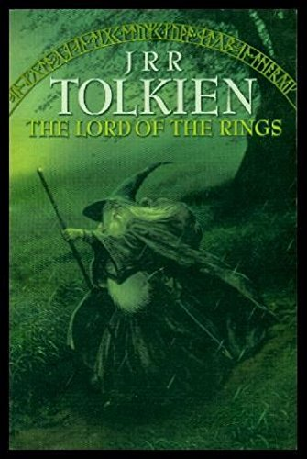
Miss Sattaur Presents: Cultural Capital Wednesday
Week: 21 | Topic: QUIZ 5
Questions 1 – 5: rearrange these books into chronological order
Answer 1 here
Answer 2 here
Answer 3 here
a
c
Answer 4 here
b
Answer 5 here
Romeo & Juliet
The Lord of the Rings
To Kill a Mockingbird
d
e
Oliver Twist
100 Year of Solitude

Slide 6
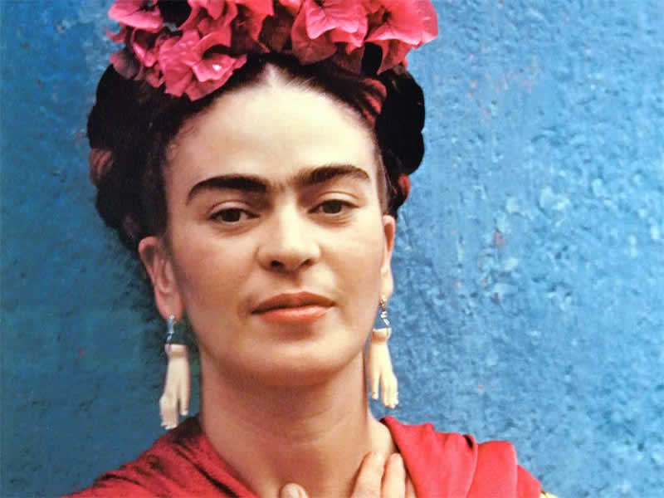
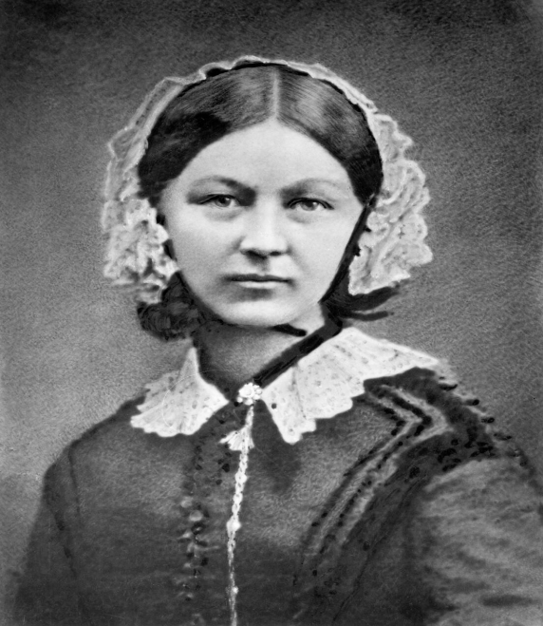
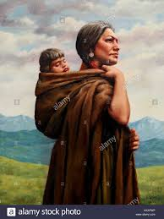
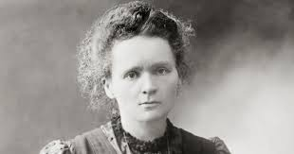
Miss Sattaur Presents: Cultural Capital Wednesday
Week: 21 | Topic: QUIZ 5
Questions 6 – 9: Name these notable women
Answer 6 here
Answer 7 here
Answer 8 here
Answer 9 here
6.
7.
8.
9.

Slide 7
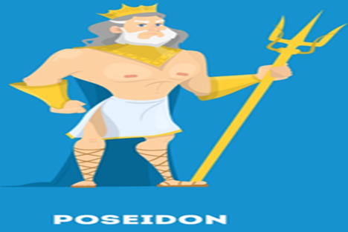
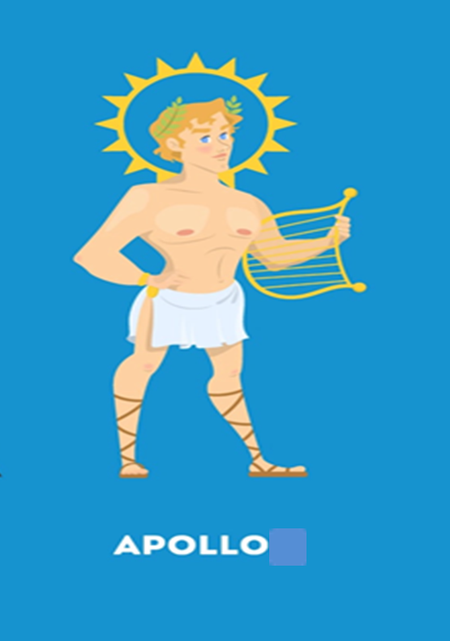
Miss Sattaur Presents: Cultural Capital Wednesday
Week: 21 | Topic: QUIZ 5
Questions 10 – 12: Multiple choice
 |  |  | 10. Poseidon was the God of the … a) seas, water, storms, hurricanes, earthquakes and horses b) dogs, horses, and the wilderness
 |  |  | 11. Apollo was the God of the… harvest, agriculture, and the seasons b) light, the sun, philosophy, archery, truth, inspiration, poetry, music, arts, medicine, healing, and plague.
 |  |  | 12. Hera was… a) Queen of the gods and the goddess of marriage, women, childbirth and family. b) Goddess of wisdom, handicraft, and warfare.
Answer 10 here
Answer 11 here
Answer 12 here

Slide 8
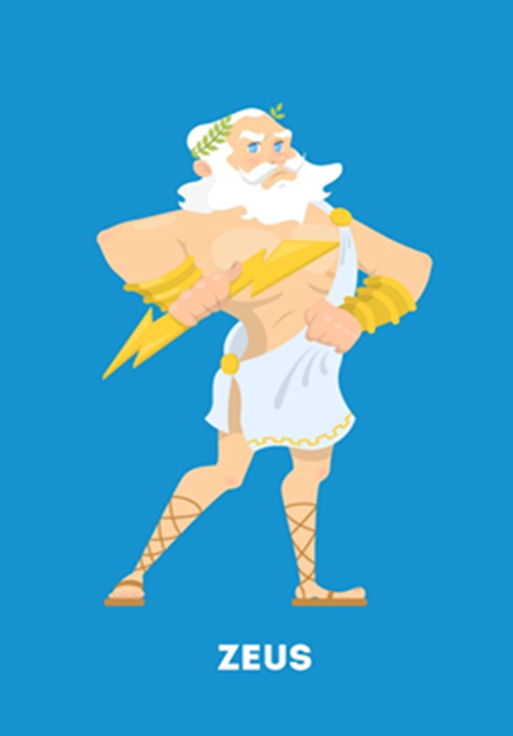
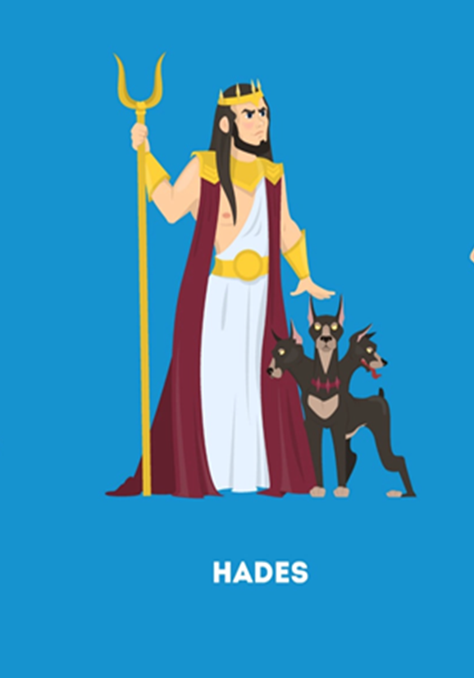
Miss Sattaur Presents: Cultural Capital Wednesday
Week: 21 | Topic: QUIZ 5
Questions 13 – 15: True or False
 |  |  | 13. TRUE or FALSE Zeus was the King of the Gods, ruler of Mount Olympus, as well as the God of the sky, lightning, thunder, law, order and justice.
 |  |  | 14. TRUE or FALSE Hades was the God of dogs, horses, bears, foxes, the wilderness, and survival.
 |  |  | 15. TRUE or FALSE Hephaetus was God of manliness, gold, metals, gems and stones.
Answer 13 here
Answer 14 here
Answer 15 here

