Slide 1
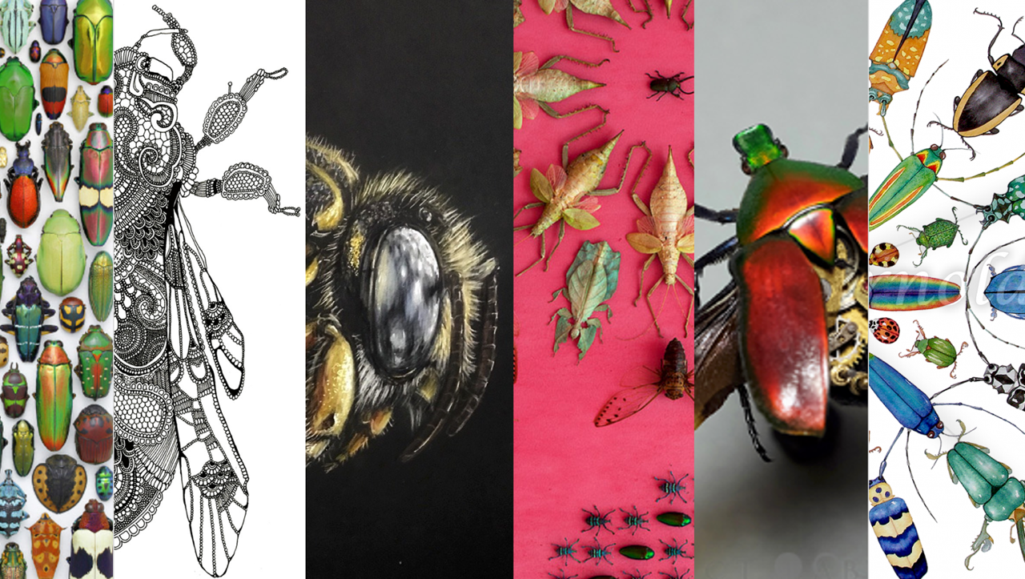
Name:
Class:

Slide 2
Task 1 – Artist Research Page – Lucy Arnold
Use the internet to research the artist Lucy Arnold and use your research to answer the questions below. Create an artist research page including three images of her work and a creative title. You can present this using Powerpoint, Word or neatly hand written (if on computer - work needs to be printed out).
Try to use full sentences in your writing
SPAG
Consider the composition (layout) of your research page
Answer the following questions:
Where is she from?
What materials does she use?
Describe her work using key art words.
Do you like her artwork? Why?
How does her work make you feel?
What types of colour does she use?
How does she use pattern in her work?
How could she inspire your work?
Californian artist Lucy Arnold has many categories on her website but one is bugs and butterflies. You might be attracted to her colourful designs which she creates using watercolours or pastels. A feature on her website which is particularly appealing is the identification charts that she places below her artworks which tell you what the various bugs and butterflies are. She states on her website “Nature is my primary source of inspiration, and colour my main mode of expression. Painting allows me to reveal the beauty I discover in small, intimate details of nature.” I wasn’t surprised to read that Lucy Arnold’s father was a scientist. The ‘About’ page on her website goes into detail about the techniques she uses which you may find interesting and you might want to have a go yourself.

Slide 3
Task 2 – Observational Drawing
Using a pencil create a line drawing to complete the beetle.
Retrieval - Write the success criteria for an observation drawing.
Stretch – carefully add tone to your drawing
Success Criteria

Slide 4
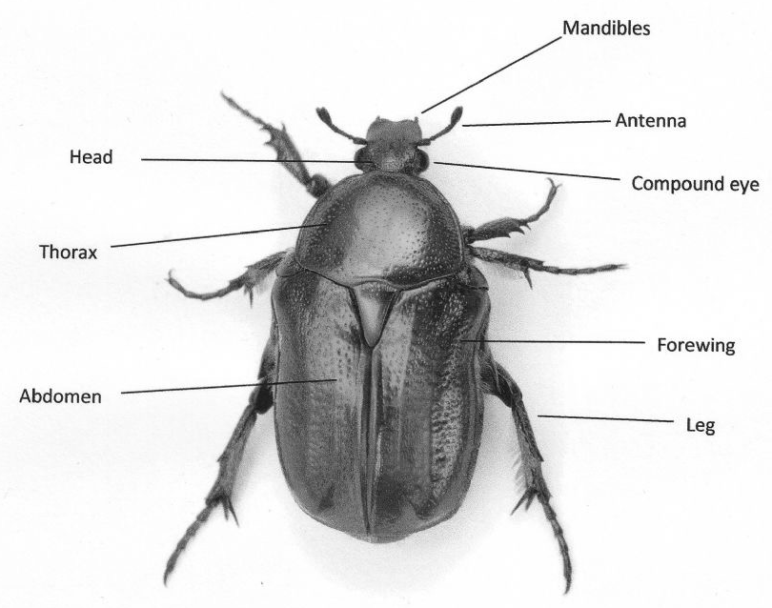
Task 3 – Insects General Knowledge
Use the internet to research about insects.
What characteristics do insects have?
Label the anatomy of these insects
Complete the life cycle of a butterfly
Characteristics

Slide 5
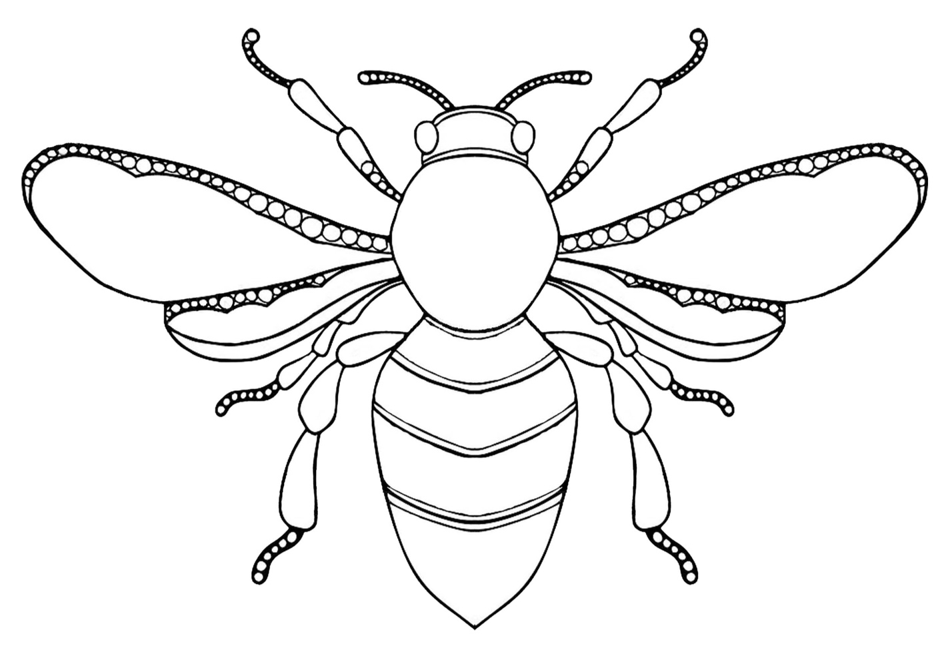
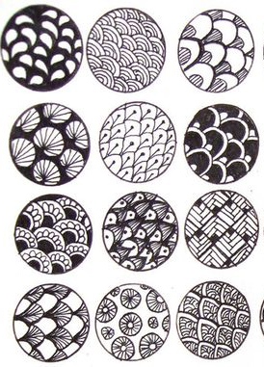
Task 4 – Creative Zentangle pattern
Use a black pen (or pencil) to add zentangle patterns to the bee below.
Use a different pattern in each section.
Use the examples below to help you/look at patterns online
Some patterns should be dark and some light

Slide 6
Task 5 – Drawing
Use this space to create a piece of art of your choice within the theme of insects.
You could find an image online to draw from, or use your imagination.
Light pencil lines and skilful use of colour.
Consider composition.

