Slide 1
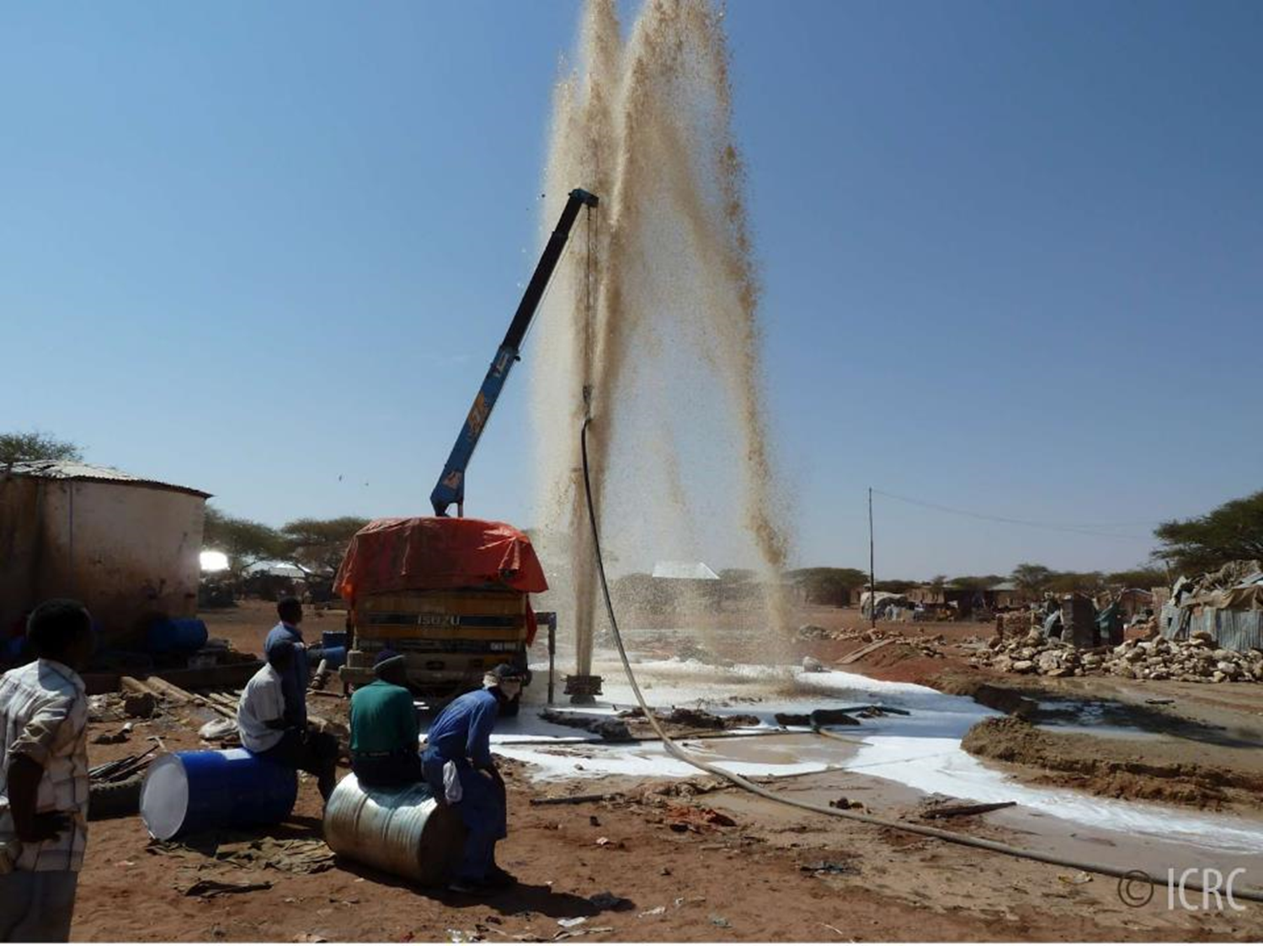
International Aid In Nigeria
Q. How can Oxfam building wells in Nigeria help?

Slide 2
Objective By the end of the lesson, you will understand… | Outcomes By the end of the lesson, you will be able to…
What international aid is, the different types of international aid and the impacts of international aid on the receiving country | Describe what international aid is and the different types of international aid
 | Describe and explain the impacts of international aid on the receiving country
 | Apply knowledge from today’s lesson to questions

Slide 3
International Aid
International Aid
  Aid is when a country or non-governmental organisation (NGO) such as Oxfam donates money or resources to another country to help its economic development or improve people’s quality of life.

Slide 4
Types Of Aid
Short And Long Term
Short-Term Aid
  Emergency help usually in response to a natural disaster, such as a flood or earthquake. Food, water and tents provided.
Long-Term Aid
  Aid that improves people lives over the long-term. Helping people to help themselves. For example, drilling wells so people have clean water to drink and grow crops with or giving people fishing rods and teaching them to fish so they can catch and sell fish.

Slide 5
Types Of Aid
Bilateral And Multilateral
Bilateral Aid
  Aid from one country to another. For example, from the UK government to the Nigerian government.
Multilateral Aid
  Richer governments give money to an international organisation such as the World Bank, which then redistributes the money as aid to poorer countries.

Slide 6
Types Of Aid
Tied And Voluntary
Tied Aid
  Aid may be given with certain conditions. For example, the recipient has to spend the aid money on the donor country’s products.
Voluntary Aid
  Money donated by the general public in richer countries and distributed by NGOs such as Oxfam.

Slide 7
Objective By the end of the lesson, you will understand… | Outcomes By the end of the lesson, you will be able to…
What international aid is, the different types of international aid and the impacts of international aid on the receiving country | Describe what international aid is and the different types of international aid
 | Describe and explain the impacts of international aid on the receiving country
 | Apply knowledge from today’s lesson to questions

Slide 8
International Aid In Nigeria
Impacts Of Aid
You’re going to be given a worksheet in today’s lesson that you need complete.
Collect the names and descriptions of the projects.
Complete the explanations of how you think these projects help.

Slide 9
International Aid In Nigeria
Impacts Of Aid

Slide 10
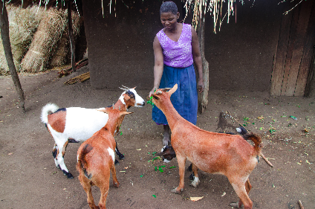
International Aid In Nigeria
Impacts Of Aid
Goat Aid From Oxfam
(Long-Term, Multilaterial, Voluntary)
Description
What are they doing?
  Goat Aid Oxfam is a project set up to help families in African countries like Nigeria.
  The money donated is used to buy a family goat, which produces milk, butter and meat.
Explanation
How does it help?

Slide 11
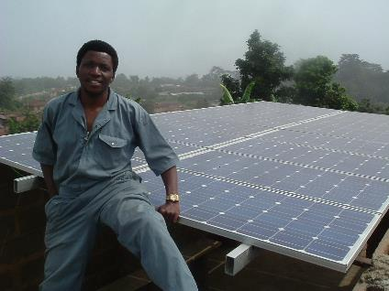
International Aid In Nigeria
Impacts Of Aid
Solar Nigeria Programme
(Long-Term, Multilateral, Voluntary)
Description
What are they doing?
  Start date 2014
  Planned end date 2020
  Budget £66 million
  This project is on track
  The UK Government and the World Bank are paying for large solar power systems to be built in Nigeria near the capital city and in the north of the country.
  The solar power system is designed to provide electricity to 2.8 million homes, schools and hospitals so that 190,000 school students and 4.7 million patients in hospitals can use electricity.
  The project will create 3,000 jobs
Explanation
How does it help?

Slide 12
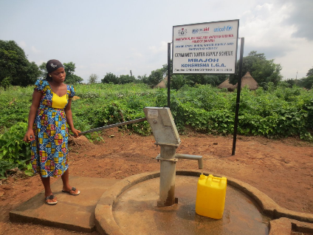
International Aid In Nigeria
Impacts Of Aid
Sanitation, Hygiene & Water In Nigeria (Phase 2)
(Long-Term, Multilateral, Voluntary)
Description
What are they doing?
  Start date 2013
  Planned end date 2018
  Budget £96 million
  This project is on track
  The UK Government and UNICEF are providing people in Nigeria with clean water taps, toilet and shower systems as well as hygiene education and items (soap, toothbrushes) to people in the north of Nigeria.
  Phase 2 and Phase 1 will mean that 7 million Nigerians will benefit.
Explanation
How does it help?

Slide 13
Answers

Slide 14
International Aid In Nigeria
Impacts Of Aid
Goat Aid From Oxfam
(Long-Term, Multilaterial, Voluntary)
Explanation
How does it help?
  Goats are an excellent food source, providing both milk and meat to stop people dying from starvation. Death rate will decrease, life expectancy will increase, infant mortality rate will decrease.
  Milk can be sold as a source of income to pay for education. Children can get a better education, earn more money to buy things they need to have a better quality of life such as a safe, warm and dry house. Death rate will decrease, life expectancy will increase, infant mortality rate will decrease, GDP will increase.

Slide 15
International Aid In Nigeria
Impacts Of Aid
Solar Nigeria Programme
(Long-Term, Multilateral, Voluntary)
Explanation
How does it help?
  People will be able to use electricity in their homes for things like heating and lighting which will improve their quality of life.
  Children will be able to get a better education so that they can get better jobs and earn more money in the future. They will be able to develop their skills of using computers. Literacy rate will increase. GDP will increase.
  More electronic equipment can be powered and used in hospitals which means that more people will be able to recover from illness and injuries. The death rate will decrease, life expectancy will increase, the infant mortality rate will decrease.

Slide 16
International Aid In Nigeria
Impacts Of Aid
Sanitation, Hygiene & Water In Nigeria (Phase 2)
(Long-Term, Multilateral, Voluntary)
Explanation
How does it help?
  More people will have access to clean water which means that they don’t have to drink dirty water which means they will get diseases and be sick or die. Less time will be wasted collecting water or being sick which means people can spend more time at work earning money. Death rate will decrease, life expectancy will increase, GDP will increase, infant mortality rate will decrease.
  If sewage is being disposed of correctly it won’t cause pollution of local rivers and spread diseases. Less people will get diseases, be sick or die. Less people will be sick which means people can spend more time at work earning money. Death rate will decrease, life expectancy will increase, GDP will increase, infant mortality rate will decrease.

Slide 17
Objective By the end of the lesson, you will understand… | Outcomes By the end of the lesson, you will be able to…
What international aid is, the different types of international aid and the impacts of international aid on the receiving country | Describe what international aid is and the different types of international aid
 | Describe and explain the impacts of international aid on the receiving country
 | Apply knowledge from today’s lesson to questions

Slide 18
Exam Question
Q. Using an example of a LIC or NEE country you have studied, describe and explain the impacts of aid on the receiving country (4 Marks)
Mark | Point | PA 1 | PA 2
1 | Describe an aid project used in a LIC or NEE What is being done?
2 | Explain the impact of this aid project in the LIC or NEE How does it help?
3 | Describe a second aid project used in a LIC or NEE What is being done?
4 | Explain the impact of this aid project in the LIC or NEE How does it help?

Slide 19
Objective By the end of the lesson, you will understand… | Outcomes By the end of the lesson, you will be able to…
What international aid is, the different types of international aid and the impacts of international aid on the receiving country | Describe what international aid is and the different types of international aid
 | Describe and explain the impacts of international aid on the receiving country
 | Apply knowledge from today’s lesson to questions

