Slide 1
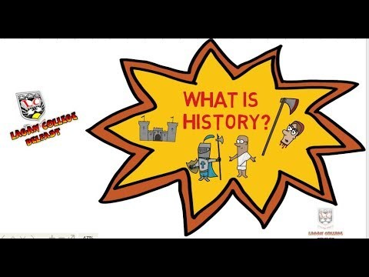
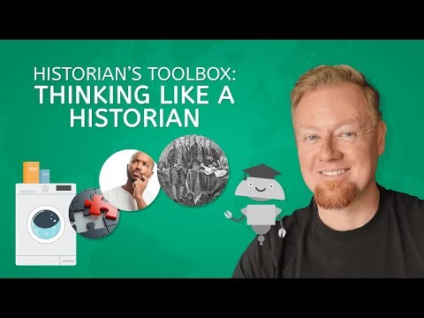
Introduction to History
What is History?
History at its core is reading the story about why the world is the way it is today. That story about the world and the billions of lives that have been lived has been told by different cultures through their documents, books, beliefs, art, and everyday objects in countless different ways. Sometimes people have not told the whole truth when they tell their stories, sometimes people have told their stories accidentally, and sometimes people and even gotten their own stories wrong.
Historians want to read these stories and find out what really happened all those years ago, and why these stories are told in the way that they are. They are passionate about investigating the truth in these stories, and separating fact from fiction.
There are thousands of years worth of history to study, and a skilled historian can spot patterns that might even enable them to predict, with confidence, what will happen in the future.
Click on the images below (or copy the link into your internet browser) to learn more about how and why we study History.
https://www.youtube.com/watch?v=LPggfw7vnLA
https://www.youtube.com/watch?v=dFZyxwyF4M0

Slide 2
Year 7 History
What do we do when we study history at Langdon Park School?
When we investigate the stories from the past we do so through a variety of different means.
We look at local and global history in a bespoke scheme of work in line with the national curriculum with an objective to develop cultural literacy. For example students in Year 7 can expect to study the medieval world of not just England and Europe, but of Mali in Africa, the Ming dynasty in China, and the Incas in South America as well.
We ensure students develop key skills centered around the use of the evidence to substantiate judgements and arguments.
We encourage a positive skepticism. Or, in other words, we encourage students to doubt and think critically about what they hear and see.
Finally, a list of topics covered in Year 7: Ancient Rome, Golden age of Islam, Norman Conquest, Crusades, The Black Death, Mansa Musa, Ming Dynasty China, War of the Roses, The Tudor Dynasty, Mughal India, Indian diaspora in America and the Caribbean.
History at Home
There are many activities that you can do to develop your
knowledge and skills as a historian.
These include:
A world map from a different time period.
A copy of one of countless versions of ‘On this day in History’ books.
Historical documentaries on television or streaming services. Magellan TV is a streaming service that specializes in documentaries.
Reading historical fiction.

Slide 3
Meet the teachers
Ms. Cobson
I am the Head of Faculty for Humanities at Langdon Park School
Ms. Bosworth
I enjoy overseas travel and visit places of historical interest.
I especially like to visit the places I teach about.
I am originally from Cheshire.
I used to teach in a school in Enfield before I taught at Langdon Park School
Fun fact about me: I enjoy visiting art galleries and my favourite is Tate Britain
Mr. Whitney
I teach History, RE, and Citizenship. I have taught History from Year 7 all the way up to Year 13.
I am originally from Basildon and take huge pride in our Hollywood style sign on the roundabout near the Pipps Hill industrial estate.
My favourite period of History is the 1381 Peasants Revolt.
I studied Humanities (mainly History and Philosophy) at Brighton University, and trained to teach at the University of Sussex.
Fun fact about me: As a student at university I played in a ‘shoegaze’ band called Gnugget. The G was silent. It didn’t work out.

