Slide 1
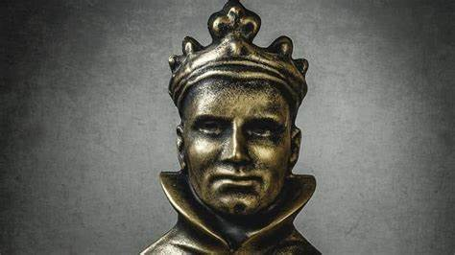
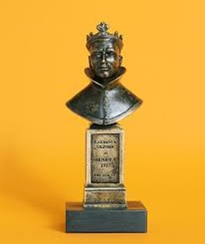
The BAFTAs
Put your design skills to the test and design a sock puppet! Think of your favourite character from a book or film and use this as inspiration. Or maybe a famous actor, playwright or Director? Take a picture and send to Miss Robinson on MILK.
Direct your family in your own performance. It could be an interpretation of a story you know well or you could pen your own. Find some costumes and create a make-shift performance space in your house.
The Oliviers
Awards Show – create an awards show for your family at this time. Think of some creative awards like ‘most lazy’ ‘most entertaining’, ‘most hungry’, ‘best dressed’ and give each family member an award. You could also work on an opening number – choreograph a dance for younger siblings to do then your present ‘The 2020 Lock-down Family Awards’
Create at least 1 award to be handed out at the awards show. Use odd bits and bobs you can find indoors, think empty loo rolls, tin cans, get creative! Or design your awards as drawings and give them out to family members.
The Offies
Drama Games – gather the family round for some classic Drama games! Whether it is SPLAT! Or wink murder, Park bench or 7 UP... there is loads of fun to be had with your favourite drama games!
Create a drama lesson for your family to take part in. Write down your plan. You must include a warm up game, 2 tasks and a performance and feedback session at the end. Think of a drama skill you could teach them – frozen picture, thoughts aloud, cross-cutting, mime, physical theatre? Once the plan looks good, try it out!

