Slide 1
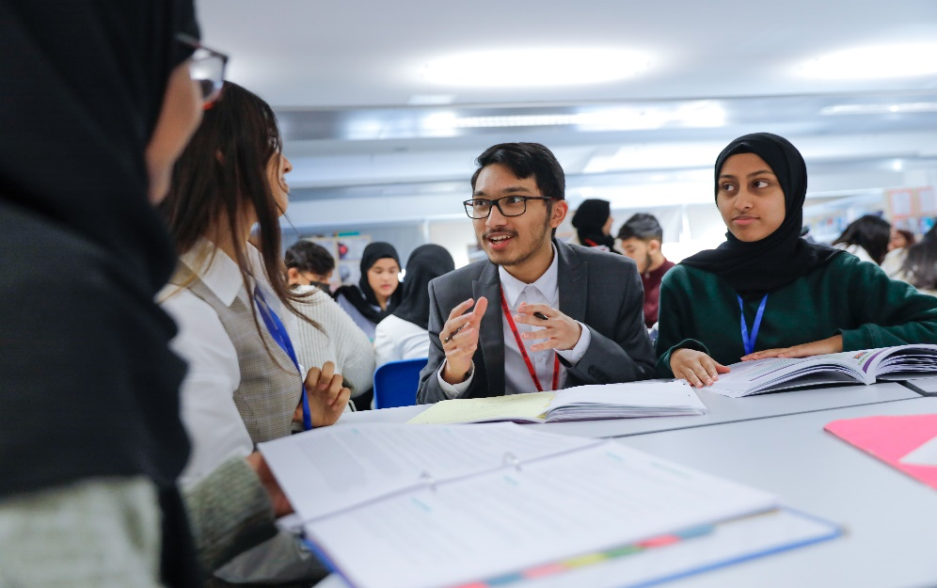
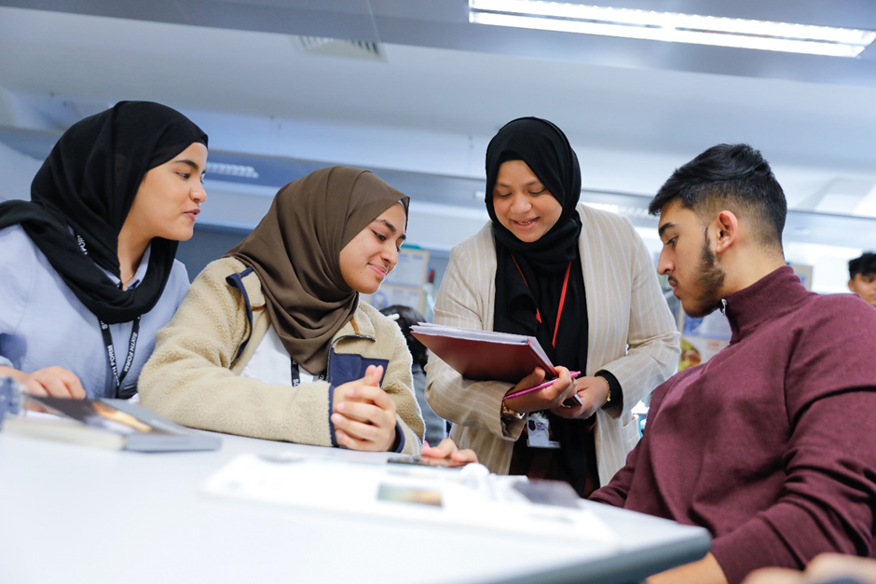
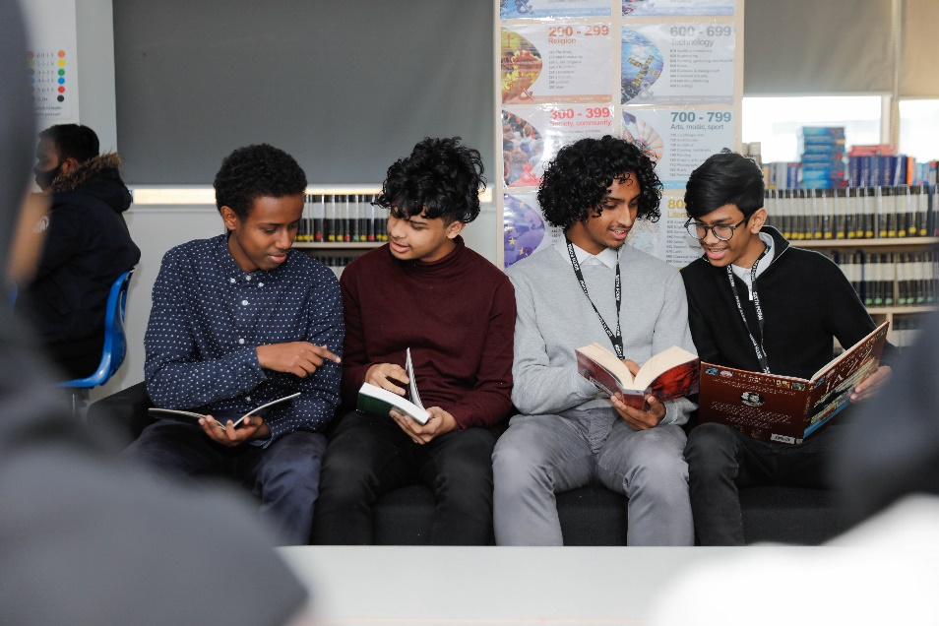
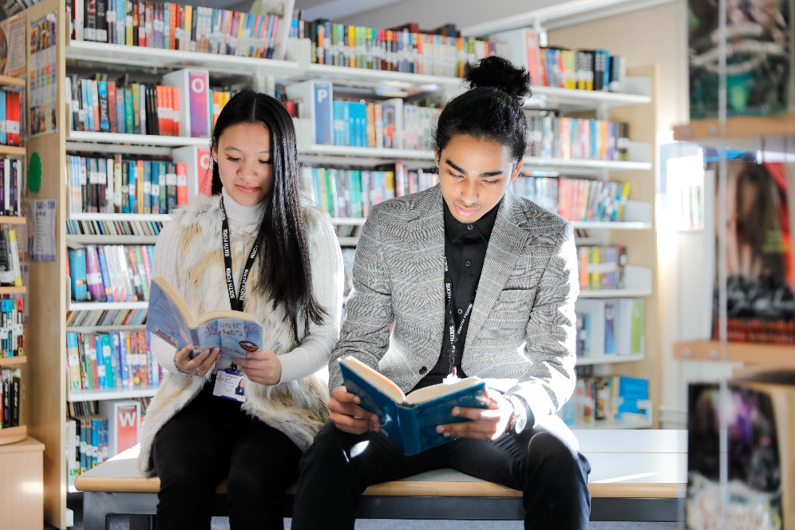
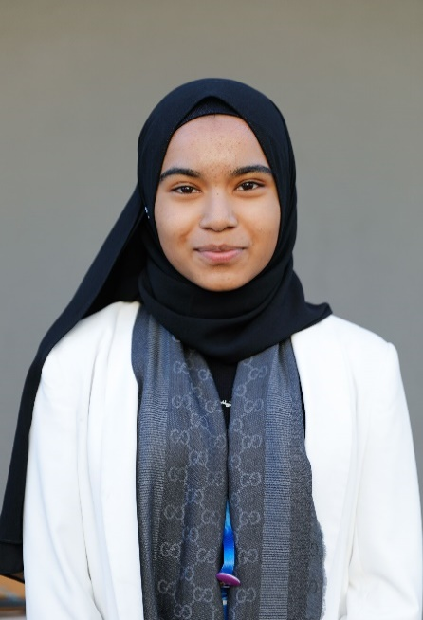
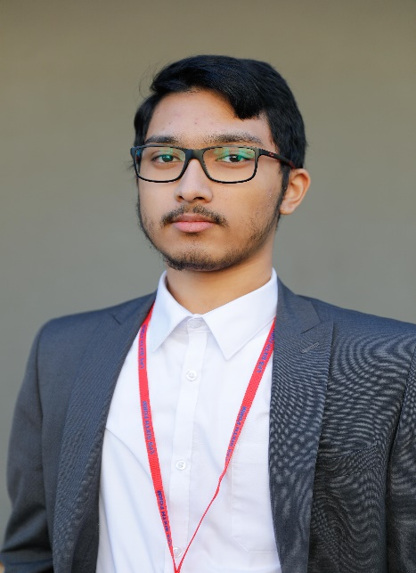
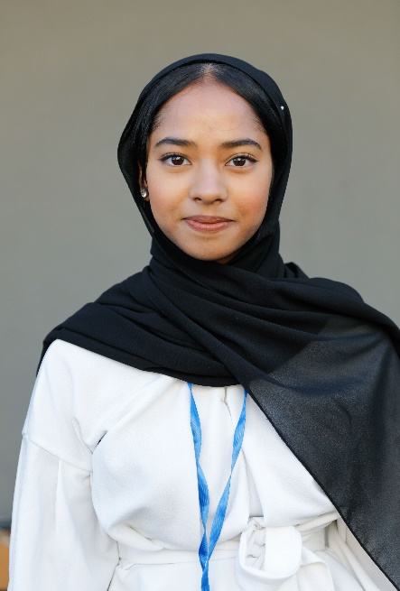
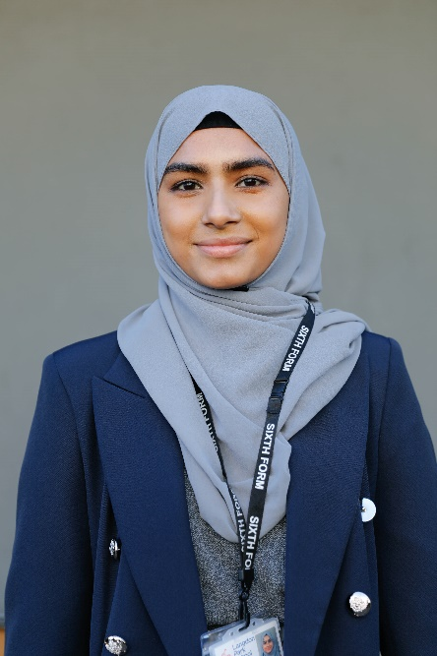
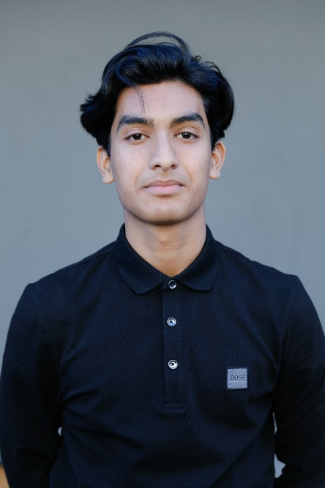
Welcome to Langdon Park Sixth Form
Black or brown polishable shoes
Collared shirt/blouse/abaya
Polo shirts
Smart trousers/dress/skirt
Cardigans
Smart jacket/blazer
ID worn at all times
All-outdoor clothing must be removed before entering classrooms/library/study spaces and the common room
Neck scarfs
Anorak with a hood
Coats
Woolly hats
Trainers/canvas shoes (no plimsolls or all-stars)
T-shirts
Hoodies
No jeans (of any colour)
No trainers of any colour
No baseball caps
No leggings
No denim jackets
No jumpers without a collar underneath
Nothing with rude/offensive images or writing
No tracksuits or jogging bottoms
No gym gear/lycra
Nothing with large logos
No sheer tops/short tops/short skirts.

Slide 2
The Sixth Form Day
08.40-09.00 | Tutor time – there is a planned tutor programme for the whole school, which is part of the curriculum on offer.
09.00-10.40 | Period 1 / Independent Study
10.40-11.00 | Break
11.00-12.40 | Period 2/Independent Study
12.40-13.25 | Lunch
13.25-15.05 | Period 3 (students with no lessons will not be required to stay on site)
 | There are 15 periods per week. Students on 3 A levels will have 9 periods per week. Friday period 1 is Enrichment on Week A. Pupils will be allowed to go home if they have no lesson during period 3. The Study Centre is open until 5pm every day. All students should have 6 timetabled periods over 2 weeks, for each subject they study as well as enrichment and supervised independent study periods.

Slide 3
Uniform Expectations
Black or brown polishable shoes
Collared shirt/blouse/abaya
Polo shirts
Smart trousers/dress/skirt
Cardigans
Smart jacket/blazer
ID worn at all times
All-outdoor clothing must be removed before entering classrooms/library/study spaces and the common room
Neck scarfs
Anorak with a hood
Coats
Woolly hats
Trainers/canvas shoes (no plimsolls or all-stars)
T-shirts
Hoodies
No jeans (of any colour)
No trainers of any colour
No baseball caps
No leggings
No denim jackets
No jumpers without a collar underneath
Nothing with rude/offensive images or writing
No tracksuits or jogging bottoms
No gym gear/lycra
Nothing with large logos
No sheer tops/short tops/short skirts.

Slide 4
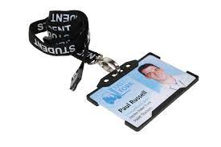
Sixth Form Expectations
95% Attendance and punctuality
Check for updates regularly
Engage with tutor programme

Slide 5
Independent Study Expectations
Like university, Sixth Form students will not be expected to be in a lesson for every period of the day.
However, they are all on a full-time programme of study, which means they are expected to study independently outside of lesson.
Teachers will be setting students homework and independent study tasks.
Students should revise on an on-going basis, not just before exams.
Students should engage with super-curriculum activities.

Slide 6
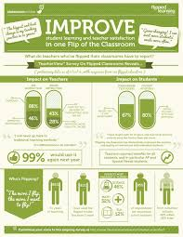
Teaching and learning expectations
Year 12:
Oct-Nov: AG1
Jan-Feb: AG2
June: PPE1
Year 13:
Oct-Nov: PPE2
Feb: PPE3

Slide 7
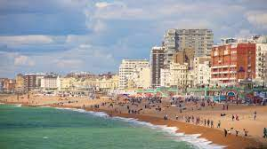
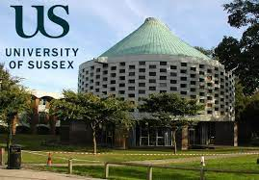
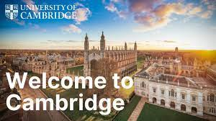
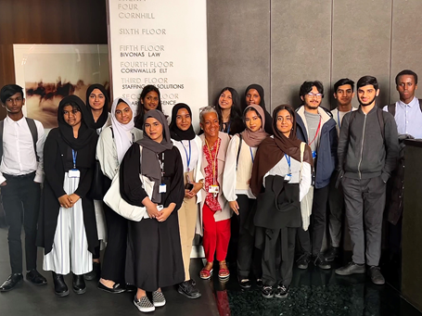
Rewards and trips

Slide 8
applications
Students need to engage in extra-curricular and super-curricular activities throughout Year 12. There are many opportunities posted through Google Classroom.
In Year 12 students will be exposed to university settings as they are taken out on general and subject specific trips.
By June, students should start thinking about the career destinations, and start exploring possible universities.
From June students should start preparing for early applications (15th October deadline for Oxbridge, Medicine, Dentistry) and for admission tests.
Students should attend university open days as part of making the correct choices.
SSeptember (Year 13) – students will start to finalise UCAS personal statements and start submitting applications.
JJanuary is the deadline for applications to be submitted.

Slide 9
Partnerships

Slide 10
Parent Survey
Please complete the survey on the link below.
https://docs.google.com/forms/d/1V0_NAB2o5f2VVq8PtLpFnCKfF-B99fVPbdIg7BD-efg/edit
Your views matter to us!
Thank you.

